Slide 1
Session 5
Campaign strategy
Notes:
Outcome to be achieved: learn the rights in law that cover reps
It is very important that a new rep feels confident in what they can and can’t do and ask for from their employer. This session looks at what are the rights of a rep and where you can prove to the employer that they have to let you do your role.

Slide 2
Describe the problem
What is the problem you want to solve?
What would be an acceptable solution to the majority?
How can you achieve that solution?
Notes:
Outcome to be achieved: learn where these laws come from.
it may be that if you H&S reps you need to mention the brown book
The link is in your book to download the code of practice 3
The rights of a rep are split broadly to into two categories; duties and activities

Slide 3
Is the issue worth taking up?
To put the campaign option to the branch the reps team needs to put some tests to the issue.
The issues must match the test of:
Anger – people really care about it
Hope – there is a realistic prospect of achieving it
Action – members are willing to do something to achieve it
Notes:
Chances are it will be a very wide issue and you will need to narrow it down.
You need to know who can make the decision to make the change.
What does this person or person’s care about that you can affect?
For this affect to happen do you need evidence that is quantifiable not just anecdotal (moaning)?

Slide 4

Getting evidence
Notes:
The result of a sound department survey put into a word cloud. if you could change one thing what would it be?

Slide 5
What is power mapping
Power mapping is a visual tool used by those seeking change to identify the best individuals to target to promote or sanction that change.
For example: used on a political change which MP’s could be pressured to vote for the change and what type of pressure would be needed?
Notes:
Outcome to be achieved: learn what rep duties are
The main thing here is that these are things that are to do with the workplace and are to be done during your paid working time or being paid extra time to do it, depending on your contract.
Handling personal cases should be a paid duty.

Slide 6
What is your goal?
What change is needed?
Who can sanction that change?
What pressure could be exerted?
Who could exert that pressure?
Notes:
Outcome to be achieved: learn what rep activities are and the relationship with their recognition agreement
Members’ attendance at internal union meetings about collective bargaining issues will be classed as "activity" rather than "duty". For reps the same meetings may be classed as a "duty" because they are directly related to negotiating with the employer. Some rep work will, however, be classed as an "activity" – for example, anything related to internal union organisation.
Reps guide 2: 2004-00013-Rep's-guide-Time-off-and-facilities-for-union-reps-Version-14-01-2015.pdf
Outcome to be achieved: learn what rep activities are and the relationship with their recognition agreement
Members’ attendance at internal union meetings about collective bargaining issues will be classed as "activity" rather than "duty". For reps the same meetings may be classed as a "duty" because they are directly related to negotiating with the employer. Some rep work will, however, be classed as an "activity" – for example, anything related to internal union organisation.
Reps guide 2: 2004-00013-Rep's-guide-Time-off-and-facilities-for-union-reps-Version-14-01-2015.pdf

Slide 7
An example would be for an office to introduce flexible working
Company owner
Office Manager
Building management
Workers
Other?
Clients
Who can make the decision to move to flexible working?
Notes:
Outcome to be achieved: learn that rep has follow their recognition procedure to ask for time off from their employer
The recognition and or facilities agreement should set down the procedure for asking for time off and recording the time spent on union duties. Where disagreement may come is over what is considered reasonable.

Slide 8
Powerful
What pressure could be applied?
Company owner
Strongly
disagree
Office Manager
Strongly
agree
Workers
What pressure could be applied?
Clients
What pressure could be applied?
Less Powerful

Slide 9
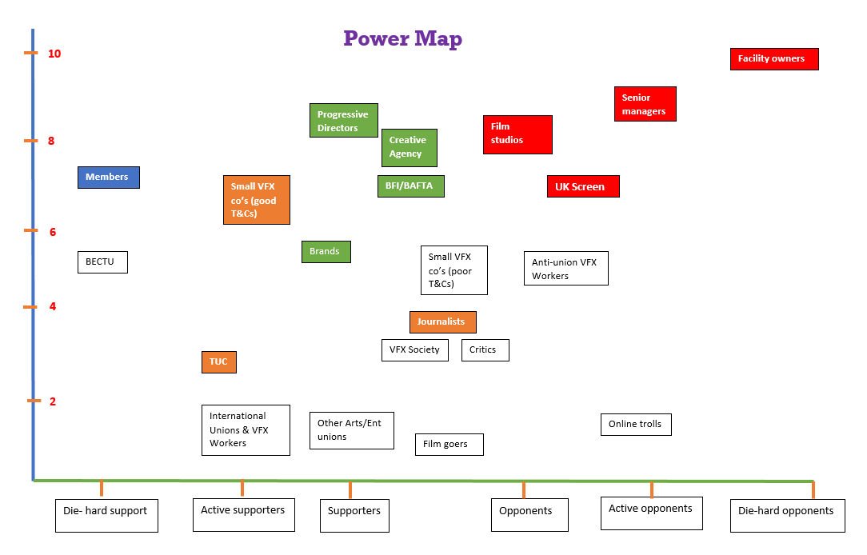

Slide 10
Justifications for change
A business case (makes financial sense, better morale etc)
A self-interest case (why it would benefit management)
A fairness case (why it would benefit the workforce, maybe comparisons with others)
A moral case (why it is the right thing to do)
SMART:
S = SPECIFIC
M = MEASURABLE
A = AGREED
R = REALISTIC
T = TIME-BOUND
Notes:
SMART:
S = SPECIFIC (narrow the desired outcome down to something very definable)
M = MEASURABLE (how can you work that the outcome has been achieved)
A = AGREED (agreed by the members of the branch as well as management)
R = REALISTIC (it has to be within the power of the management you are meeting to sanction this agreement)
T = TIME-BOUND (set an agreed timescale for the management action/decision to happen. The longer a dispute goes on the worse it is for you to keep the members interest and anger going)

Slide 11

How to change someone’s mind
People are generally better persuaded by the reasons which they have themselves discovered than by those which have come into the mind of others.
Blaise Pascal 17th Century philosopher
Notes:
Put simply, Pascal suggests that before disagreeing with someone, first point out the ways in which they’re right. And to effectively persuade someone to change their mind, lead them to discover a counter-point of their own accord.
When we wish to correct with advantage, and to show another that he errs, we must notice from what side he views the matter, for on that side it is usually true, and admit that truth to him, but reveal to him the side on which it is false. He is satisfied with that, for he sees that he was not mistaken, and that he only failed to see all sides. Now, no one is offended at not seeing everything; but one does not like to be mistaken, and that perhaps arises from the fact that man naturally cannot see everything, and that naturally he cannot err in the side he looks at, since the perceptions of our senses are always true.
Pascal added:
People are generally better persuaded by the reasons which they have themselves discovered than by those which have come into the mind of others.

Slide 12
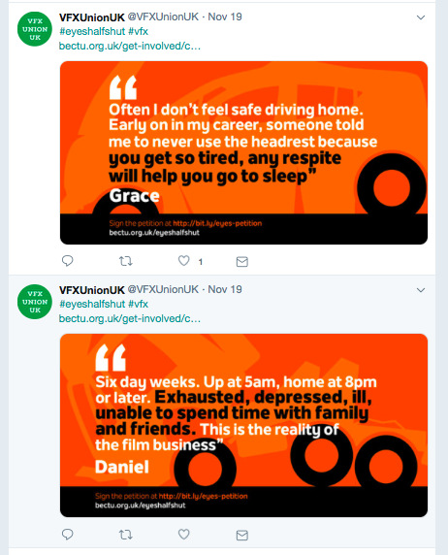
Notes:
Hoe do these posts affect you?

Slide 13
Picking a campaign team
The negotiator
The Passionate person (voice of the angry)
The IT person
The creative person
The strategist
It should be a team playing to its strengths
Notes:
Statements to disciplinary hearings
Address the points made against the member in any documentation of the case – overall charges and specific examples given.
Challenge evidence that is inaccurate or could be interpreted differently.
Provide countervailing evidence e.g. testimony from colleagues, good performance/conduct.
Include arguments in mitigation, if relevant.

Slide 14
•
•
•
STRENGTHS
(+)
WEAKNESSES
(–)
INTERNAL FACTORS
S
W
O
T
•
•
•
EXTERNAL FACTORS
OPPORTUNITIES
(+)
THREATS
(–)
Notes:
There is need to analyse how the campaign is going to drop things that don’t work and increase things that do. The other side may change tactics too. Doing a SWOT analysis is good tool to do this with.

Slide 15
Session 6
Ingredients of union influence
Notes:
Outcome to be achieved: learn how a strong branch works
In this session, we take a look what gives a union influence in the workplace and how reps can increase that influence.

Slide 16
Ingredients
Membership density
Engaged members
Visible Profile
Constructive Dialogue
Representative membership
Representatives
Notes:
Membership density, It is very important that reps realise, without enough members the management will not take the union seriousy and could look to de-recognise the union.
Engaged members, it is very unlikely that any issues will get resolved if the member are not involved or care
Visible Profile, the management will conveniently forget to consult if they never see a union presence. Why would a non-member join something they never see or hear about
Dialogue, the need to have good lines of communication to members and management is necessary to make things happen
Representative membership, If members don’t feel they have a voice, their membership will be their first cost saving when they look at it

Slide 17
The virtuous circle
Growing Membership
Members set and support union’s negotiating priorities
Encourages others to join
Negotiations deliver results
Notes:
Outcome to be achieved: learn how you need all the ingredients to make a strong branch
When the virtuous circle is working effectively members can see the benefit of being part of the union and they take that message with them – whatever company they work for in the future.
Effective local organisation – meaning reps like you – stands at the heart of Prospect’s ability to keep the virtuous circle going. Local union reps…
are the union’s eyes and ears, picking up issues that matter to members and can be resolved by negotiation.
are the union’s voice in the workplace, getting members involved in new campaigns and keeping them informed about on-going negotiations.
give the union a positive profile – visible on notice boards, identified with important issues.
grow the union by talking about joining to colleagues who are not yet in Prospect
keep members in touch with the wider union, eg by organising meetings and events with visiting speakers from beyond the branch.
A really important task for everyone involved in Prospect’s activities is to feed members’ views, queries, concerns and ideas back to Prospect – keeping the union in touch with members.

Slide 18
Session 7
Building a stronger union
Notes:
Outcome to be achieved: learn what can be done in their branch to build organising in to the branch
In this session we look at a snapshot of how you think your branch is right at this moment. Do you as a member think it has the right approach and where you would like it go in the future?

Slide 19

Activity I : Map your branch
Working in a big group with the sample branch information
Complete a map of the branch in the following ways:
Give every member a rating of A to E as to how pro union they are
Draw a map of this branch showing the three sections and give a summary of members
Notes:
Outcome to be achieved: learn how to map the workplace
Sum up what benefits this information will have for a rep
Saves time and energy on recruitment
Look at issues that can be taken up

Slide 20
Approaching non-members
Where are you going to bump into them during your working day?
Do you know them personally?
Do you think they have a clue about trade unions?

Slide 21
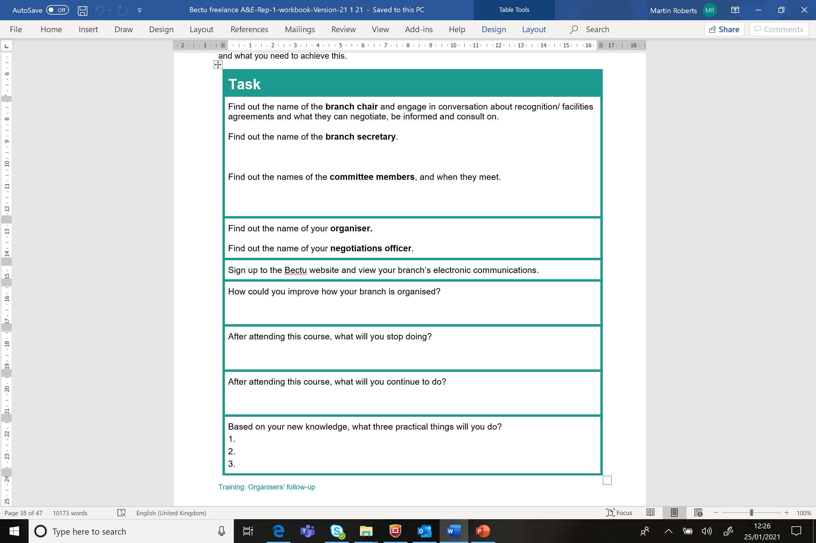
Action Plan

Slide 22
Any questions

