Slide 1
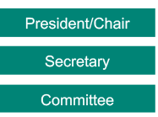
A branch
Branch
Live events
Corporate
Theatre/Venues
Notes:
Outcome to be achieved:
How a branch is set up
This diagram shows a branch that is at one site and has members in three different departments.
According to Prospect’s rules, a branch has to have an elected chair, (click 1)
Another role needed under union rules is a secretary (click 2)
A branch meeting is where an issue can be discussed and a democratic decision can be decided and voted on. What the majority at a branch meeting decides is the course of action a representative takes up with management on the members’ behalf.
Most members do not want to attend regular branch meetings, But decisions still need to be made on the day-to-day business of the branch and to facilitate this the branch elects a committee (click 3)
As part of your action plan you need to find who fills these roles in your branch? (click 4)
It is very important that all the different working areas/grades/departments are represented on the committee.

Slide 2
Why does it matter what branch you are in?
A branch is a bargaining unit.
A bargaining unit is the group of workers for whom a trade union is requesting, or has been granted, recognition.
It is very important that a member is in the right branch/bargaining unit as they might not be able to speak or vote on issues that affect them if not.
A rep should give guidance for a new member to be put in the right branch
Notes:
Outcome to be achieved:
Learn what a bargaining unit is
Prospect branches come in all different shapes and sizes. They evolve to fit the needs of their members. Most are designed to match the organisational structure of the employer. There are a number of regional branches that contain members from various employers which are too small to form a branch or there is no recognition with their employer.
Because of the TU ACT 2016, for a ballot to be legal, it has to have all the members who are affected by the outcome balloted, and this may be called into question by the employer.
This is a basic principle to get reps to start to understand the structure and democratic structure of the union.

Slide 3
What happens when a new member joins Prospect/Bectu?
A new member is put into the appropriate branch.
This is decided from the following information:
their job or role
who they work for
their work location
Notes:
Outcome to be achieved:
Learn how a branch is determined and a new member is put in a branch
Ask delegates to turn to page 15 in the workbook to look at the diagram. Use examples of how this works for their branch.
Where they work to be relevant for their workplace
Who they work for so pay and conditions can be improved.
What they do, so working conditions can be compared with others who do the same role.

Slide 4
A branch
Branch
Lighting
Carpenters
Sound
As part of the rep’s action plan on going back to the workplace you need to find out who fills these roles in your branch?
Who are you representing? (department, workplace, grade)
Notes:
Outcome to be achieved: How a branch is set up
This diagram shows a branch that is at one site and has members in three different departments/locations/teams/offices.
According to rule a branch has to have an elected chair,(click 1)
Another role needed under union rules is a Secretary (click 2)
A branch meeting is where an issue can be discussed and a democratic decision can be decided and voted on. What the majority at a branch meeting decides is the course of action a representative takes up with management on the members behalf.
Most members do not want to attend regular branch meetings, apathy rules in most cases. Decisions still need to be made on the day-to-day business of the branch and to facilitate this the branch elects a committee (click 3)
As part of the rep’s action plan of going to back to the workplace you need to find who fills these roles in your branch?(click 4)
It is very important that all the different working areas/grades/departments are represented on the committee.

Slide 5
How is a branch democratic?
An issue is raised and an action is voted on at a meeting.
Meeting
In between meetings, the committee can discuss an issue that arises and an action decided on.
Committee
The branch usually instructs the committee to take action.
Meeting
Notes:
Outcome to be achieved:
What can happen at a meeting or a committee meeting
A meeting needs to be in quorate for a decision to be made and action taken at the meeting.
A quorum is enough members to be a reasonable representation of the branch total number. It can be set to reflect the branch, so 10% for instance.
Emphasise that the committee acts on the will of the members at the meeting. It is generally the case that the committee has to steer the members into making a decision and keep expectations realistic.

Slide 6
Branch issues
Problem 1
Branch
Live events
Corporate
Theatre/Venues
Problem 1 & 2
Problem 1 & 3
Which issue should the branch try to address first?
Can you set up a working group to tackle each problem?
Notes:
Outcome to be achieved:
Explain how we look which problems to pick and how to go forward with them
Go through the slide as to which problem to tackle first, try adding member numbers to the departments/offices/locations such department C having more members than dept A & B put together. This is a good time to explain the benefit of mapping the workforce.
One of the golden rules for reps is if you are not sure what to do, consult a more experienced rep or a Prospect full-time officer.
To be able to retain members it is very important that issues that affect the majority of the branch are dealt with as a priority, not just the member who shouts.
Getting agreement at a meeting may not be easy. The chair will need to keep order and make sure all the sides of the argument are heard. The committee should have a plan beforehand of who will provide the information needed for the members to make an informed decision.

Slide 7
Arts & Entertainment Division
A&E
UK theatres
Indie art centres
Cinemas
National houses
These can have reps on negotiation committees such as for UK theatres/Bectu agreement
Notes:
Outcome to be achieved: How a branch is set up
This diagram shows a branch that is at one site and has members in three different departments/locations/teams/offices.
According to rule a branch has to have an elected chair,(click 1)
Another role needed under union rules is a Secretary (click 2)
A branch meeting is where an issue can be discussed and a democratic decision can be decided and voted on. What the majority at a branch meeting decides is the course of action a representative takes up with management on the members behalf.
Most members do not want to attend regular branch meetings, apathy rules in most cases. Decisions still need to be made on the day-to-day business of the branch and to facilitate this the branch elects a committee (click 3)
As part of the rep’s action plan of going to back to the workplace you need to find who fills these roles in your branch?(click 4)
It is very important that all the different working areas/grades/departments are represented on the committee.

Slide 8
Bectu sector
Bectu
LPD
BBC
RPD
A&E
IB
President/Chair
Secretary
Committee
Notes:
Outcome to be achieved: How a branch is set up
This diagram shows a branch that is at one site and has members in three different departments/locations/teams/offices.
According to rule a branch has to have an elected chair,(click 1)
Another role needed under union rules is a Secretary (click 2)
A branch meeting is where an issue can be discussed and a democratic decision can be decided and voted on. What the majority at a branch meeting decides is the course of action a representative takes up with management on the members behalf.
Most members do not want to attend regular branch meetings, apathy rules in most cases. Decisions still need to be made on the day-to-day business of the branch and to facilitate this the branch elects a committee (click 3)
As part of the rep’s action plan of going to back to the workplace you need to find who fills these roles in your branch?(click 4)
It is very important that all the different working areas/grades/departments are represented on the committee.

Slide 9
Branch support
Research
Negotiation officer
Education
Networks
MCC
Organiser
Legal
Comms
Branch
As part of your action plan find out who is your branch negotiation officer and organiser.
Notes:
Outcome to be achieved:
Understand what support is available
If you are just teaching one branch you may be able to name the officers, but it is written in their action plan to find out.

Slide 10
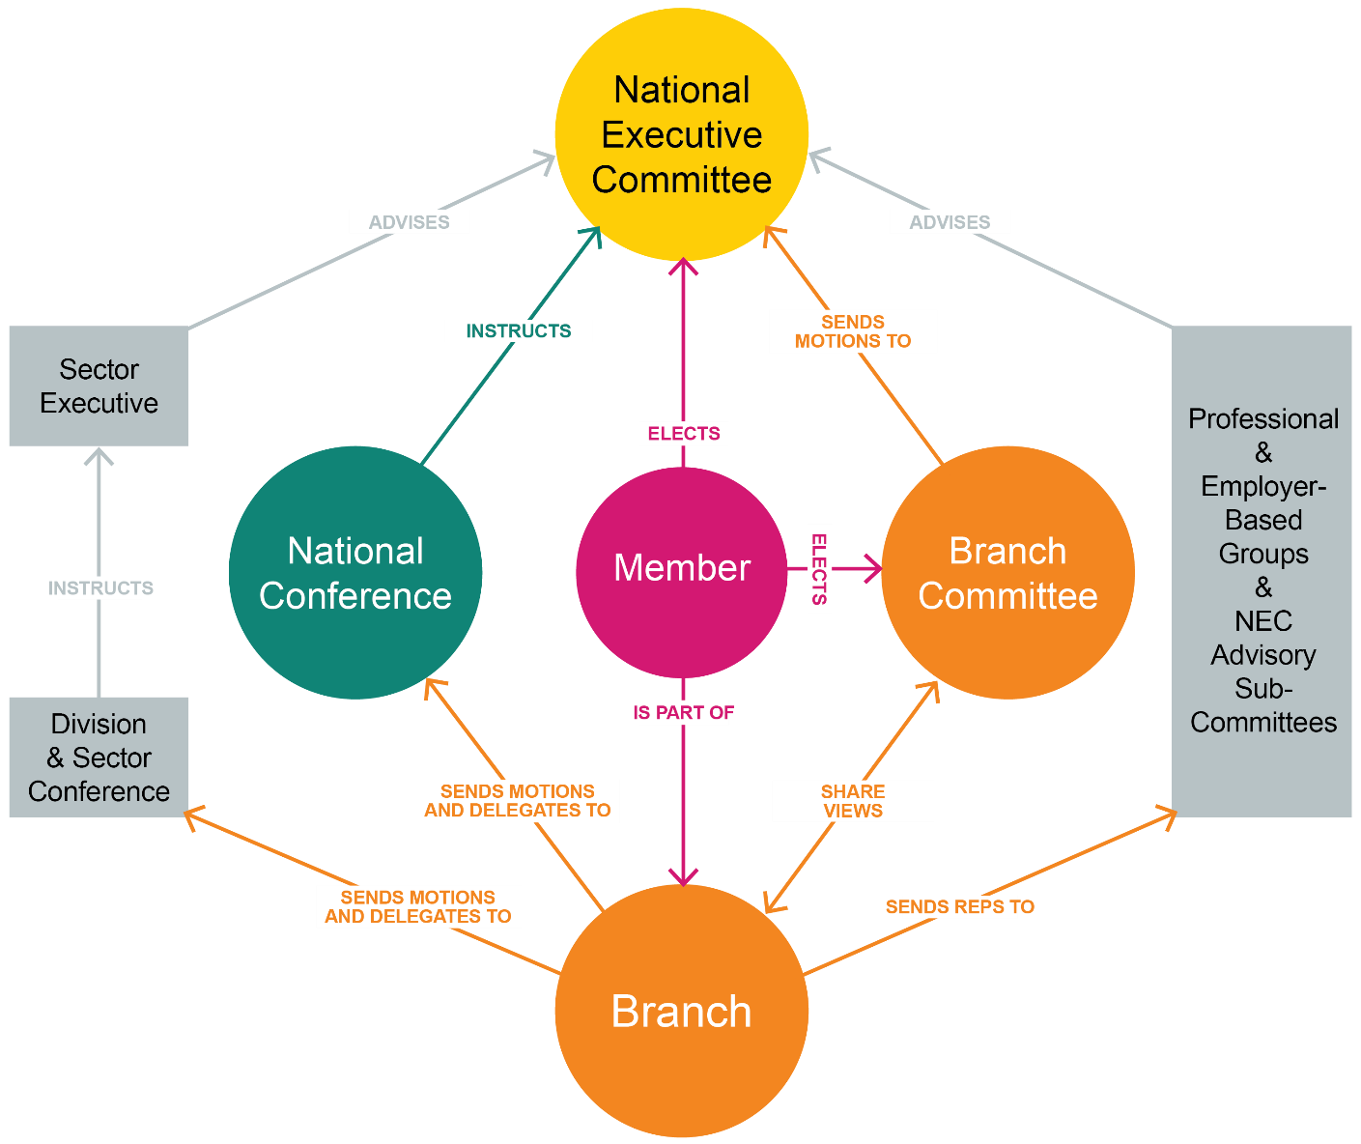
Prospect structure
Notes:
Outcomes to be achieved:
Learn how the member interacts with union as a whole
This diagram is from the rep’s handbook and shows the communication and relationship members have with parts of the union.

Slide 11
How do you get Prospect to do something?
Motion: - a proposal (usually written down) put forward for discussion by at least two people, the mover and the seconder. This is how members can submit items for discussion and decisions at formal meetings. A ‘motion’ that is voted on and carried is called a ‘resolution’.
A motion:
Identifies an issue or problem
Describes an action to be taken
Identifies the people who are being asked to take the action (a conference, SEC, branch committee, etc.)
More detail on page 32 of the workbook
Notes:
Outcome to be achieved: learn what a motion is
There are specific ways of carrying out discussions and decision making at formal meetings. These are designed to safeguard the rights of members and to be ‘legal’ within the rules and transparent so members can see what is happening and why.
Passing a motion is the formal way to agree on an action
It has to be decided by a yes or no decision for a vote to happen.
Once passed it becomes a resolution

Slide 12
The role of a rep
Session 4
Notes:
Outcomes to be achieved:

Slide 13

Activity E: What do union reps do?
Working together in a large group, make a list of all the things a Prospect rep might do as part of their duties.
Complete the list of things a rep does.
Make a list of the skills needed by a rep to do the tasks.
On the first list pick the four most important tasks.
Notes:
Do this activity as big group face to face
Outcome to be achieved:
Do this activity on the Whiteboard as a large group

Slide 14
Different types of reps
President/Chair
Vice-president chair
Secretary
Treasurer
Membership and recruitment secretary
Branch organiser
Health & safety rep
Union learning rep
Equality rep
Pension rep
Environmental rep
Case handler
Communication rep
Notes:
Outcome to be achieved: learn what different roles there are in the branch
There are explanations in the workbook taken from the handbook (20 -23) pick out any that people have an interest in

Slide 15
Code of practice for Prospect/Bectu reps
Responsibilities
Act honestly, responsibly and with integrity.
Communicate respectfully and honestly.
Treat others with fairness, dignity, and respect.
Encourage the open expression of views at meetings but accept collective responsibility for all decisions and policies once finalised.
Not behave in ways that may cause physical or mental harm or distress to another person, such as verbal abuse, physical abuse, assault, bullying, or discrimination or harassment.
Notes:
Tutor Note; In line with the latest agreed NEC guidance as of Dec 2021, new information of the code of practice all reps representing the union should adhere to.

Slide 16
Code of practice for Prospect/Bectu reps
In representing Prospect/Bectu, representatives must:
Only speak or act on behalf of Prospect/Bectu when authorised to do so and clarify the capacity in which you are speaking.
Always be mindful of their responsibility to maintain and develop Prospect’s ethos and reputation.
Declare any interests that may conflict with their role in Prospect/Bectu, for example in a professional or political capacity.
Respect confidentiality and ensure GDPR compliance in dealing with any documents, material, or devices containing confidential information.
Not bring Prospect/Bectu into disrepute, including through the use of email, social and mainstream media and other internet sites.

Slide 17
Recap of the expected values and behaviour of reps
Respectful
Non-judgemental
Integrity
Supportive
Honest
Able to network
Flexible
Positive
Good listener
Clear communicator
A sounding board for ideas
Notes:
Outcome to be achieved: learn what different roles there are in the branch
There are explanations in the workbook taken from the handbook (20 -23) pick out any that people have an interest in and need clarity on.

Slide 18
Picking the right reps
Who do your colleagues listen to?
Do other department/ management listen to them?
Who will bring other skills to the branch?

Slide 19
The branch and its data
(further information in appendix)
Notes:
Outcomes to be achieved:
Its important reps understand about GDPR and how it affects them.

Slide 20
GDPR – things to remember
Mark all correspondence, electronic or otherwise as private and confidential; Be aware the act applies to paper file, records of telephone conversations, audiotapes, photographs and social networking media.
Respect confidentiality and the rights of a member.
Be open with people about information held about them.
Ensure all personal data is disposed of as confidential waste.
Think of personal data held about individuals as though it was held about you.
Back to work action – find out about your workplace policy and how it is important to know the difference between processors and controllers – who controls information on work computers (we do).
*New template agreement added to the course resource area for reps to formalise their own agreement with the employer around Data needs.

Slide 21
GDPR – Don’t
Disclose any personal data over the phone
Put personal data about a member on the internet without their permissions
Take personal data home unless it can be securely stored
Use personal data held for someone for a different purpose without permission from that member.
Send personal data outside the EEA (European Economic Area) without taking advice from Prospect
Further advice can be sought from Tracey Hunt if you‘re unsure about your practices. (details in the workbook)

Slide 22
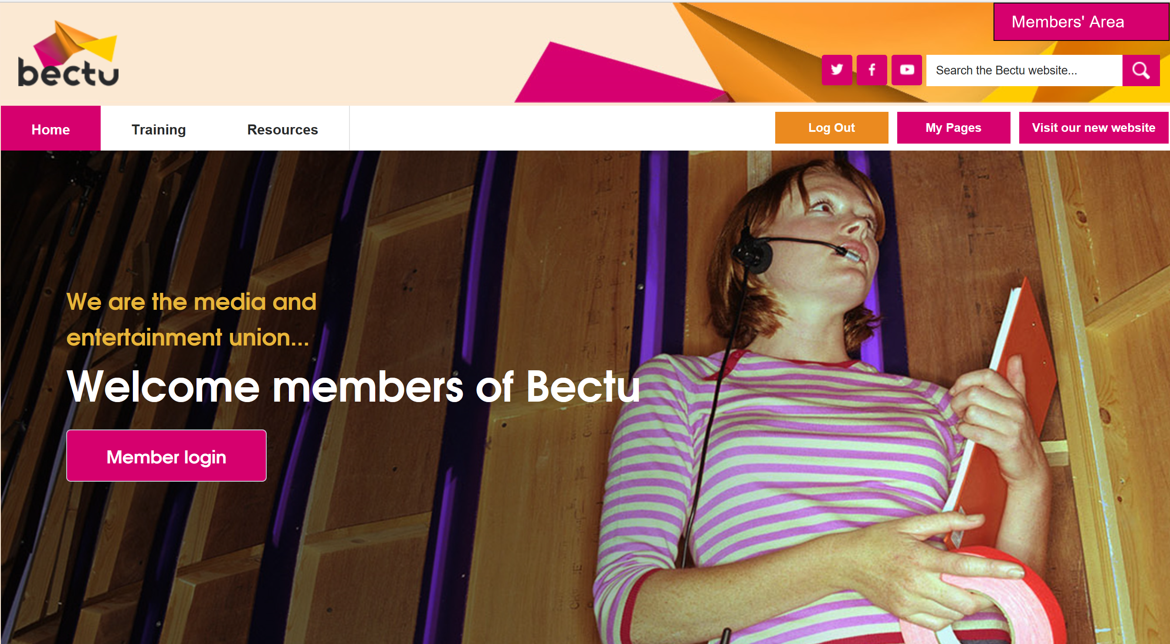
E Branch
On your action plan look sign up to the BECTU website and look at your branches pages and find out how the branch communicates with its members safely
Notes:
Outcome to be achieved: learn The best way to comply is to communicate with members is through the website
Check that the reps are aware of the ebranch and the members area

Slide 23
Activity F:
What would you do if?
In groups look at the situations and decide what can be done.
Notes:
Do this activity as big group face to face
Outcome to be achieved:
Much of your role initially will be signposting or finding out information. However, there are instances where you can assist whilst you build up your knowledge and understanding. Here are some scenarios (page 29/30 in workbook) as a group discuss what you might do as a rep……….
Remind reps they are not trained to deal with personal cases but can advise and signpost queries.

Slide 24
Activity G: Why people don’t join a union?
In groups look to persuade a non-member to join who has a particular reason for not joining.
Notes:
Outcome to be achieved: improve recruitment (10 minutes)
Assign a common reason to a group to come up with an answer in list in the workbook page 32

Slide 25
Action plan so far…
Homework
Start to fill in your action plan for when you return to the workplace to improve your organisation (continued infurther online sessions.
As part of the rep’s action plan on going back to the workplace you need to find out who fills the branch roles, who is organiser & F.T.O?
Log in to the Bectu website.

Slide 26
Questions?

