Slide 1

Key skills for union reps: union reps part 1
Version 3 August 2023.
Notes:
Outcomes to be achieved: Awareness of rules and health and safety
Introduce yourself (pronoun to be mentioned on intro; how people want to be referred to) ask to look at the back of the name cards.
Go through fire safety arrangements, toilet location and breaks 11:45, 13:00, 15:30 and finish around 16:30
Go through that this is a course where we let people speak, page 5
Go through learning outcomes, page 8
Know what a trade union is and how to increase membership
Know your rights as a rep
Know the role of a rep
Know Prospect’s structure
Know how the union can influence the workplace

Slide 2

Session 1: Activity A
Introductions
In pairs go through the questions and introduce each other
Notes:
Outcomes to be achieved: Find out peoples’ names, experience and any specific learning requirements and practice listening skills (one hour for big group)
Refer to workbook introductions page, split the group into pairs and an odd group of three if an uneven group number
Give them five mins each way to find out the answers to the questions
Ask them in turn to introduce their partner
Write down the answers to what the reps want to get out of the course. This can be referred to during the course; topics covered in another course can be parked.
Note if any have specific roles, such as H&S, that may need to be referred to later in the course.
Finish the session by summing up that the traditional media image of a trade union rep is blown away by the reality that we are a very skilled and diverse group. Back this up by all the interesting facts the reps have just given about themselves.
Emphasise that you all have one thing in common, you want to help people you work with and that is a very good thing.

Slide 3
What is a trade union?
Session 2
Notes:
Outcomes to be achieved:
This session is designed to find out what the reps think a trade union is and how it can help them.
In particular when a rep is asked “Why should I join?”
One of the things all reps find hard is recruiting. What should they say to persuade someone to join.
Ask the question, then go the next slide

Slide 4
The definition of a trade union
An organised association of workers in a trade, group of trades, or profession, formed to protect and further their rights and interests.
Notes:
Outcome to be achieved:
This is the definition you would find in a dictionary. Most young workers have no idea what a union is and any view they do have is one that is out of date.
We need to be explain this is not so and why union’s arestill relevant.
Ask why they are interested in being reps? The sort of answers we are looking for are: a safe place to work, environmental issues and robust procedures that help members.

Slide 5
Recognition in the workplace
Employers are not obliged to bargain with unions.
They can voluntarily recognise a union or a union can gain statutory recognition by meeting certain criteria and applying to the Central Arbitration Committee.
With a recognition agreement in place, the employer ‘recognises’ the union for purposes of collective bargaining and a written agreement sets out the scope and the process of how it is done. Statutory recognition is limited to pay, hours and holidays.
Notes:
Outcome to be achieved: Learn what recognition is:
If this is for one branch, and you know what sort of recognition agreement it has, go through it. This is something they need to know and leads to the next exercise.
Even if employer resists, union can achieve recognition if has
over 50% membership; or
over 10% membership and
gets a majority in a ballot of all employees.

Slide 6
An unrecognised workplace Vs a recognised workplace
In an unrecognised workplace | In a recognised workplace
A union member can get: representation at disciplinary and grievance hearings with the employer. legal advice financial help and advice | On top of the individual rights, collective agreements usually cover pay arrangements and other terms and conditions of employment. These include the right to: disclosure of information by the employer for collective bargaining purposes reasonable paid time off for union reps to carry out union duties reasonable paid time off for union learning reps to carry out their duties reasonable unpaid time off for members to carry out union activities appoint a union safety rep appoint safety committee representatives consultation prior to redundancy; and consultation prior to business transfers.
Notes:
Outcome to be achieved: Learn what recognition is:
If this is for one branch, and you know what sort of recognition agreement it has, go through it. This is something they need to know and leads to the next exercise.
Even if employer resists, union can achieve recognition if has
over 50% membership; or
over 10% membership and
gets a majority in a ballot of all employees.

Slide 7
Your right to join a trade union
You have the right to:
choose to join, or not join, a union
decide to leave or remain a member of a union
belong to the union you choose, even if it’s not the one your employer negotiates with on pay, terms and conditions
belong to more than one union.
Your employer isn’t allowed to:
offer you a benefit to leave a trade union
threaten to treat you unfairly if you don’t
leave a union or stop doing union activities.
Notes:
Outcomes to be achieved:
Facts that can be used promote the benefits of joining Prospect:
If someone is saying their career might be affected if they join, or it is not for my level of management, the law gives anyone the right to join a union

Slide 8
The benefits of trade unions
You are better off in a workplace that recognises a union because:
you average 4.2% more in salary (Statista 2023)
health and safety is better
more training.
Trade unions all together in the UK:
6.4 million members: (Resolution Foundation 2023)
Got £320 million in compensation (TUC 2015)
Trained 29,694 representatives (TUC 2019)
(TUC – these are still the latest stats)
Prospect:
158,000 members in July 2024.
Got £3.1m in injury compensation December 2023 and £960,000 at tribunal in 2023
Provided over 991 members with training in 2023.
Notes:
Outcome to be achieved:
Facts that can be used promote the benefits of joining Prospect
This slide has two clicks the first is for trade union figures as a whole and the second is for Prospect only.
Prospect negotiates with more than 400 different employers.
Page 10 has a list of historical union victories.
These are the facts that back up why it is value for money to join.
Always mention that local issues make the most difference to people.

Slide 9

Activity B: Other options
Discuss the benefits of being in a trade union as opposed to some of the following options:
Facebook group or other social media groups
Workers/employee’s forum
Single employee action
Professional body
Notes:
Do this activity as big group face to face
Outcome to be achieved:
There is no real alternative to a trade union (five minutes)
Workbook page 13 act as moderator for the discussion and raise questions such as:
What would happen if the employer finds out about what is being said on Facebook?
What would happen if the employer said no to a request from a forum or an individual?
How can we argue against the person who says they get a pay rise even if they don’t join )a freeloader)?
Sum up the benefits of union membership, in particular for an individual member with an issue.
Generally the easiest recruitment pitch is to say why you joined. As you work in the same place, it will have resonance with the non-member and the passion will show through, rather than sounding like a script.

Slide 10
Activity C: What can a union negotiate on?
In your groups make a list of what you would like a trade union to negotiate on, over and above the statutory recognition minimum.
Notes:
Outcomes to be achieved: improve understanding of what can be negotiated (15 minutes)
Split class into small groups of 3 or 4 (10 mins max)
Sum up with explaining that negotiate is finding a compromise that both sides are happy with. Campaigning is persuading others that something needs to be done.
We are looking for the groups to come up with
Explain only trade issues not political issues such the global climate strike 2019
Can negotiate on:
Pay and conditions
Health & safety
Equality
Redundancy
Time off
If you know examples from anyone branch, add them in.

Slide 11
Activity D: Your workplace
Read the statements in the workbook and tick which describes your branch at the moment. Using the questionnaire, think about how you rate your workplace.
Start/think of your action plan to improve your organisation when you return to the workplace.
Notes:
Outcomes to be achieved: snapshot of their branch, what are members expecting (15 minutes)
Session 2 Activity D - Servicing or Organising (introduce the main difference between without giving any opinion) 10 mins
For brief overview –Servicing focusses on the service element of of a union and tends not to rely on members involvement and election of reps is usually done by union leadership and organising which involves members at all levels and reps are elected by co-workers.
Ask delegates to put a tick next to the statement they feel best describes their workplace or ideas of the union from colleagues/themselves.
Ask delegates which column had the most ticks and what they feel based on their results may be the best approach. (we would hope they say organising)
The main points are that some parts of the union will always be servicing heavy (i.e. home workers) but the organising approach allows for more activity, greater empowerment and a greater longevity of the union
This will lead into later activity about how organised their workplace is.

Slide 12
Tea break – 15 mins

Slide 13
Session 3
How Prospect works
Notes:
Outcome to be achieved:
Knowledge of the union structure
As a union is democratic; it has to have a structure that makes that possible. A member gets to have a say on their workplace, their pay no matter how big the employer or an issue in the industry sector or a National issue and the first part of that structure is the branch
The video is in the next slide

Slide 14


Slide 15
A branch
President/Chair
Branch
Secretary
Committee
Notes:
Try to get reps to answer after watching video
Outcome to be achieved:
How a branch is set up
This diagram shows a branch that is at one site and has members in three different departments.
According to Prospect’s rules, a branch has to have an elected chair, (click 1)
Another role needed under union rules is a secretary (click 2)
A branch meeting is where an issue can be discussed and a democratic decision can be decided and voted on. What the majority at a branch meeting decides is the course of action a representative takes up with management on the members’ behalf.
Most members do not want to attend regular branch meetings, But decisions still need to be made on the day-to-day business of the branch and to facilitate this the branch elects a committee (click 3)
As part of your action plan you need to find who fills these roles in your branch? (click 4)
It is very important that all the different working areas/grades/departments are represented on the committee.

Slide 16
Why does it matter what branch you are in?
A branch is a bargaining unit.
A bargaining unit is the group of workers for whom a trade union is requesting, or has been granted, recognition.
It is very important that a member is in the right branch/bargaining unit as they might not be able to speak or vote on issues that affect them if not.
A rep should give guidance for a new member to be put in the right branch
Notes:
Outcome to be achieved:
Learn what a bargaining unit is
Prospect branches come in all different shapes and sizes. They evolve to fit the needs of their members. Most are designed to match the organisational structure of the employer. There are a number of regional branches that contain members from various employers which are too small to form a branch or there is no recognition with their employer.
Because of the TU ACT 2016, for a ballot to be legal, it has to have all the members who are affected by the outcome balloted, and this may be called into question by the employer.
This is a basic principle to get reps to start to understand the structure and democratic structure of the union.

Slide 17
What happens when a new member joins Prospect?
A new member is put into the appropriate branch.
This is decided from the following information:
their job or role
who they work for
their work location
Notes:
Outcome to be achieved:
Learn how a branch is determined and a new member is put in a branch
Ask delegates to turn to page 12 in the workbook to look at the diagram. Use examples of how this works for their branch.
Where they work to be relevant for their workplace
Who they work for so pay and conditions can be improved.
What they do, so working conditions can be compared with others who do the same role.

Slide 18
A branch
President/Chair
Branch
Secretary
Committee
As part of the rep’s action plan on going back to the workplace you need to find out who fills these roles in your branch?
Who are you representing? (department, workplace, grade)
Notes:
Try to get reps to answer after watching video
Outcome to be achieved:
How a branch is set up
This diagram shows a branch that is at one site and has members in three different departments.
According to Prospect’s rules, a branch has to have an elected chair, (click 1)
Another role needed under union rules is a secretary (click 2)
A branch meeting is where an issue can be discussed and a democratic decision can be decided and voted on. What the majority at a branch meeting decides is the course of action a representative takes up with management on the members’ behalf.
Most members do not want to attend regular branch meetings, But decisions still need to be made on the day-to-day business of the branch and to facilitate this the branch elects a committee (click 3)
As part of your action plan you need to find who fills these roles in your branch? (click 4)
It is very important that all the different working areas/grades/departments are represented on the committee.

Slide 19
How is a branch democratic?
An issue is raised and an action is voted on at a meeting.
Meeting
In between meetings, the committee can discuss an issue that arises and
an action decided on.
Committee
The branch usually instructs the committee to take action.
Meeting
Notes:
Outcome to be achieved:
What can happen at a meeting or a committee meeting
A meeting needs to be in quorate for a decision to be made and action taken at the meeting.
A quorum is enough members to be a reasonable representation of the branch total number. It can be set to reflect the branch, so 10% for instance.
Emphasise that the committee acts on the will of the members at the meeting. It is generally the case that the committee has to steer the members into making a decision and keep expectations realistic.

Slide 20
Branch issues
Problem 1
Branch
Problem 1 & 2
Problem 1 & 3
Which issue should the branch try to address first?
Can you set up a working group to tackle each problem?
Notes:
Outcome to be achieved:
Explain how we look which problems to pick and how to go forward with them
Go through the slide as to which problem to tackle first, try adding member numbers to the departments/offices/locations such department C having more members than dept A & B put together. This is a good time to explain the benefit of mapping the workforce.
One of the golden rules for reps is if you are not sure what to do, consult a more experienced rep or a Prospect full-time officer.
To be able to retain members it is very important that issues that affect the majority of the branch are dealt with as a priority, not just the member who shouts.
Getting agreement at a meeting may not be easy. The chair will need to keep order and make sure all the sides of the argument are heard. The committee should have a plan beforehand of who will provide the information needed for the members to make an informed decision.

Slide 21
Branch support
Research
Negotiation officer
Education
Networks
MCC
Organiser
Not all branches will have an organiser
Legal
Comms
Branch
As part of your action plan find out who is your branch negotiation officer and organiser.
Notes:
Outcome to be achieved:
Understand what support is available
If you are just teaching one branch you may be able to name the officers, but it is written in their action plan to find out.

Slide 22
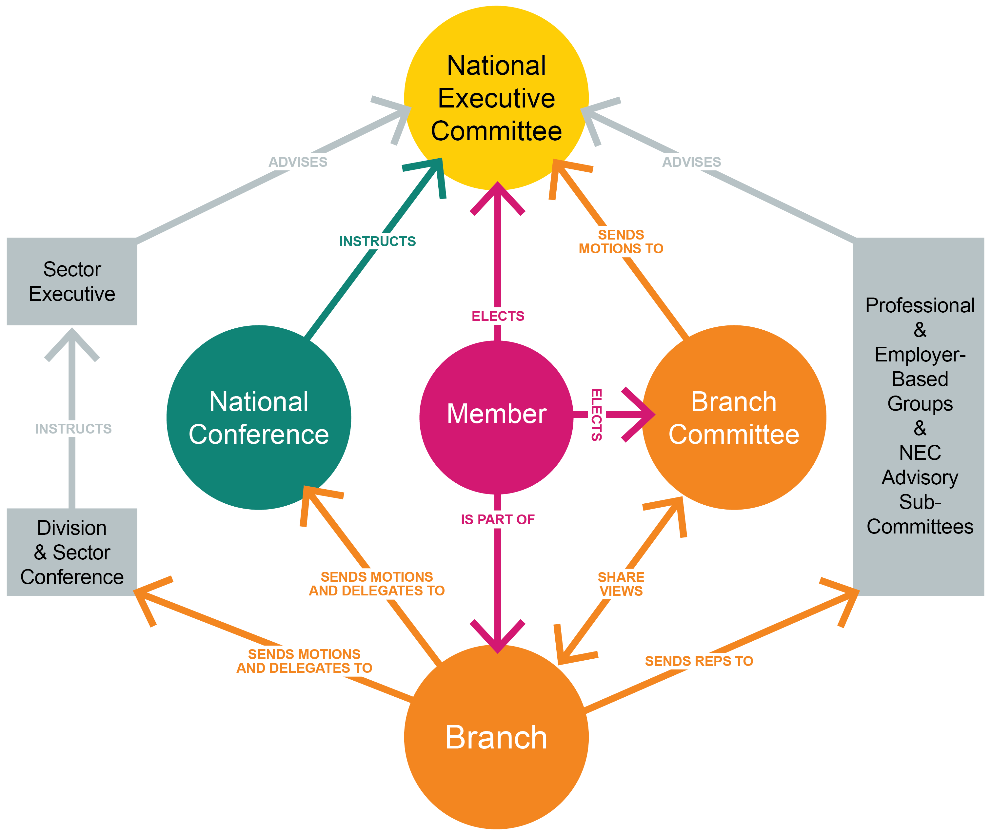
Prospect structure
Notes:
Outcomes to be achieved:
Learn how the member interacts with union as a whole
This diagram is from the rep’s handbook and shows the communication and relationship members have with parts of the union.

Slide 23
The role of a rep
Session 4
Notes:
Outcomes to be achieved:
Highlight the actual role, skills and expectations….

Slide 24
Activity E: What do union reps do?
Working together in a large group, make a list of all the things a Prospect rep might do as part of their duties.
Complete the list of things a rep does.
Make a list of the skills needed by a rep to do the tasks.
On the first list pick the four most important tasks.
Notes:
Do this activity as big group face to face
Outcome to be achieved:
What is required of reps – what skills, expectation. Do reps have experience of a really good rep or a really bad rep and learn by example in order to add items to this list…..
I tend to ask each reps to pick the 4 that mean the most for them as each branch is different and one reps primary goal/focus may be different to another reps.

Slide 25
Different types of reps
President/Chair
Vice-president chair
Secretary
Treasurer
Membership and recruitment secretary
Branch organiser
Health & safety rep
Union learning rep
Equality rep
Pension rep
Environmental rep
Case handler
Communication rep
Notes:
Outcome to be achieved: learn what different roles there are in the branch
There are explanations in the workbook taken from the handbook pick out any that people have an interest in

Slide 26
The values and behaviour of reps
Respectful
Non-judgemental
Integrity
Supportive
Honest
Able to network
Flexible
Positive
Good listener
Clear communicator
A sounding board for ideas
Notes:
Go through slide

Slide 27
The branch and its data
(further information in appendix)
Notes:
Outcomes to be achieved:
To understand how GDPR impacts new reps when recruiting members and how to be mindful of data collected and stored.,…..
Its worth noting that many new reps may ask for a list of their members to date – dependent on their branch secretary this may be permitted but some areas may need new reps to do a bit more leg work……… maybe hold an all member meeting, get to know who is a member on your floor, in your department and check back with the B/S or Prospect.

Slide 28
GDPR – things to remember
Mark all correspondence, electronic or otherwise as private and confidential; Be aware the act applies to paper file, records of telephone conversations, audiotapes, photographs and social networking media.
Respect confidentiality and the rights of a member.
Be open with people about information held about them.
Ensure all personal data is disposed of as confidential waste.
Think of personal data held about individuals as though it was held about you.
Back to work action – find out about your workplace policy and how it is important to know the difference between processors and controllers – who controls information on work computers (we do).
Notes:
REPS TO THINK ABOUT WHAT THEY MAY NEED IN ORDER TO THE DO THE ROLE EFFECTIVELY – WHAT ACCESS DO YOU HAVE, IS IT A SHARED COMPUTER, CAN YOU HAVE PRIVACY SETTINGS

Slide 29
GDPR – Don’t
Disclose any personal data over the phone
Put personal data about a member on the internet without their permissions
Take personal data home unless it can be securely stored
Use personal data held for someone for a different purpose without permission from that member.
Send personal data outside the EEA (European Economic Area) without taking advice from Prospect
Further advice can be sought from Tracey Hunt if you‘re unsure about your practices. (details in the workbook)

Slide 30
Prospect eSite
Prospect gives branches a way of communicating with their members which reduces the chance of a data breach when sending emails. This is done via our free eSite system
Branch officers (Secretary/assistant, chair/vice chair, membership and recruitment secretary/organiser automatically get admin rights to look after their eSite, as does our new communications rep role)
All branches have a ‘starter’ eBranch which gives their branch officers access to online membership lists. The same applies at section level.
Notes:
Most GDPR compliant way of contact reps via bulk mail, with updated minutes, newsletters etc….
Go over the functionality of the ebranch. (Communications role access rights for this area of work)

Slide 31
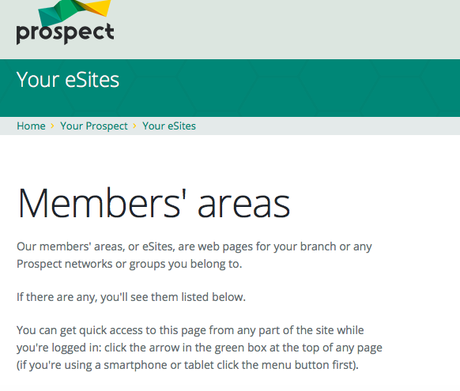
eBranch
On your action plan look sign up to the Prospect website and look at your branches eSites and find out how the branch communicates with its members safely
Notes:
Outcome to be achieved: learn The best way to comply is to communicate with members is through the website
Check that the reps are aware of the ebranch and the members area

Slide 32
Action plan so far…
Start to fill in your action plan for when you return to the workplace to improve your organisation (continued in further online sessions.
As part of the rep’s action plan on going back to the workplace you need to find out who fills the branch roles, who is organiser & F.T.O?
Log in to the Prospect website.

Slide 33
Lunch break
45 minutes

Slide 34
A rep’s rights
Session 5
Notes:
Outcomes to be achieved:
To add confidence to reps when embarking on the role, most new reps want to know what they and can’t do. This next section clarifies the legal rights of a rep and in accordance with the TULR©A ACT; based on the ACAS guidance for time off for representatives – also known as facility time the categories and how they are divided.

Slide 35
Your legal rights and responsibilities
Your legal rights come under the Trade Union and Labour Relations (Consolidation) Act 1992.
Under section 199 of the Trade Union and Labour Relations (Consolidation) Act 1992 the Advisory, Conciliation and Arbitration Service (Acas) has a duty to provide practical guidance on the time off to be permitted by an employer
ACAS Code of Practice 3
Notes:
Outcome to be achieved: learn where these laws come from.
it may be that if you H&S reps you need to mention the brown book
The link is in your book to download the code of practice 3
The rights of a rep are split broadly to into two categories; duties and activities.

Slide 36
Duties
Employees who are union representatives of an independent trade union recognised by their employer are to be permitted reasonable paid time off during working hours to carry out certain trade union duties.
Examples are: pay negotiations, consultation on restructuring, or representing an individual member in a grievance. These tasks also include time to prepare for these duties and to do other things "concerned with" them (eg briefing and consulting members before and after meetings with management, or branch committee meetings to discuss such issues).
Notes:
Outcome to be achieved:
The rights of a rep are split broadly to into two categories; duties and activities.
What is a duty? As listed on slide……. Anything that benefits the employer/ reps need to inform/consult or negotiate on
Reasonable paid time off by employer in recognised workplace.

Slide 37
Activities
Union reps are entitled to reasonable time off during working hours to carry out certain trade union activities, which are seen as different from duties.
In essence, the law recognises that unions need the participation of their members to operate effectively.
Activities might include: attending meetings to discuss internal union business, organising union elections.
Notes:
Outcome to be achieved: learn where these laws come from.
Reps are entitled to reasonable time off to carry out certain trade union duties. The law recognises that unions need the participation of their members and so activities are to allow reps time for this. E.G recruitment. This time although entitled is more often unpaid.
It is important that reps understand that the ACAS guidance is the minimum expected but reps need to check their own agreement as the facility time may be better.

Slide 38
Responsibilities
A Union rep has to inform the employer when they wish paid time off to undertake trade union duties or activities.
The procedure would normally found in the facilities agreement or in the recognition agreement.
This should provide clear guidelines on how a rep applies for time off.
Time for training can be declined as there is no cover, but a reasonable request can’t keep being denied.
Notes:
Outcome to be achieved: learn where these laws come from.
A rep should always try to build good relationship with their manager to show they are professional in their role, this includes keeping the employer informed if they need facility time.

Slide 39
Activity F :
What are your rights?
Working together in small groups, for the following examples, come up with what are the reps rights and what they can check to confirm this?
What other options are there?
Notes:
Using the information on the previous slides, look at the word doc with the headings and decide as a group which examples would fit under which headings. Examples on page 28 of workbook.

Slide 40
Activity G:
What would you do if?
As a big group look at the situations and decide what can be done.
Notes:
Do this activity as big group face to face
Outcome to be achieved:
Much of your role initially will be signposting or finding out information. However, there are instances where you can assist whilst you build up your knowledge and understanding. Here are some scenarios (page 29/30 in workbook) as a group discuss what you might do as a rep……….
Remind reps they are not trained to deal with personal cases but can advise and signpost queries.

Slide 41
Ingredients of union influence
Session 6
Notes:
Outcomes to be achieved:

Slide 42
Activity H:
What are the ingredients that increase the union’s influence
Working together in small groups, You will be split into groups and given an ‘ingredient’
Discuss as a group how this ingredient’s presence helps build an effective union on the ground and what happens if it isn’t there. Try to prove yours is the most important
Notes:
Outcome to be achieved: learn the ingredients to make a strong branch
Use flipchart and nominate someone to report back to the group. You have 10 minutes to complete the activity.

Slide 43
Ingredients
Membership density
Engaged members
Visible Profile
Constructive Dialogue
Representative membership
Representatives
Equality & Diversity
Notes:
Outcome to be achieved: learn what different roles there are in the branch
Density – proportion of members to help campaign./add their voice
Engaged members – keeping information relevant and specific, timely and useful.
Visible profile – is the union visible in the workplace, if you started a job tomorrow, would you know how to join the union?
Constructive dialogue – do you listen to members? Do you have opportunities to discuss issues? Is it worthwhile conversation?
Representative membership – Does every member in your branch have a say – or a rep to speak on their behalf. If you have a large percentage of under 35’s – do you/have you elected a young members rep? To ensure the proportion of the memberships’ voice is heard.
Representatives – Key role in the communications between the employer and the members and the union and it’s members. Supporting/advisory roles.
Equality and Diversity. – Encourage reps that this should be paramount in their thinking in line with union values. A key benefit to demonstrate to members – improving conditions for all.

Slide 44
The virtuous circle
Growing Membership
Members set and support union’s negotiating priorities
Negotiations deliver results
Encourages others to join
Notes:
Outcome to be achieved: learn how you need all the ingredients to make a strong branch
When the virtuous circle is working effectively members can see the benefit of being part of the union and they take that message with them – whatever company they work for in the future.
Effective local organisation – meaning reps like you – stands at the heart of Prospect’s ability to keep the virtuous circle going. Local union reps…
are the union’s eyes and ears, picking up issues that matter to members and can be resolved by negotiation.
are the union’s voice in the workplace, getting members involved in new campaigns and keeping them informed about on-going negotiations.
give the union a positive profile – visible on notice boards, identified with important issues.
grow the union by talking about joining to colleagues who are not yet in Prospect
keep members in touch with the wider union, eg by organising meetings and events with visiting speakers from beyond the branch.
A really important task for everyone involved in Prospect’s activities is to feed members’ views, queries, concerns and ideas back to Prospect – keeping the union in touch with members.

Slide 45
Activity I: Why people don’t join a union?
In groups look to persuade a non-member to join who has a particular reason for not joining.
Notes:
Outcome to be achieved: improve recruitment (10 minutes)
Assign a common reason to a group to come up with an answer in list in the workbook page 32

Slide 46
Tea Break – 15 mins

Slide 47
Building a stronger union
Session 7
Notes:
Outcomes to be achieved:

Slide 48
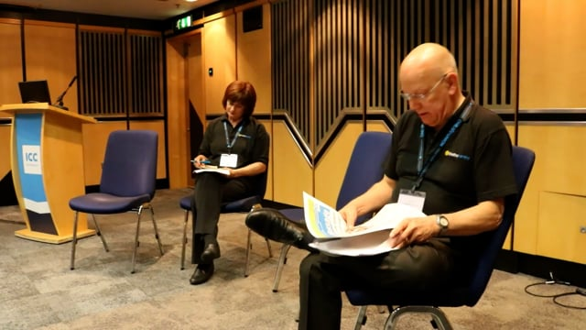

Slide 49
Activity J continued
in a big group discuss how you felt the recruitment went?
Then in smaller groups discuss how one of the three issues below can be taken forward:
  Staff survey
  IT issues
  Unachievable targets
Notes:
The sort of thing we want suggested was:
to challenge staff being coerced into the survey replies
Stress resulting from IT issues
Challenge how the targets are set and if they are not achieved how is that dealt with

Slide 50
Activity K: How well organised is your workplace?
On a scale of 1-10.
Fill in your action plan for when you return to the workplace to improve your organisation.
Notes:
Looking at Activity K; what is the response from reps on their scales of 1-10. If reps state 10 for their answers, why do they feel it warrants a 10? What are they doing?

Slide 51
Activity L:
Chart your work area
The tutor will provide a scenario for you (in workbooks) Activity L
Devise a strategy to organise the members of each department and effectively feedback to management.
Consider the following points.
How can the branch co-ordinate dialogue between the various departments?
How can the branch use this consultation for recruitment?
What message do the branch want to communicate to the management?
Notes:
As the tutor we would suggest dividing the group to have reps to look over each department and pick out the key findings. There are two different proposals, so the groups may want to divide themselves into the organising of the branch/members and then devising the strategy. NOTE; The second proposal is the same amount of hours for staff but over a 10 day rolling rota rather than a 5 day rolling rota.
We want reps to identify the following.
find out where members are and the strength in the workplace, areas which could be improved in terms of membership.
What can they do to engage members further?
Highlight the two different proposed changes and would this change their approach to management. We would suggest using a working party as two proposals affect different groups – who would be on the working party (ideally one from each department – won’t always necessarily need to be the rep)
How would their members feel about the first proposal?
How many members are affected negatively by the second proposal for operations – two reps in the department but differing views – would this provide a balanced view. (What do we think of Martha’s viewpoint as the rep? Perhaps working on her own agenda of trying to increase pay rather than thinking of the work/life balance)
What if there is a well-being policy within the workplace?
Can anyone be identified as a potential rep/advocate for the union?
Things to remember when recruiting/then mapping the workplace… Pitfalls to doing this; membership list is only updated on the information members have given to us e.g. if a member has left they won’t necessarily let Prospect/Bectu know and so they may still show on the membership list.
The list is private and confidential/any notes you make about members/non- members need to be kept very securely. Not every member wants to be known and you’ll have to show some discretion in your work as a rep (hence the ebranch and the list of members most GDPR compliant way of contact members.
Always be wary of GDPR, if members have expressed a wish no to be contacted, we have to honour that as part of the consent on the application forms.
(use points on p38 to help)

Slide 52
Action Plan – Tasks
Task
Find out the name of the branch chair and engage in conversation about recognition/ facilities agreements and what they can negotiate, be informed and consult on. Find out the name of the branch secretary. Find out the names of the committee members, and when they meet.
Find out the name of your organiser. Find out the name of your negotiations officer.
Sign up to the Prospect or Bectu website and view your branch’s electronic communications.
Reflecting on activity D and activity K, how could you improve how your branch is organised? Does your branch have a development plan?
After attending this course, what will you stop doing?
After attending this course, what will you continue to do?
Based on your new knowledge, what three practical things will you do? 1. 2. 3.
Notes:
Go over the action plan and ensure reps are clear on the task. To complete, where possible before the follow up with the organiser.

Slide 53
Questions?

