Slide 1

Exchange Summary
Prospect Bectu, UNI Global Union
January 12, 2023
What is the most important issue for you, as an Orsted employee, in 2023?

Slide 2

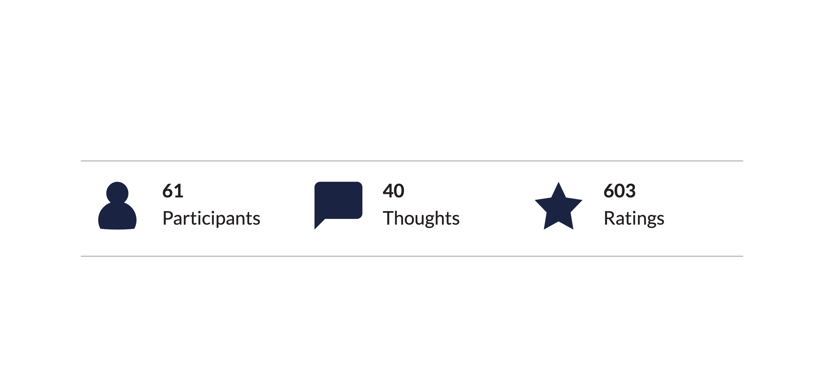
PARTICIPATION
Breakdown of Participation

Slide 3

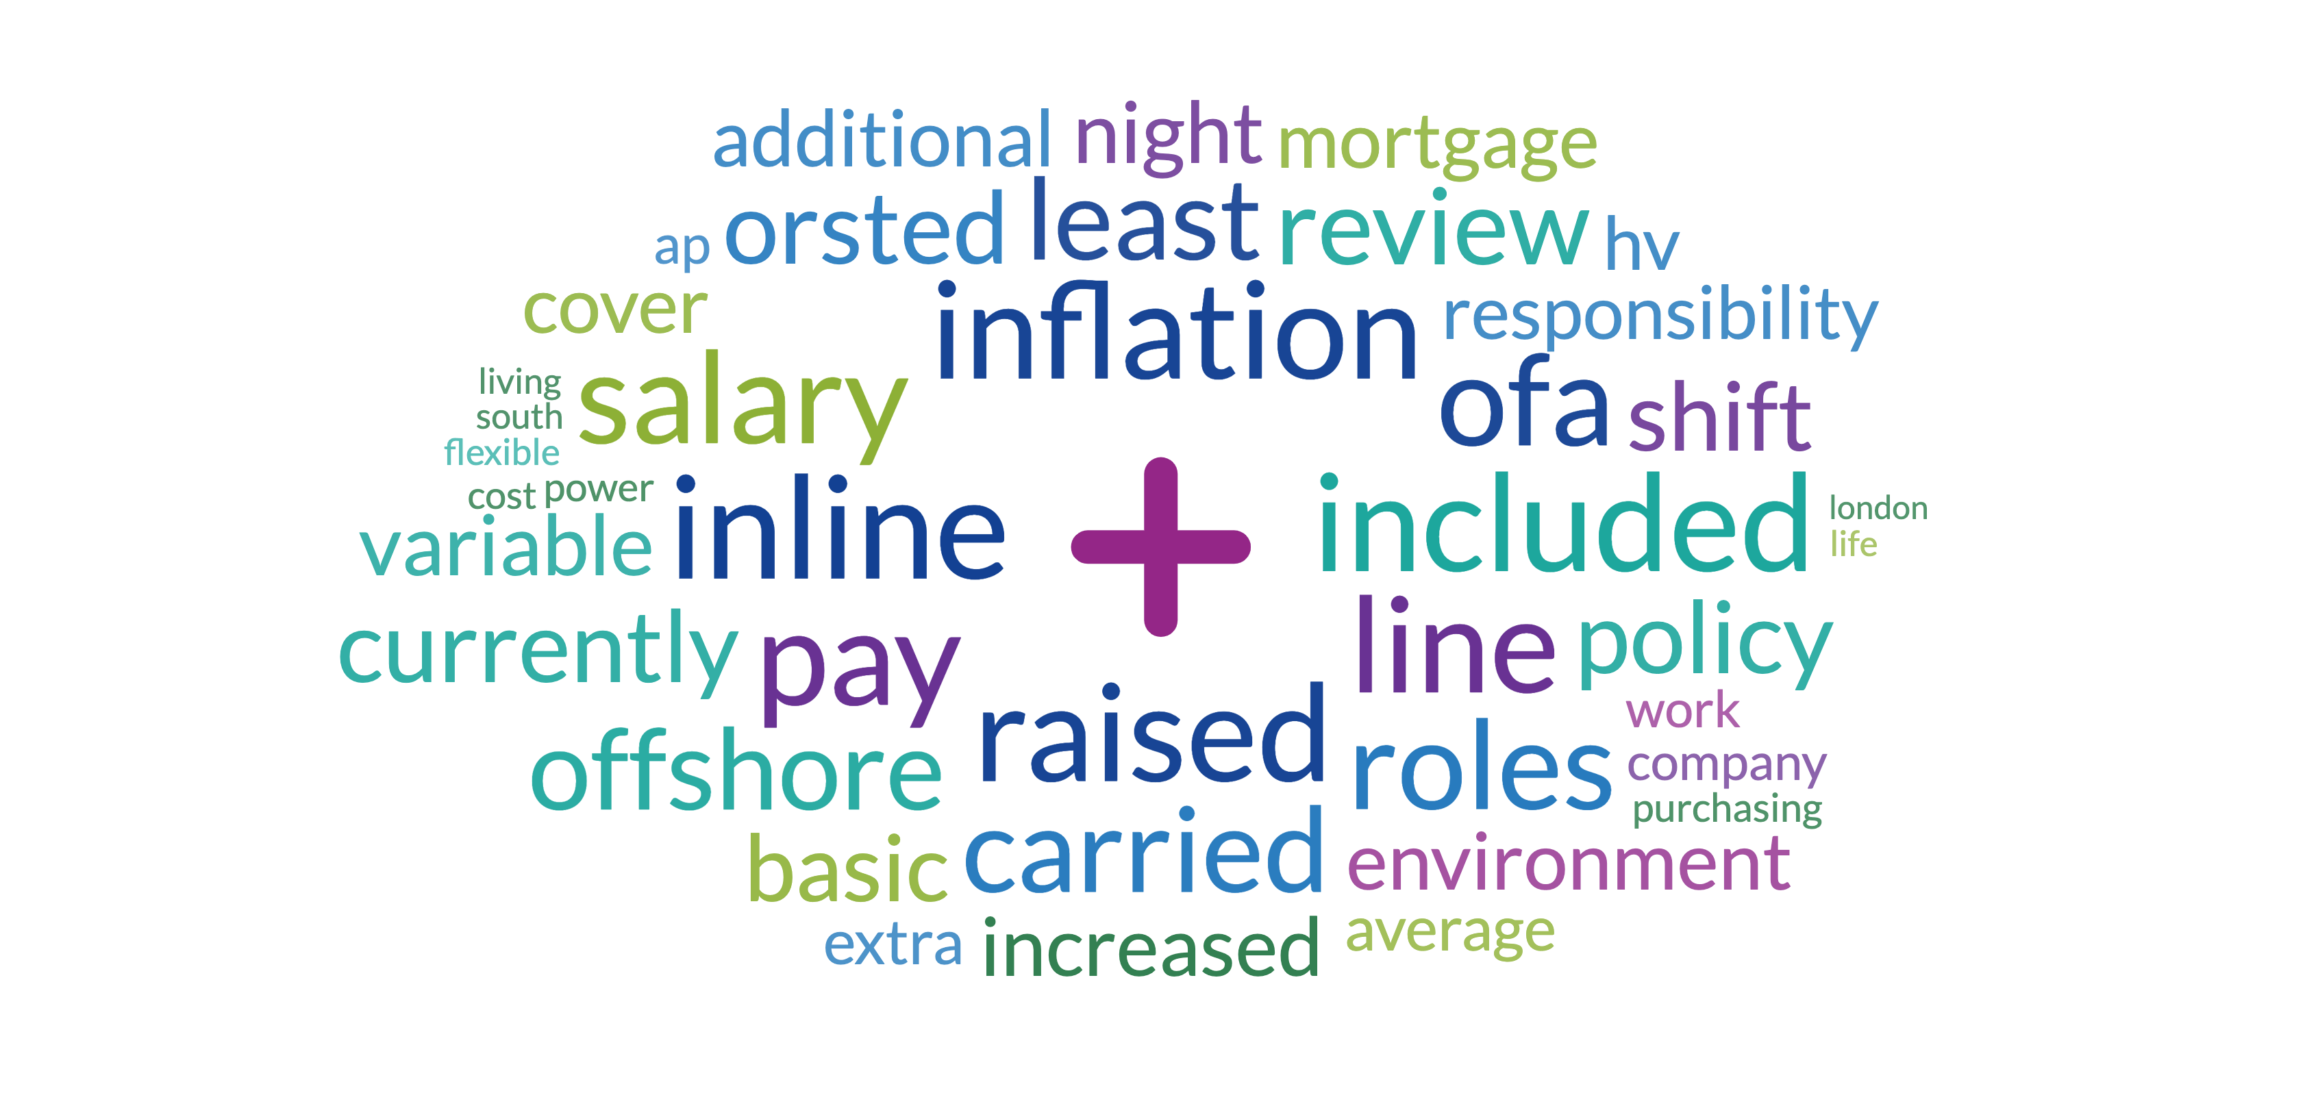
WORDCLOUD
Top Rated

Slide 4

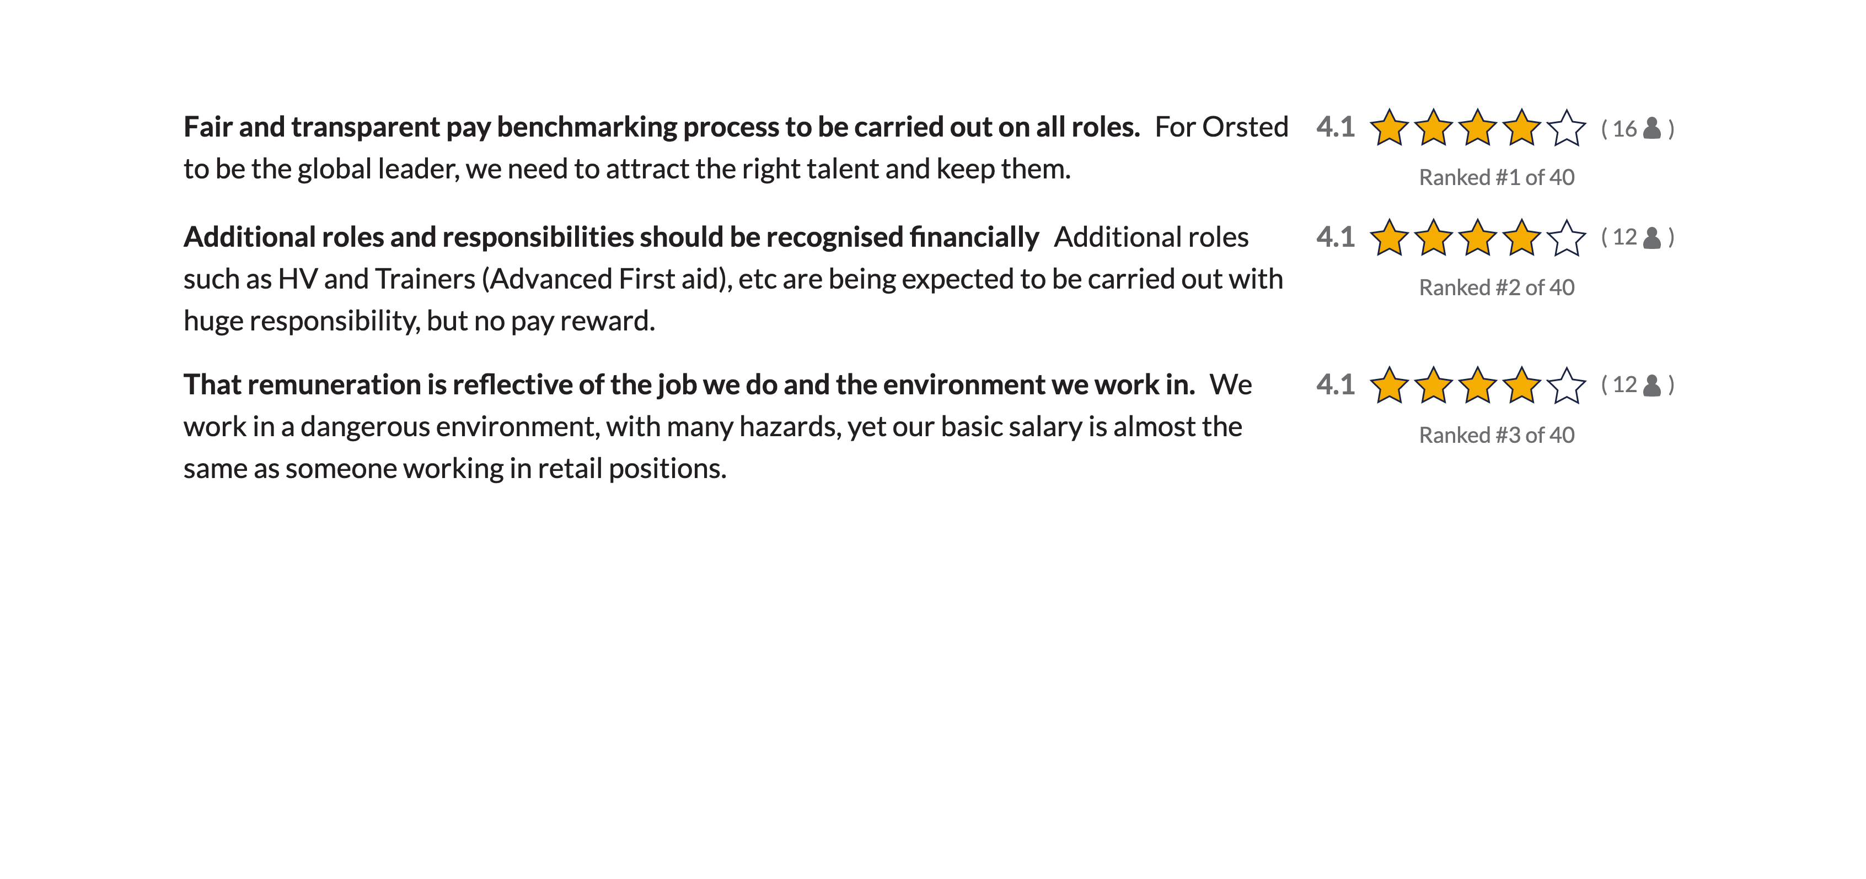
THOUGHTS
Key Thoughts

Slide 5

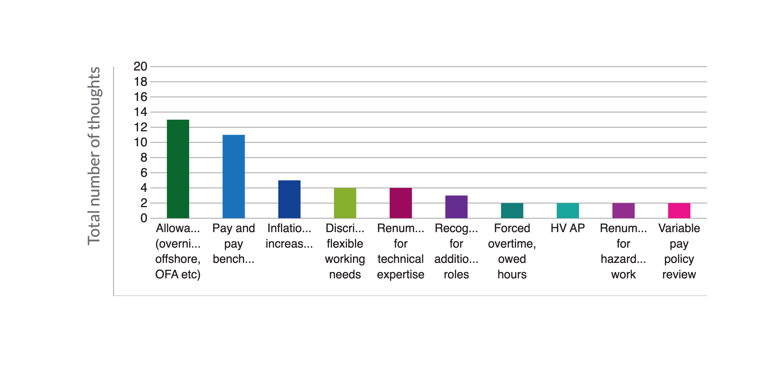
ORSTED PRIORITY THEMES
Top Themes by total thoughts

Slide 6
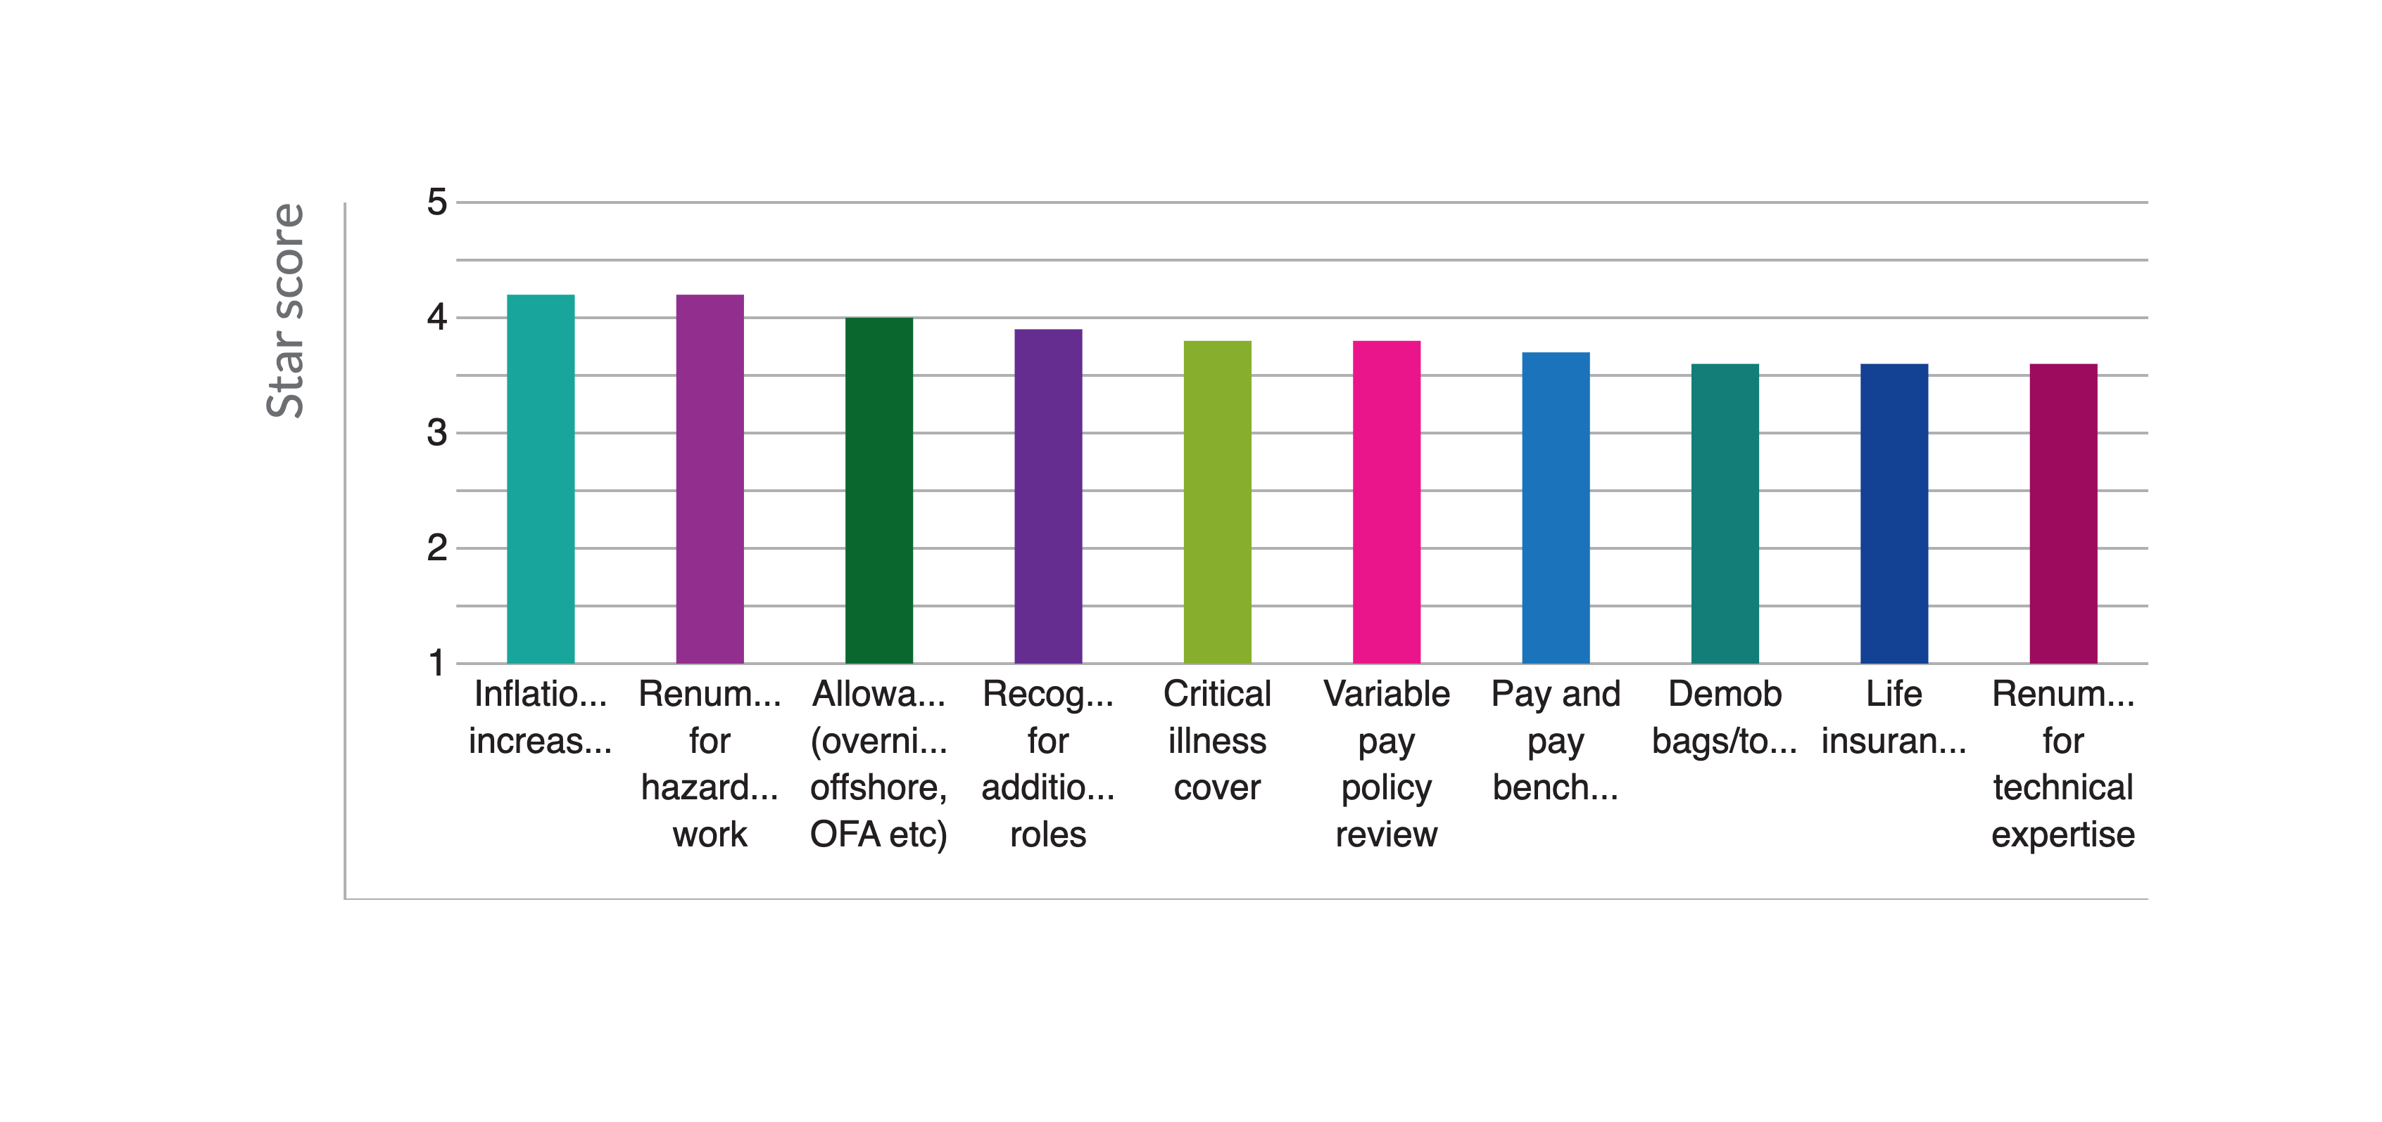
ORSTED PRIORITY THEMES
Top Themes by star score

Slide 7
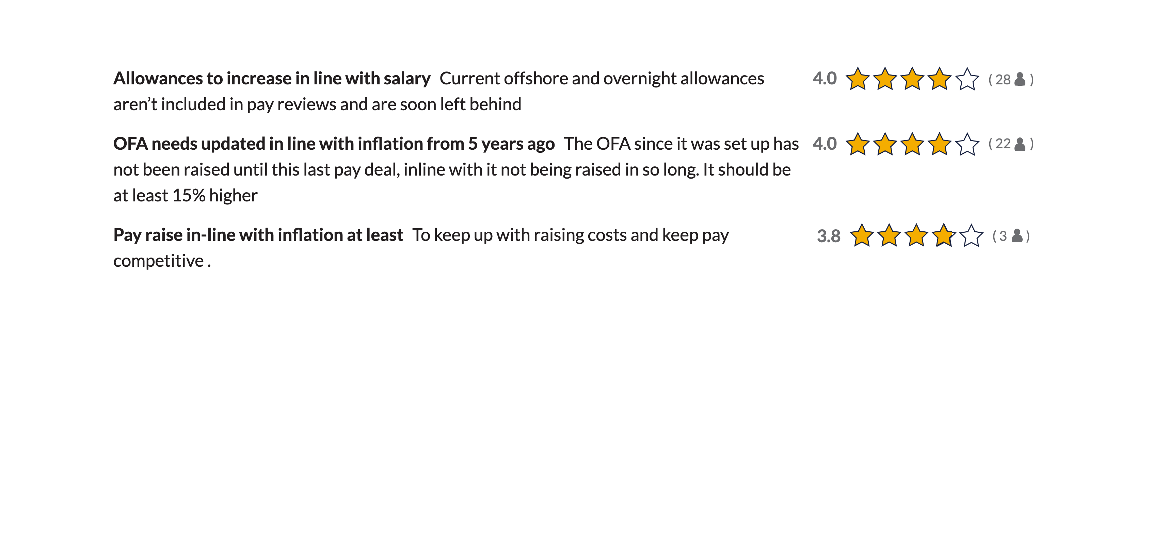
THOUGHTS
Inflationary increases

Slide 8
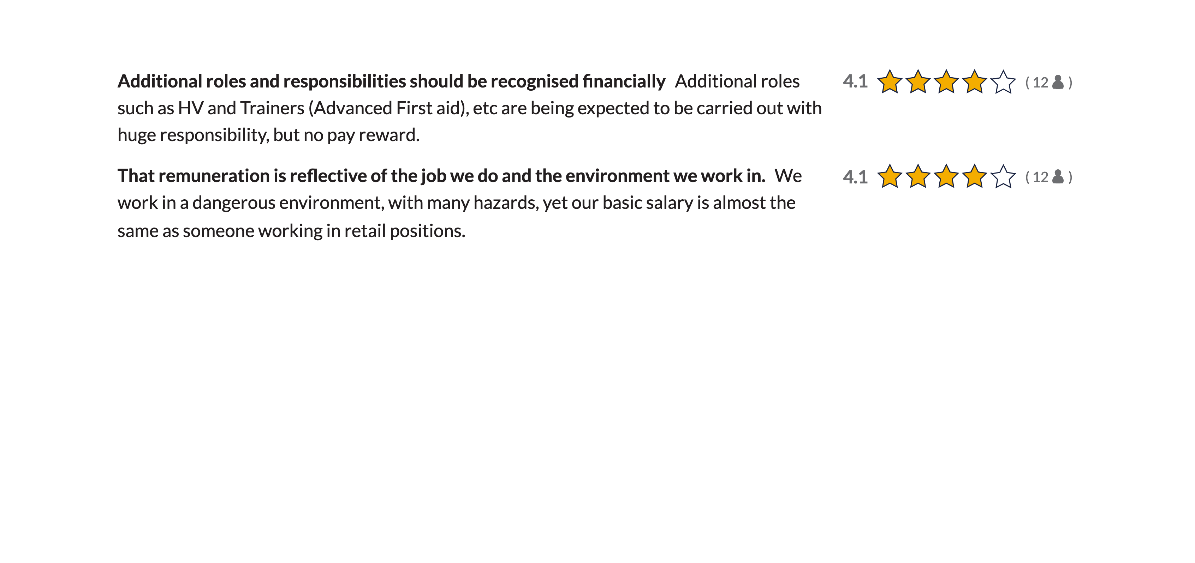
THOUGHTS
Renumeration for hazardous work

Slide 9
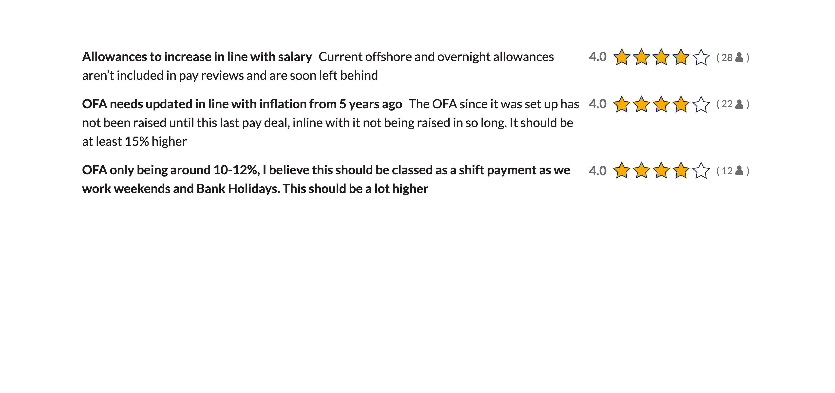
THOUGHTS
Allowances (overnight, offshore, OFA etc)

Slide 10
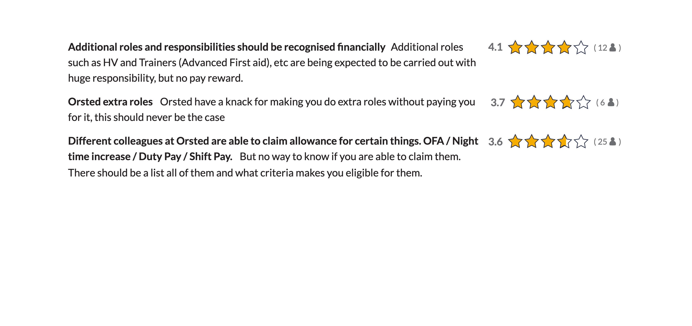
THOUGHTS
Recognition for additional roles

Slide 11

THOUGHTS
Critical illness cover

Slide 12
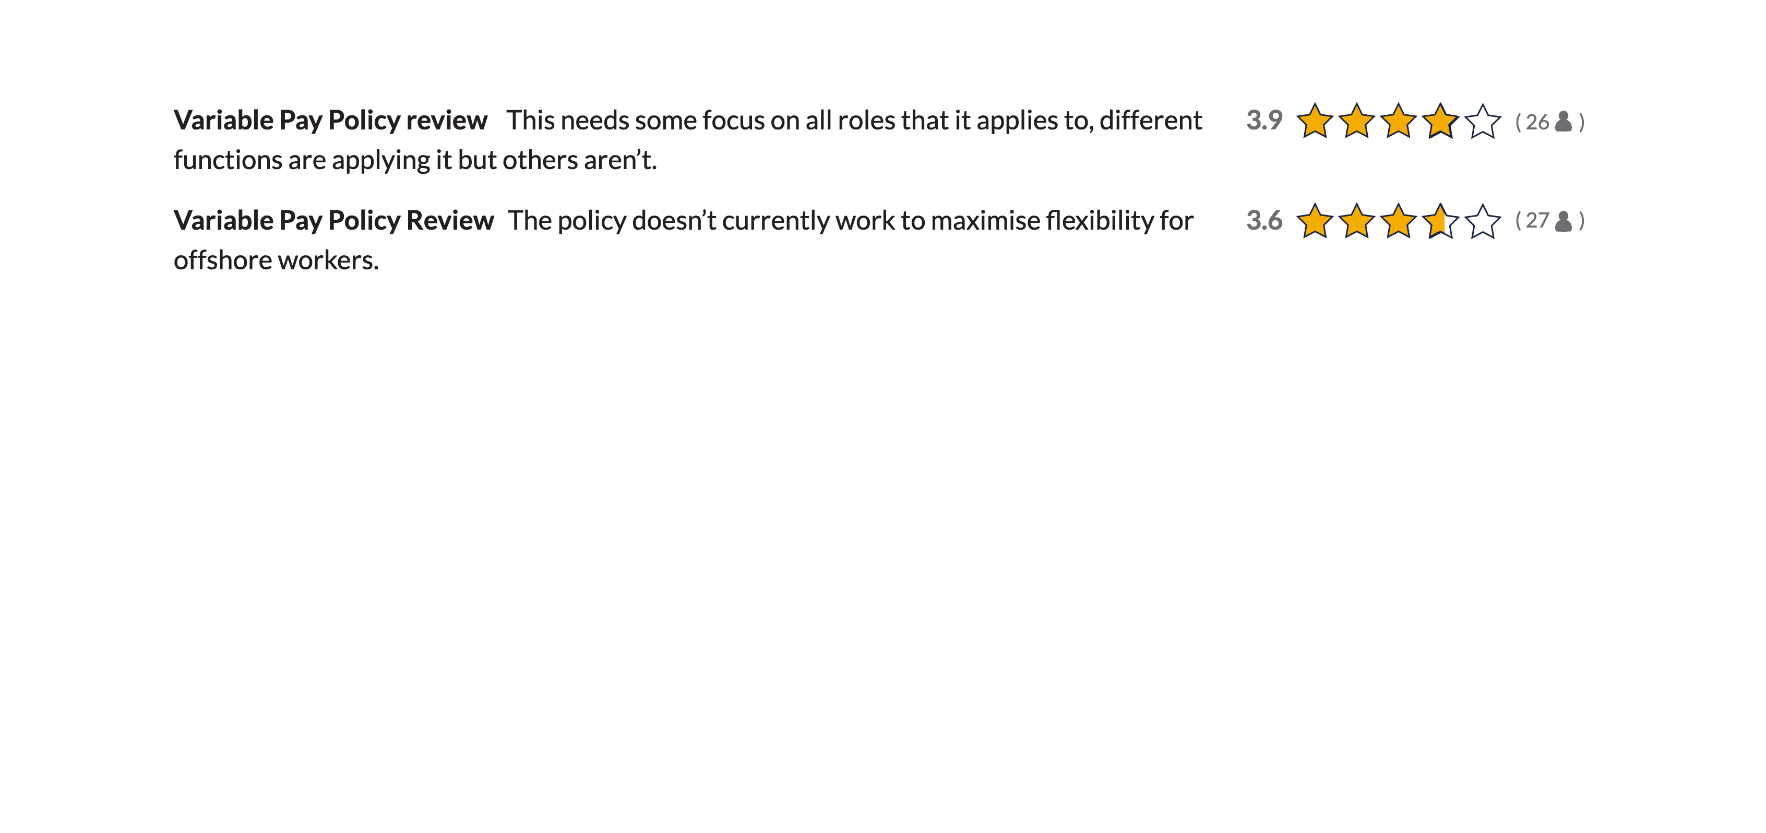
THOUGHTS
Variable pay policy review

Slide 13
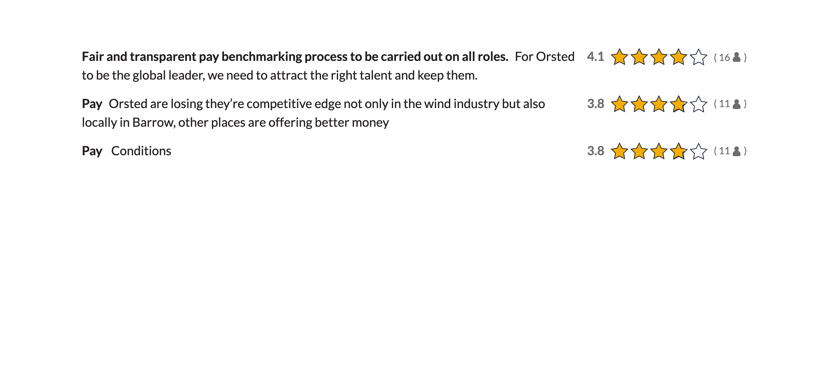
THOUGHTS
Pay and pay benchmarking

Slide 14
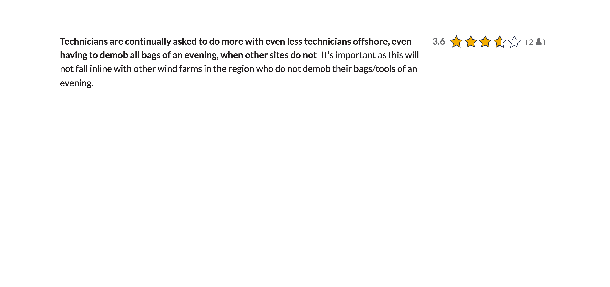
THOUGHTS
Demob bags/tools

Slide 15
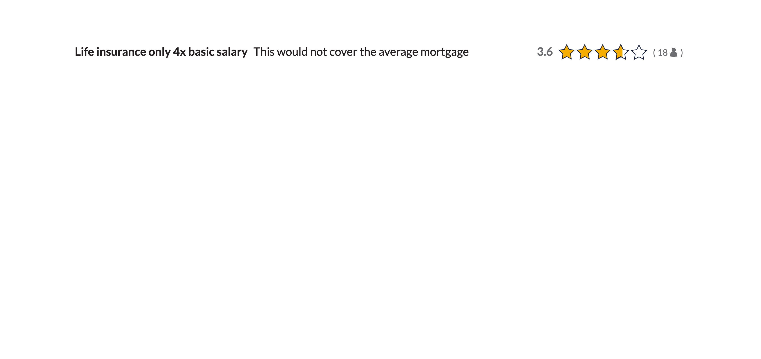
THOUGHTS
Life insurance

Slide 16
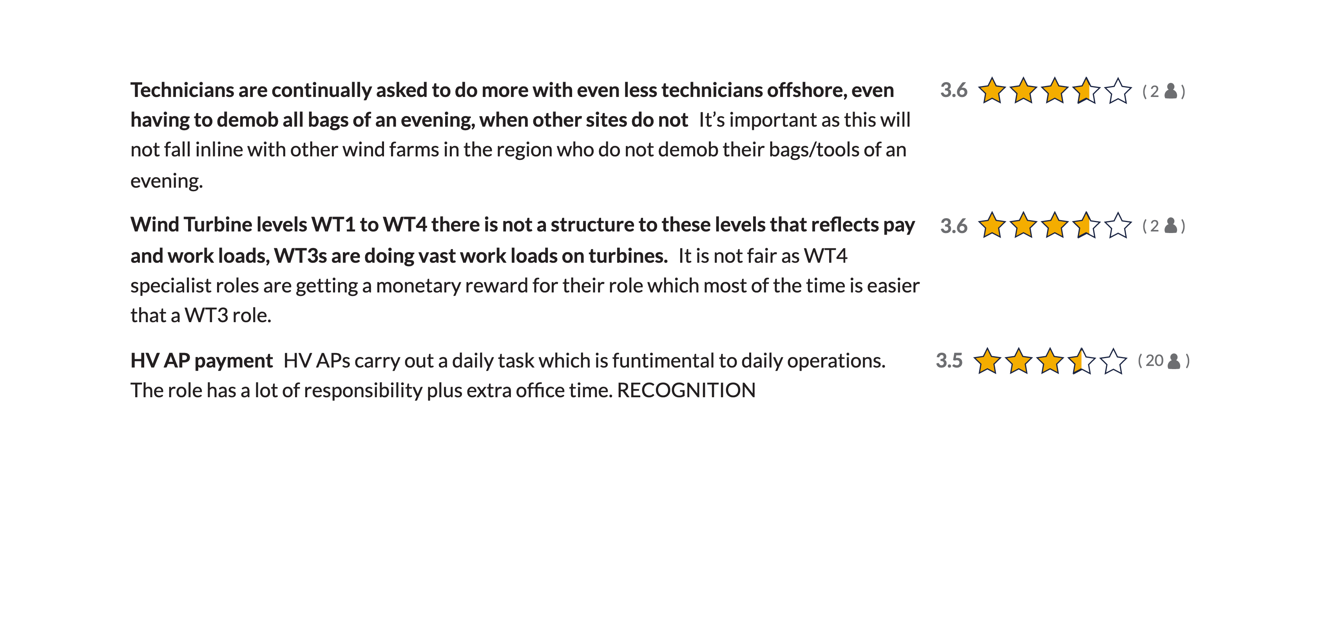
THOUGHTS
Renumeration for technical expertise

Slide 17

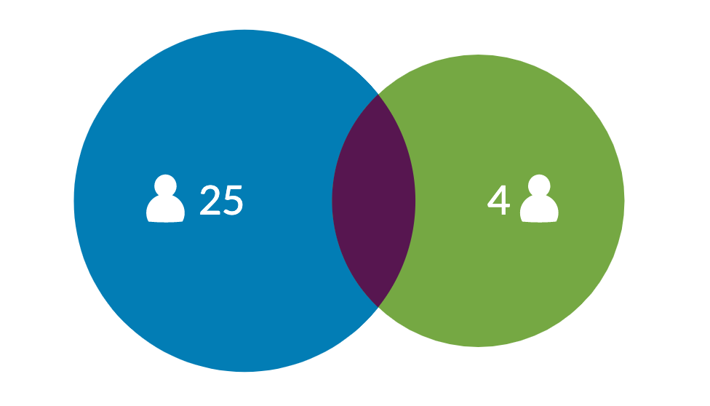
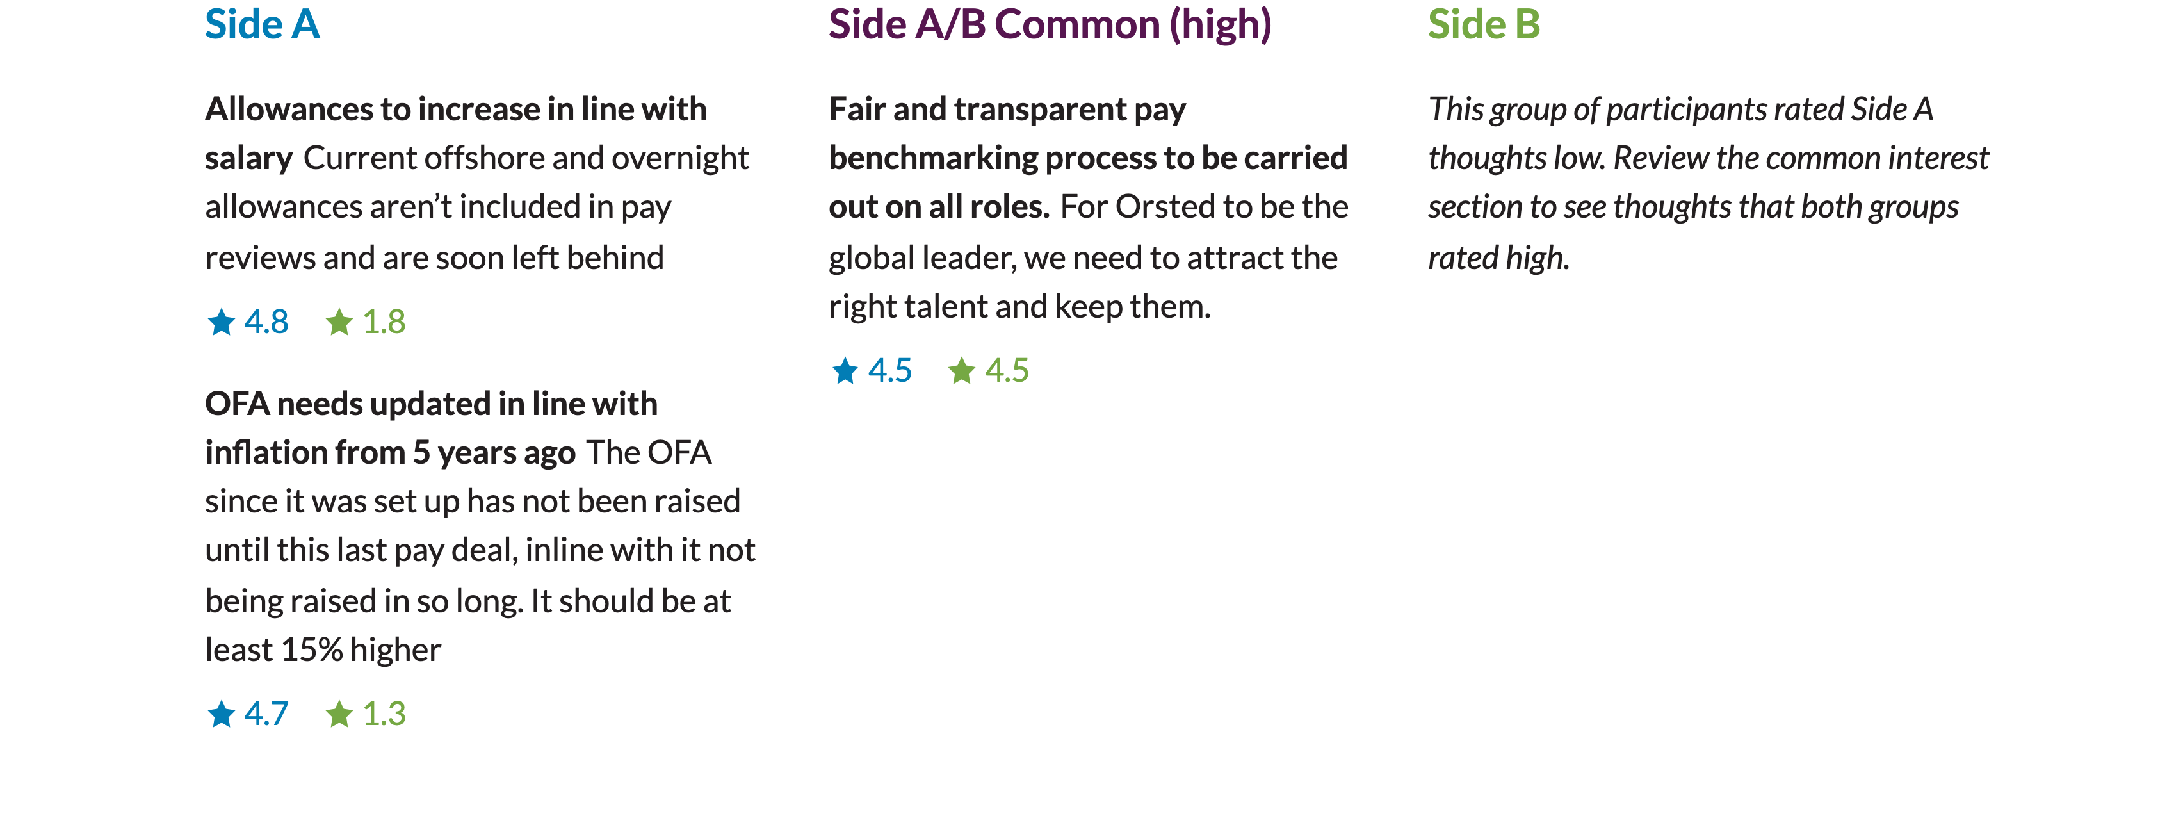
DIFFERENCES
Night Pay [25 | 4]

Slide 18
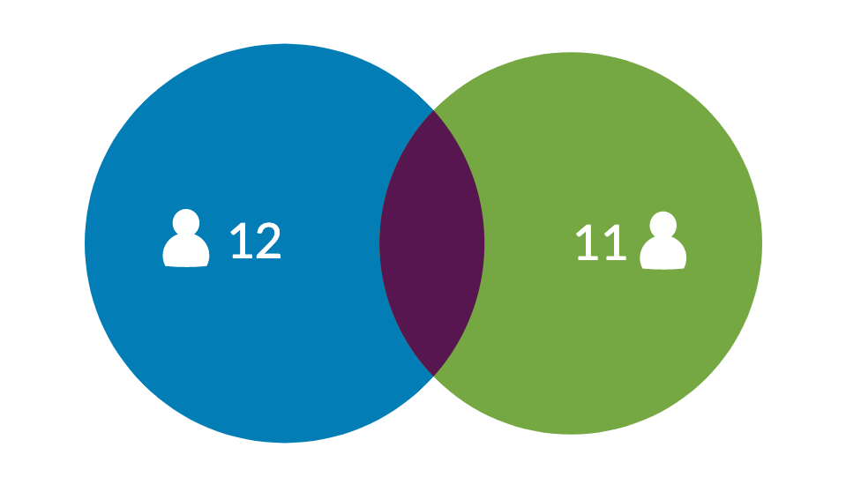
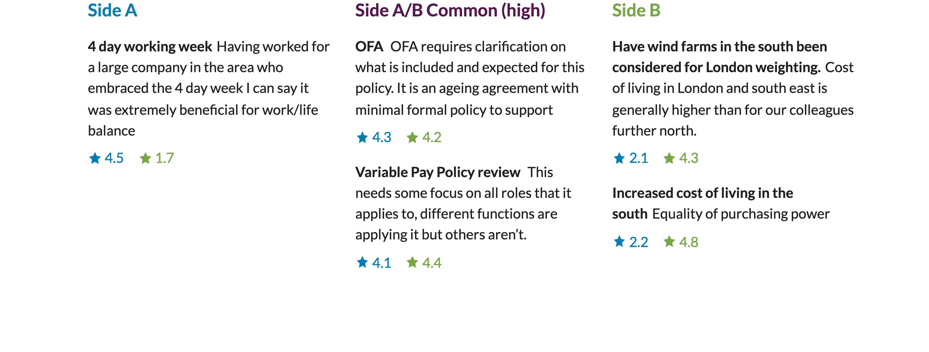
DIFFERENCES
Work | Cost Of Living [12 | 11]

Slide 19
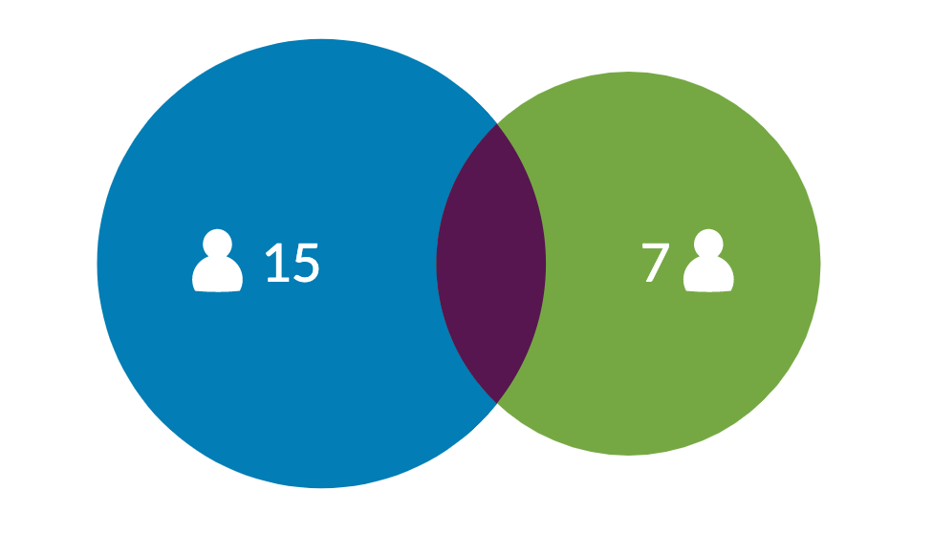

DIFFERENCES
Night Shift [15 | 7]

Slide 20

WRAP UP
Next Steps
Thanks for participating
‌
We'll be carefully considering what we learned and sharing our actions back with you.

