Slide 1
A branch
President/Chair
Branch
Secretary
Committee
Notes:
Try to get reps to answer after watching video
Outcome to be achieved:
How a branch is set up
This diagram shows a branch that is at one site and has members in three different departments.
According to Prospect’s rules, a branch has to have an elected chair, (click 1)
Another role needed under union rules is a secretary (click 2)
A branch meeting is where an issue can be discussed and a democratic decision can be decided and voted on. What the majority at a branch meeting decides is the course of action a representative takes up with management on the members’ behalf.
Most members do not want to attend regular branch meetings, But decisions still need to be made on the day-to-day business of the branch and to facilitate this the branch elects a committee (click 3)
As part of your action plan you need to find who fills these roles in your branch? (click 4)
It is very important that all the different working areas/grades/departments are represented on the committee.

Slide 2
Why does it matter what branch you are in?
A branch is a bargaining unit.
A bargaining unit is the group of workers for whom a trade union is requesting, or has been granted, recognition.
It is very important that a member is in the right branch/bargaining unit as they might not be able to speak or vote on issues that affect them if not.
A rep should give guidance for a new member to be put in the right branch
Notes:
Outcome to be achieved:
Learn what a bargaining unit is
Prospect branches come in all different shapes and sizes. They evolve to fit the needs of their members. Most are designed to match the organisational structure of the employer. There are a number of regional branches that contain members from various employers which are too small to form a branch or there is no recognition with their employer.
Because of the TU ACT 2016, for a ballot to be legal, it has to have all the members who are affected by the outcome balloted, and this may be called into question by the employer.
This is a basic principle to get reps to start to understand the structure and democratic structure of the union.

Slide 3
What happens when a new member joins Prospect?
A new member is put into the appropriate branch.
This is decided from the following information:
their job or role
who they work for
their work location
Notes:
Outcome to be achieved:
Learn how a branch is determined and a new member is put in a branch
Ask delegates to turn to page 12 in the workbook to look at the diagram. Use examples of how this works for their branch.
Where they work to be relevant for their workplace
Who they work for so pay and conditions can be improved.
What they do, so working conditions can be compared with others who do the same role.

Slide 4
A branch
President/Chair
Branch
Secretary
Committee
As part of the rep’s action plan on going back to the workplace you need to find out who fills these roles in your branch?
Who are you representing? (department, workplace, grade)
Notes:
Try to get reps to answer after watching video
Outcome to be achieved:
How a branch is set up
This diagram shows a branch that is at one site and has members in three different departments.
According to Prospect’s rules, a branch has to have an elected chair, (click 1)
Another role needed under union rules is a secretary (click 2)
A branch meeting is where an issue can be discussed and a democratic decision can be decided and voted on. What the majority at a branch meeting decides is the course of action a representative takes up with management on the members’ behalf.
Most members do not want to attend regular branch meetings, But decisions still need to be made on the day-to-day business of the branch and to facilitate this the branch elects a committee (click 3)
As part of your action plan you need to find who fills these roles in your branch? (click 4)
It is very important that all the different working areas/grades/departments are represented on the committee.

Slide 5
How is a branch democratic?
An issue is raised and an action is voted on at a meeting.
Meeting
In between meetings, the committee can discuss an issue that arises and an action decided on.
Committee
The branch usually instructs the committee to take action.
Meeting
Notes:
Outcome to be achieved:
What can happen at a meeting or a committee meeting
A meeting needs to be in quorate for a decision to be made and action taken at the meeting.
A quorum is enough members to be a reasonable representation of the branch total number. It can be set to reflect the branch, so 10% for instance.
Emphasise that the committee acts on the will of the members at the meeting. It is generally the case that the committee has to steer the members into making a decision and keep expectations realistic.

Slide 6
Branch issues
Problem 1
Branch
Problem 1 & 2
Problem 1 & 3
Which issue should the branch try to address first?
Can you set up a working group to tackle each problem?
Notes:
Outcome to be achieved:
Explain how we look which problems to pick and how to go forward with them
Go through the slide as to which problem to tackle first, try adding member numbers to the departments/offices/locations such department C having more members than dept A & B put together. This is a good time to explain the benefit of mapping the workforce.
One of the golden rules for reps is if you are not sure what to do, consult a more experienced rep or a Prospect full-time officer.
To be able to retain members it is very important that issues that affect the majority of the branch are dealt with as a priority, not just the member who shouts.
Getting agreement at a meeting may not be easy. The chair will need to keep order and make sure all the sides of the argument are heard. The committee should have a plan beforehand of who will provide the information needed for the members to make an informed decision.

Slide 7
Branch support
Research
Negotiation officer
Education
Networks
MCC
Organiser
Legal
Comms
Branch
As part of your action plan find out who is your branch negotiation officer and organiser.
Notes:
Outcome to be achieved:
Understand what support is available
If you are just teaching one branch you may be able to name the officers, but it is written in their action plan to find out.

Slide 8
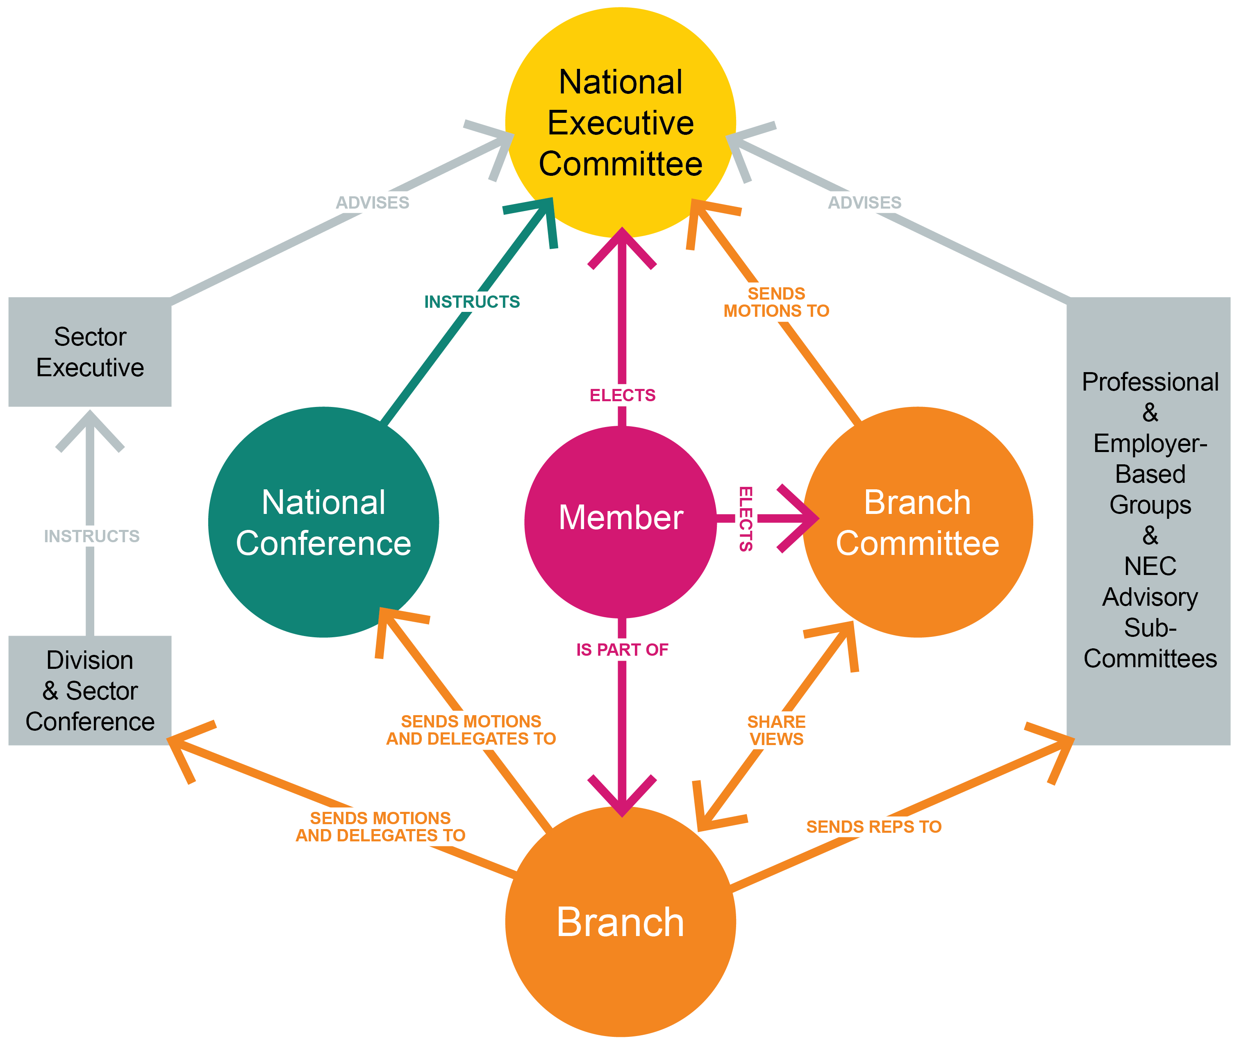
Prospect structure
Notes:
Outcomes to be achieved:
Learn how the member interacts with union as a whole
This diagram is from the rep’s handbook and shows the communication and relationship members have with parts of the union.

Slide 9
The role of a rep
Session 4
Notes:
Outcomes to be achieved:
Highlight the actual role, skills and expectations….

Slide 10
Activity E: What do union reps do?
Working together in a large group, make a list of all the things a Prospect rep might do as part of their duties.
Complete the list of things a rep does.
Make a list of the skills needed by a rep to do the tasks.
On the first list pick the four most important tasks.
Notes:
Do this activity as big group face to face
Outcome to be achieved:
What is required of reps – what skills, expectation. Do reps have experience of a really good rep or a really bad rep and learn by example in order to add items to this list…..
I tend to ask each reps to pick the 4 that mean the most for them as each branch is different and one reps primary goal/focus may be different to another reps.

Slide 11
Different types of reps
President/Chair
Vice-president chair
Secretary
Treasurer
Membership and recruitment secretary
Branch organiser
Health & safety rep
Union learning rep
Equality rep
Young members Rep
Environmental rep
Case handler
Communication rep
Notes:
Outcome to be achieved: learn what different roles there are in the branch
There are explanations in the workbook taken from the handbook pick out any that people have an interest in

Slide 12
Code of practice for Prospect reps
Responsibilities
Act honestly, responsibly and with integrity.
Communicate respectfully and honestly.
Treat others with fairness, dignity, and respect.
Encourage the open expression of views at meetings but accept collective responsibility for all decisions and policies once finalised.
Not behave in ways that may cause physical or mental harm or distress to another person, such as verbal abuse, physical abuse, assault, bullying, or discrimination or harassment.
Notes:
Tutor Note; In line with the latest agreed NEC guidance as of Dec 2021, new information of the code of practice all reps representing the union should adhere to.

Slide 13
The values and behaviour of reps
Respectful
Non-judgemental
Integrity
Supportive
Honest
Able to network
Flexible
Positive
Good listener
Clear communicator
A sounding board for ideas
Notes:
Outcome to be achieved: learn what different roles there are in the branch
There are explanations in the workbook taken from the handbook pick out any that people have an interest in

Slide 14
The branch and its data
(further information in appendix)
Notes:
Outcomes to be achieved:
To understand how GDPR impacts new reps when recruiting members and how to be mindful of data collected and stored.,…..
Its worth noting that many new reps may ask for a list of their members to date – dependent on their branch secretary this may be permitted but some areas may need new reps to do a bit more leg work……… maybe hold an all member meeting, get to know who is a member on your floor, in your department and check back with the B/S or Prospect.

Slide 15
GDPR – things to remember
Mark all correspondence, electronic or otherwise as private and confidential; Be aware the act applies to paper file, records of telephone conversations, audiotapes, photographs and social networking media.
Respect confidentiality and the rights of a member.
Be open with people about information held about them.
Ensure all personal data is disposed of as confidential waste.
Think of personal data held about individuals as though it was held about you.
Back to work action – find out about your workplace policy and how it is important to know the difference between processors and controllers – who controls information on work computers (we do).
Notes:
REPS TO THINK ABOUT WHAT THEY MAY NEED IN ORDER TO THE DO THE ROLE EFFECTIVELY – WHAT ACCESS DO YOU HAVE, IS IT A SHARED COMPUTER, CAN YOU HAVE PRIVACY SETTINGS

Slide 16
GDPR – Don’t
Disclose any personal data over the phone
Put personal data about a member on the internet without their permissions
Take personal data home unless it can be securely stored
Use personal data held for someone for a different purpose without permission from that member.
Send personal data outside the EEA (European Economic Area) without taking advice from Prospect
Further advice can be sought from Tracey Hunt if you‘re unsure about your practices. (details in the workbook)
Under the course resource area, reps can download their own template to formalise an agreement with the employer. Once you have completed this, please send to datacompliance@prospect.org.uk

Slide 17
Prospect eSite
Prospect gives branches a way of communicating with their members which reduces the chance of a data breach when sending emails. This is done via our free eSite system
Branch officers (Secretary/assistant, chair/vice chair, membership and recruitment secretary/organiser automatically get admin rights to look after their eSite, as does our new communications rep role)
All branches have a ‘starter’ eBranch which gives their branch officers access to online membership lists. The same applies at section level.
Notes:
Most GDPR compliant way of contact reps via bulk mail, with updated minutes, newsletters etc….
Go over the functionality of the ebranch. (Communications role access rights for this area of work)

Slide 18
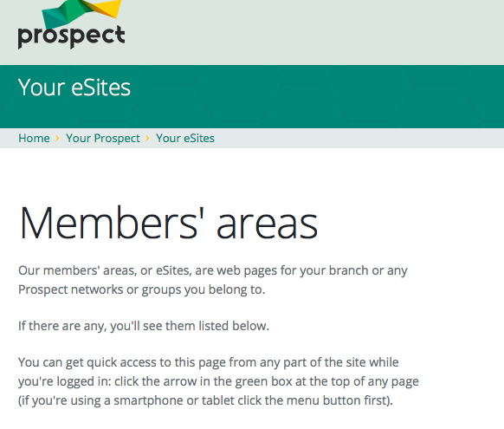
eBranch
On your action plan look sign up to the Prospect website and look at your branches eSites and find out how the branch communicates with its members safely
Notes:
Outcome to be achieved: learn The best way to comply is to communicate with members is through the website
Check that the reps are aware of the ebranch and the members area

Slide 19
Action plan so far…
Homework
Start to fill in your action plan for when you return to the workplace to improve your organisation (continued infurther online sessions.
As part of the rep’s action plan on going back to the workplace you need to find out who fills the branch roles, who is organiser & F.T.O?
Activity K - How well organised is your workplace?
Log in to the Prospect website.

Slide 20
Activity K: How well organised is your workplace?
Homework
On a scale of 1-10.
Fill in your action plan for when you return to the workplace to improve your organisation.

