Slide 1
Activity H: A real case what really happened
As reasonable adjustments had not all been put in place it was decided to add the missing recommendations
The formal process to be ended and an informal to continue.
Sasha to apply to move to a different team.
Notes:
12.55 – 13.00
Go through the real life outcome

Slide 2
Dealing with distressed members
Members who are being disciplined or who have grievances against their employers are often frightened, hurt, angry or a mixture of all three.
Your role is:
To help them set aside their emotional responses so that they are in a better position to deal with the situation at hand;
To assess their case and look for the best achievable outcome;
To help the member to take a realistic view
of their case and how it will progress.

Slide 3
Remember!
Manage expectations
It may need tough love
You are not a counsellor
Signpost members to employer assistance programs/other
Look after yourself

Slide 4
Recap
Q&A on what has been learned so far…

Slide 5
Q1. How should a rep behave during the formal process
Q2. What should a rep take with them to a formal meeting?
Q3. Can a rep ask questions of a hearing manager or investigator?
Q4. Can a rep answer for a member in a formal meeting?
Q5. What can a rep do/ask during a formal meeting?
Notes:
Answers;
1, Calmly professionally and assertive if needed.
2. A copy of proforma, relevant documents including policy, witness statements and investigation findings.
3. Yes.
4, No. Unless the member has specified they wish the reps to speak on their behalf. Its far better for the member to speak on events at their own meeting. They can prepare wording if the member is nervous about what to say and use a cue sheet. The rep can also confer with the member if they can’t remember or have missed a vital piece of information.
5, A rep can take notes, be present in the formal meeting (in accordance with the procedure to ensure fairness)
A rep can also call/ask for adjournment, request further information if needed, ask for the meeting to be rescheduled (if inconvenient – should be prior to the meeting)
Ask for a copy of the minutes taken and a timeframe for decision making if its not forthcoming.

Slide 6
Managing members expectations
Session 9
Notes:
Outcomes to be achieved:
This session is designed to manage members and their wishes. There will be times when we have to have a honest conversation with members about how realistic their request is or whether it is something they can sort themselves with our support.

Slide 7
Managing members expectations
Not every problem or complaint is justified
Be clear with member if you need to refer to someone else
You may have to put the other point of view
Union agreements cannot be broken for just one person
Be realistic with when you can be back in touch.
Notes:
13.55 – 14.05
We’ve just gone over a real life case and in both cases it was a fairly positive outcome. Nevertheless, that won’t always be the case. One of the key elements of a case handler’s role is to manage members’ expectations and understand how this may change their behaviours.
Go through slide and clarify points.

Slide 8
Activity I:
Managing expectations
The e-mail below is from a longstanding member who wants you to help them. You have 10 minutes to come up with a bullet point list of how you would deal with the attached email.
Notes:
Member email on page 109 (bottom) and bullet points on page 110.
Know how to make a realistic assessment of members’ issues
• Appreciate the balance between individual and collective interests
Key points
Refer them to their employer’s policy on use of social networking sites.
Give delegates 10 minutes (working on their own) to decide how to deal with the member’s query.
Then lead a discussion about what they have decided.
If necessary use questions to prompt feedback e.g.:
- Does Mr. Shouting have a legitimate complaint?
- Do you have any sympathy for Mr. Shouting?
What factors would help you decide how far you could or should help Mr. Shouting?
Main issue from company will be using slack as a personal attack on colleagues – as it’s used on work equipment, the company will have access – even a seemingly private account/conversation.
Members sometimes have unrealistic expectations
Important to explain why Prospect/Bectu can’t help or their desired outcome is unachievable – in a way that won’t alienate the member
Prospect/Bectu will not help members if what they want conflicts with a collective agreement
Link is included on a useful case based on this type of scenario – is it ever private?

Slide 9
Grievances
Session 10
Notes:
Outcomes to be achieved:
To understand the informal/formal process and what should be included in the grievance.

Slide 10
Formal casework documentation
In general:
Get the member to write the first draft.
Make sure you have cleared the final draft before the member sends it.
Include references to the appropriate procedure and other policies or procedures relevant to the issue at hand.
Include all relevant facts
Exclude irrelevant
Explain why this is important to the member.
Make sure it is addressed to the correct
person, according to the procedure.
Notes:
Include all relevant facts – if necessary append a separate timeline of events.
Exclude irrelevant issues – they will detract from the impact of the case

Slide 11
Formal casework documentation
Grievance letters
State how the informal stage was addressed
and why it needs to go further
Propose potential solutions that would be acceptable to the member.
Requests for changes to working arrangements
Make a business case for the desired resolution, taking account of impact on customers/clients and colleagues.
Cite precedents, if possible, from
within the same department.
Notes:
Statements to disciplinary hearings
Address the points made against the member in any documentation of the case – overall charges and specific examples given.
Challenge evidence that is inaccurate or could be interpreted differently.
Provide countervailing evidence e.g. testimony from colleagues, good performance/conduct.
Include arguments in mitigation, if relevant.

Slide 12
Activity J:
Sharon’s grievance
In groups, look at the information that Sharon has brought to you and assess a plan to go forward with her case.
Notes:
Activity J Sharon’s Grievance
In pairs look at the what help you can give Sharon at her grievance meeting
Look over Sharon’s points and evidence and put together a plan for the formal grievance meeting (formal grievance guidance on page 124/126)
Points we’re looking for from the delegates are;
Sole reason are the failures in GDPR the company have made – although staff are accepting of the terms when providing their contact details, this is on the basis it is for swapping shifts only.
Important that the delegates identify that Sharon wants the procedure changed, not action against Dave.
This involves a large whatsapp group – it’s impossible to ensure vital information sometimes gets through – advice should be that this whatsapp group should only be used for swapping shifts and another informal group should be set up for general chat. (if needed)
If you have time – ask the reps how they would approach if Dave was their member and whether that may alter how they advise Sharon initially.

Slide 13
The real case outcome
The grievance was upheld
Recommendations to formalise the swapping shifts contact system to enable a ‘no need to share personal details’ basis
Dave was disciplined for giving female staff members unwanted attention.
Notes:
Go through the real life outcome
Extra information – worth commenting on Dave's disciplinary, as he was new, he was still under probation and this wasn’t extended, so in effect Dave lost his job.
Dave wasn’t a union member as he was new.

Slide 14
Internet use at work
Where employers may have a problem with a member
Personal use
Time wasting
Security
Downloading
Harassment
Notes:
Go over possible problems with internet use. More details in the workbooks for delegates but do’s and don’ts include;
Do:
• find out if your employer has a policy on acceptable use
• familiarise yourself with the policy
• encourage your Prospect/Bectu representative to negotiate a policy if one does not exist
• ensure that you stay within the terms of the policy
• respect other colleagues at work
• remember that emails and internet access can be traced
• remember that social media sites are public so anything you write may be brought to the employer’s attention
• remember that posting on social media, even in a personal capacity, may lead to disciplinary action against you.
Don’t:
• use email or internet facilities for personal use if this is not allowed
• use the facilities excessively for personal use
• access pornographic or offensive materials
• send or forward offensive or harassing messages
• load unauthorised software
• access parts of the computer to which you do not have official access.
Extract from the Prospect/Bectu guide on E-mail and the internet at work
Tea break

Slide 15

Activity K:
Assisting a member with a formal letter
Draft key bullet points for Nick’s formal request for flexible working. What would you advise Nick to include?
Please use the guidelines on page 107
Notes:
15 minutes for activity
5 – 10 minutes for feedback
Delegates to go over most valid points to be raised.
Include;
Following on from company’s own policy. The company will decide based on;
‘What is your job – that no one else covers and can you deal with all aspects of your work’ (in specific to flexible/part time working). Nick only wants to apply for home working.
Initial contact with line manager (not formal)
Larger client base/off site meetings
Travel time impact on working day/ time efficient to travel direct to meetings. When does the working day actually start? Leaving home/arrival at first meeting?
Reasonable request and compromise to work a day a week in the office to follow up on leads and collect updated materials.
Trial period solution
Cover the office as needed.
Go over feedback

Slide 16
There must be a law against it
Session 11
Notes:
Outcomes to be achieved:
Highlights how useful the law is and realistic claims achieved through tribunal.

Slide 17
There must be a law against it…?
Members often think that the best way to resolve their issues at work will be through an Employment Tribunal case
It is difficult to envisage a situation where Prospect/Bectu could support a member who wanted to completely by-pass normal procedure and take an issue directly to an Employment Tribunal
If a member has been researching their
question on-line they may have got a false
idea of how useful the law really is.

Slide 18
The reality
It takes a long time to get an Employment Tribunal complaint heard.
Contrary to what members may read in the press from time to time – compensation is usually modest
If it’s possible to resolve the issue internally with the employer, that’s nearly always what’s best for the member.

Slide 19
Employment Tribunal Statistics – 2019/20*(*no latest figures yet see tutor notes)
There were 103,984 applications made in this period
Nature of claim | Number of claims awarded compensation | Median award (£)
Unfair Dismissal | 580 | 6,646
Sex Discrimination | 46 | 14,073
Race Discrimination | 28 | 8,040
Disability Discrimination | 71 | 13,000
Religious Belief Discrimination | 0 | 0
Sexual Orientation Discrimination | 5 | 9,245
Age Discrimination | 10 | 11,791
Notes:
On 9 June 2022, the Ministry of Justice published quarterly tribunal statistics for January to March 2022 and annual tribunal statistics for 2021/22. The report explains that employment tribunals transitioned to a new database between March and May 2021. Since then, it has not been possible to gather employment tribunal case data on a consistent basis, and therefore the annual totals for 2021/22 are not available. The jurisdictional breakdown of claims for 2021/22 is subject to further analysis but will be presented when available

Slide 20



Slide 21


Putting what you’ve learnt into practice
Spend a few minutes thinking about what you would like to do when you get back to your workplace and what you need to achieve this.
Task
Find out about your GDPR requirements and which resources you’ll have access to as a case handler.
Do you feel ready to take on your first case? Y / N If not, what else can we do to support you?
Ensure you’re familiar with the grievance/disciplinary procedures of your workplace. Do you have access to/know where to find your workplace policies? Y / N Are you able to be present in investigation meetings? Y / N
After attending this course, what will you stop doing?
After attending this course, what will you continue to do?
Based on your new knowledge, what will you start to do?

Slide 22
And finally
I hope this training as been useful for you?
Don’t forget the following:
You will always be nervous when you start to represent members with their personal issues, just do your best
If you are not sure ask a more experienced rep or a full-time officer that is what they are there for
Your role as the rep is to ensure fairness is upheld in the workplace and policies are adhered to.
If you reach an agreement with a manager in a meeting
back it up in writing. An example of the wording would be:
  Thank you for meeting me today
  and just to clarify the following course
  of action was agreed.
Notes:
15.50 – 16.00
Go over learning outcomes form the day before – all covered?
Useful links going forward and the appendix pages
Mention about further training on offer (employment law if people wish)
Take a case asap to keep the skills up to date and don’t fall into bad habits (or what other case handlers do)
Have confidence in your own abilities and don’t forget the support is there.

Slide 23

What next?
Negotiation Skills - runs over 3 mornings of the same week, Tuesday – Thursday, running 3 times a year online (as demand requires) and once a year via classroom over two days.
Employment Law – Runs twice over the year, 3 afternoons of 3 consecutive weeks and one classroom course over two days.
Public Speaking - 3 sessions planned - one day course.
Formal hearing training - 3 sessions planned - one day course.
For more details on any course, please visit https://prospect.org.uk/training-for-reps/ or contact your Prospect/Bectu Organiser.

Slide 24
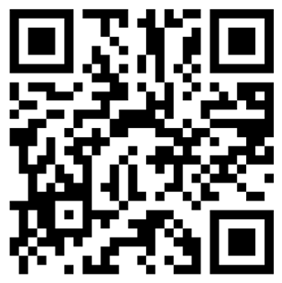
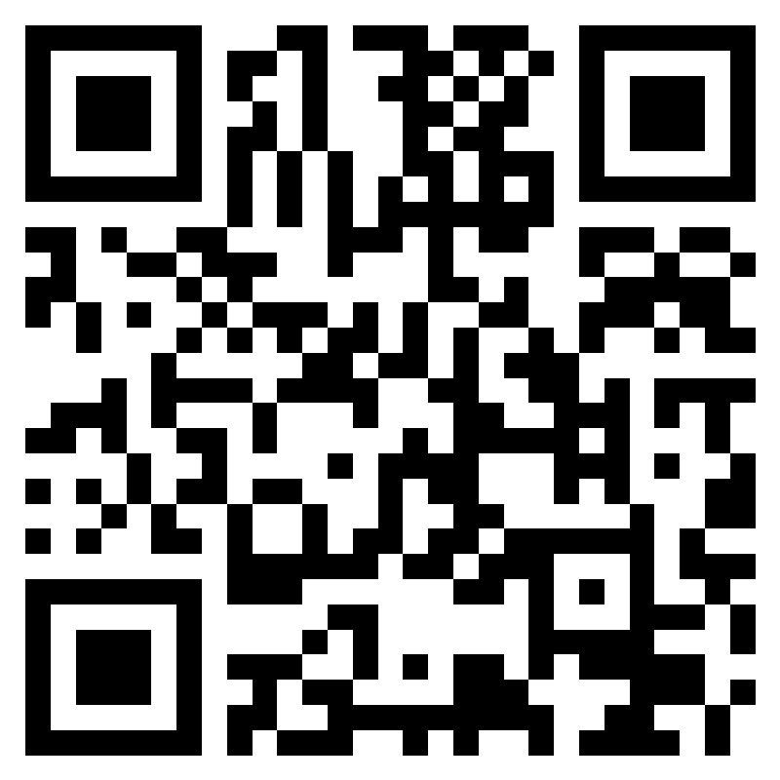
Evaluation & EDI
https://forms.office.com/e/5FCnzqRaMj
https://forms.office.com/e/ZQmRFJYa6i?origin=lprLink
Notes:
On teams where no polls are set up – use these links/QR codes for the evaluations & EDI

Slide 25

Questions?

