Slide 1
Bargaining for a sustainable workplace

Slide 2
Session Overview
Pollution, Biodiversity and Coronavirus
Actions for Sustainable workplace
examples of motions to conference
Action Plans and Follow up
Notes:
Climate change is not the only threat to sustainability. In the final session we look at other threats and what we have learned over the course of the pandemic. We also look at how we can make changes through union democracy and finally tie everything up with action plans for after the course.

Slide 3
Unit 7
Pollution, Biodiversity & Coronavirus

Slide 4
Pollution (UN definition)
the direct or indirect introduction
by humans
of substances or energy into the environment,
resulting in:
harm to living resources,
hazards to human health,
hindrances to human activities,
impairment to environmental quality,
and reduction of amenities.
Notes:
Just to give an official ‘legalese’ definition
Also ask for examples from their workplace or communities.

Slide 5
Pollution is not new…
Edward III, an unlikely environmentalist!
1306 – makes burning ‘sea coal’ a capital offence
1345 – 2 shilling fine for dumping refuse in the street
1369 – bans butchery within the City of London
Notes:
Just to show it’s not a recent issue!

Slide 6
…but it has intensified
Urbanisation concentrates disposal of waste near centres of population
Industrialisation has made consumption – and thus waste – more efficient
Notes:
(Photo) The Great Smog of London, or Great Smog of 1952, was a severe air pollution event that affected London, England, in December 1952. A period of unusually cold weather, combined with an anticyclone and windless conditions, collected airborne pollutants—mostly arising from the use of coal—to form a thick layer of smog over the city.
Government medical reports in the weeks following the event estimated that up to 4,000 people had died as a direct result of the smog and 100,000 more were made ill by the smog's effects on the human respiratory tract. More recent research suggests that the total number of fatalities may have been considerably greater, with estimates of between 10,000 and 12,000 deaths.

Slide 7
Some notable victories
Great London Smog → Clean Air Act 1956
Silent Spring (Rachel Carson,1962) → international ban on DDT
Farman et al., 1985 – unmasking the ozone hole → widespread ban on CFCs
Notes:
This slides shows that activism has lead to change in relatively recent times. We can make a difference.

Slide 8
Pollution/Biodiversity
What can we do in our workplaces?
Identify and eliminate polluting activities
Natural Spaces
Rewilding/Wildflowers
Bees!
Litter picking
Community initiatives
Notes:
Rewilding was an example given by a rep in terms of not cutting the grass on the workplace grounds.
Bees was about bee friendly (or hives on rooves) workplace environment eg wildflowers.
Community initiatives could include beach cleanups.

Slide 9
Any Examples From Your Workplaces?
Notes:
Do attendees have any of their own examples.

Slide 10
What are the current issues?
Notes:
Discussion, based on issues as the course delegates see them. Can be local or international.

Slide 11
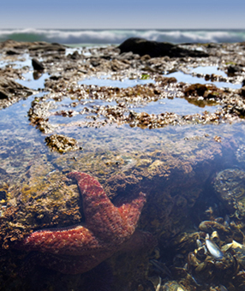
Biodiversity (ecology 101)
Ecology: the study of the interactions among organisms and their environment
Some key concepts:
Habitat
Ecosystem
Food-web
Niche
Biodiversity
Notes:
Climate change is the headline grabbing danger but loss of biodiversity is as dangerous and only just coming into the wider public consciousness. As a workplace issue this is less easy to see how we can make small changes but the group could reflect on how their proposed changes to their workplaces could feed into this.

Slide 12
The trouble with humans…
Habitat destruction
Direct:
deforestation
urban sprawl
Indirect:
Ice-sheet loss
Coral bleaching
Notes:
Again, as a workplace issue this is less easy to see how we can make small changes but the group could reflect on how their proposed changes to their workplaces could feed into this.

Slide 13
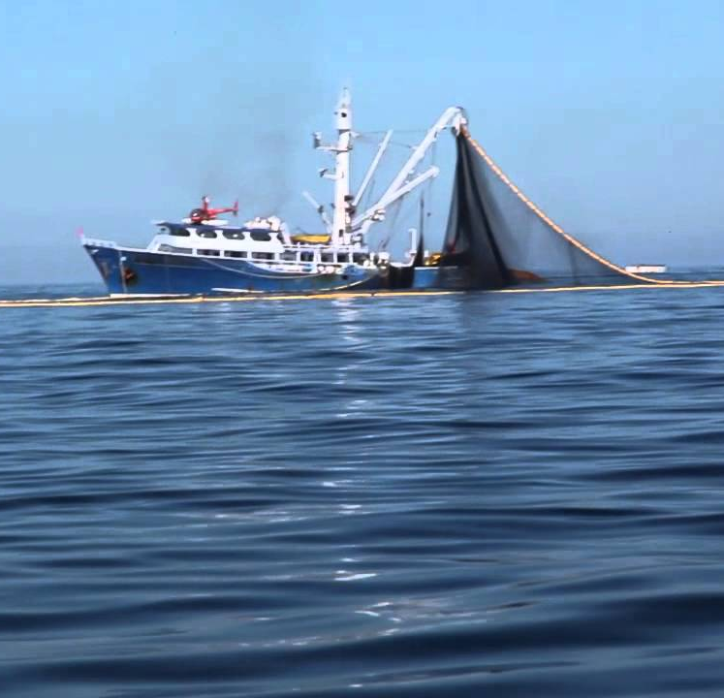
The trouble with humans…
Predation
Industrially efficient predators
Preference for big prey
Targets least resilient parts of the ecosystem

Slide 14
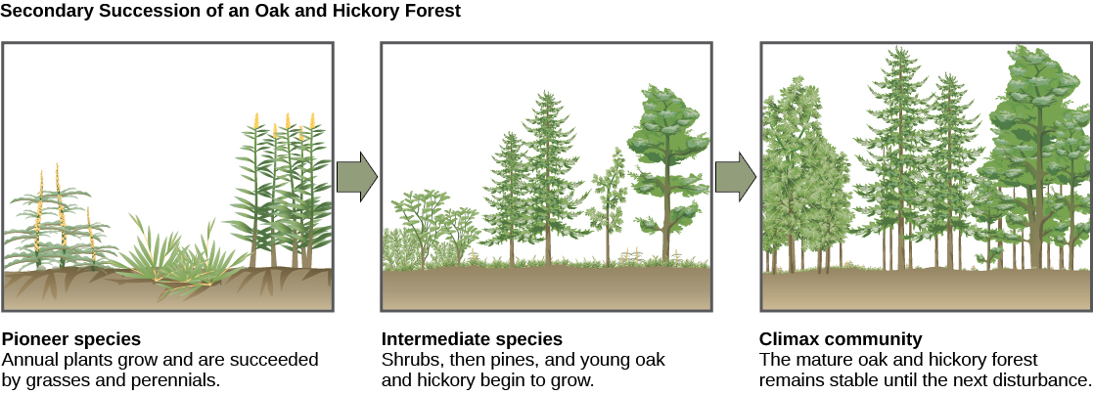
Disturbance vs resilience
A disturbance is any process that removes biomass from the ecosystem, such as:
Fire
Flood
Drought
Predation
Pollution
Resilience is the ability of the ecosystem to recover its equilibrium
Notes:
I went over this quickly, not least because a lot of our members are experts in the field.

Slide 15
Coronavirus – Opportunity or Threat
Reduction in C emissions of approx. 6.4% in 2020
Road vehicle mileage down by 21.3% in 2020
Return to ‘normal’ – or will normal actually be turbo charged what we were doing before?
Biodiversity – risk of more zoonotic viruses in future (average 2/year over the last 50 years, although most do not jump to humans)
https://www.nature.com/articles/d41586-021-00090-3
Notes:
To highlight:
C-virus emission reductions were temporary, and if we don’t act collectively will go back to at least what they were before.
Also, just to highlight that Cvirus wasn’t an unexpected event if scientist had been listened to, there is plenty more potential for zoonotic viruses if we keep encroaching on natural habitat.
Worth mentioning that we are Euro/Western centric as well, these types of viruses have been experienced in other parts of the world in the past (eg MERS, SARS, Ebola) but didn’t reach Europe to any great extent, so it was seen as not our problem (although it is the case that Western demand for goods encourages encroachment into previously wild environments, thus increasing the chances of zoonotic diseases).

Slide 16
Coronavirus
Pollution
Falls related to reduced road transport
Also, areas with high pollution result in higher levels of respiratory illness
Intersection with poverty
Threats in workplace?
Pent up demand
Notes:
Highlight that C-virus exacerbates existing inequalities

Slide 17
Coronavirus
Green recovery
Accelerate change in energy usage?
EV’s
But should it be a 1:1 replacement of existing vehicles?
How to support households and industry in transition?
Can we influence councils and government?
Measures of happiness – green space, noise pollution, renewing/rewilding environments
Notes:
General discussion – what should we do?
Alongside and following on from the current Covid-19 health crisis, national governments and international institutions will need to respond to the most severe economic crisis experienced for decades.
This creates a valuable opportunity to advocate for a climate-focused recovery plan, and we will play our part.
Prospect is at the forefront of TUC work on climate and is working with the International and European TUCs in preparation for COP26. We have already been active in making the case to the UK government, business and decision-makers about the urgency of the climate challenge.
Tried to guide so it was at a workplace practical level, rather than a national policy level they have no influence over.

Slide 18
Unit 8
Next Steps

Slide 19
Bringing about change through policy review…
Travel & subsistence | Home-working | Relocation strategies
IT & data infrastructure | Supply chains | Skills development
Company cars | Cycle-to-work | Corporate sponsorship
Notes:
Policy review is a great place to start mainstreaming sustainability in union negotiations. This is absolutely critical to balancing the tensions, and exploiting the synergies between environmental issues and other bargaining points. For example:
TENSION – A public sector organisation is under pressure to cut their carbon footprint. They put a blanket ban on the use of internal flights, except for a small quota reserved for senior managers. The union branch points out that this contravenes the equalities policy, by limiting the ability of some disabled workers and carers to travel for professional activities.
SYNERGY – A major private sector employer presents a location strategy that requires regionally dispersed workers to consolidate into a handful of big offices. The union branch surveys members on current and predicted commute distance/mode, to demonstrate the additional GHG emissions likely to result from the employer’s decision. They use the employer’s published environmental sustainability policy as leverage for a more flexible approach to remote working.
Ask participants to suggest environmental dimensions to other policies
Note we are looking for examples of good policy and implementation relating to sustainability. If workplaces have well-used car-share schemes, or branches have negotiated incentives to use the Eurostar instead of flying, we want to hear about it!

Slide 20
Bringing about change through union democracy: Motions
Notes:
Reminder from Reps 1 that union democracy is set up to affect change whether that is at branch, sector or national level. If they want to steer the direction of the union at whatever level then the motion to AGM/Conference is the way to do that. This is the point to remind them of how to write a motion and there is an example in the workbook on page 38

Slide 21
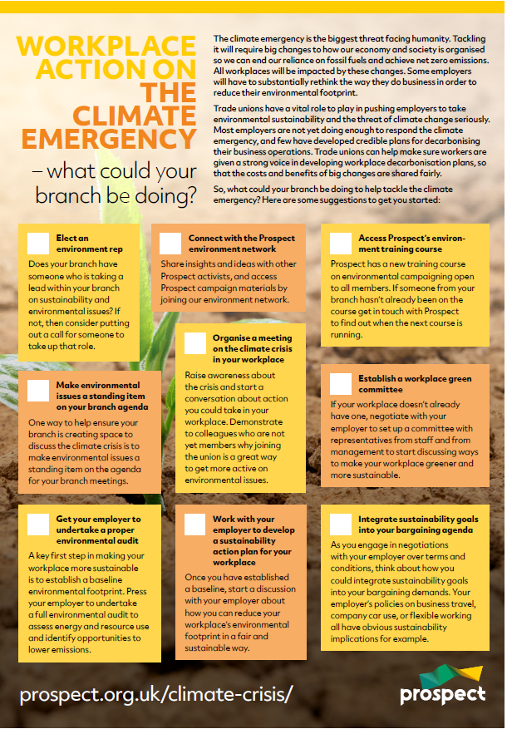
Green Checklist
Start point – Prospect Checklist
Elect an environment rep
Standing item on branch agenda
Environmental audit
Prospect environmental network
Climate crisis meeting
Develop a sustainability action plan
Training
Workplace green committee
Integrate sustainability into bargaining agenda
Notes:
Focus on the checklist as a starting point for self assessment and action planning within their branch. Good way to focus on what they already do and what they need to develop.

Slide 22
Actions for a sustainable workplace
Make a pledge for individual action.
Negotiate with your employer for action.
Campaign for local action
Ask Prospect Union to take some action.
Campaign for national action.
Notes:
Just a reminder that action can be taken at all levels. We have focussed on workplace/individual but worth mentioning broader opportunities for influencing.
Individual actions are important, and we won’t be able to make positive change without this. By working together union members can support and encourage each other to make positive changes.
Use your collective strength and your negotiating power to ask for positive changes in your workplace. The environmental group and climate slack group can help you by sharing examples of best practice in other workplaces.
Prospect is led by its members and your members can engage in the democratic process of Prospect to ask for changes to be made union wide.
The expertise of Prospect members means they can be a valuable voice to lobby for change at national and governmental level.

Slide 23
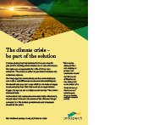
Resources
https://prospect.org.uk/climate-emergency/

Slide 24
Case studies on website
https://prospect.org.uk/news/climate-emergency-webinar-the-reps-making-a-difference-in-their-workplace/
“Starting with education, with so much stuff to read and worry about, our roles as environmental reps include providing useful and relevant information that can actually be acted upon,”
Adrian Bond, Department for International Trade, environment rep and chair of the DIT’s Green Network speaking about taking and approach through education, collaboration and communication.
I wanted to ‘clean up’ the industry and so I stood for election as the first sustainability rep in my branch. I began reaching out to other like-minded branches and individuals and created and elected a sustainability subcommittee. We created five key goals that we wanted to achieve.
Laurence Johnson, a freelancer, in Bectu’s London Production Division explained that a a single $70m film in the course of its production would create as much carbon as 630 UK homes in a year.
Notes:
Inspiration from other reps

Slide 25
Review
Have difficult conversations with confidence.
Look at what are the barriers and how to overcome them
Action plan for the branch
Structural
Project based
Campaign

Slide 26
Action Plan and Next Steps
This is just the start!
What are YOU going to do differently in the workplace?
What support do you need?
How are you going to implement plans?
Remember – Publicising successes can inspire others to follow
Feedback – now or later chat/email
Notes:
Encouragement to feed back if they take any action in the workplace!

Slide 27
External Resources
Energy Saving Trust
Guides to measuring carbon footprint and engaging employees in energy saving
Nature Scot
Guides to improving biodiversity at work
NetRegs.org.uk and Gov.UK
Pollution Prevention Guidelines
Notes:
Pollution prevention guidelines – legal responsibilities. Regulated by EA and SEPA (plus other devolved orgs)

Slide 28
Questions?
Notes:
Remind them they will need to have further meetings and of their action plan.

