Slide 1
Setting up a Jamboard
Open https://jamboard.google.com/

Slide 2
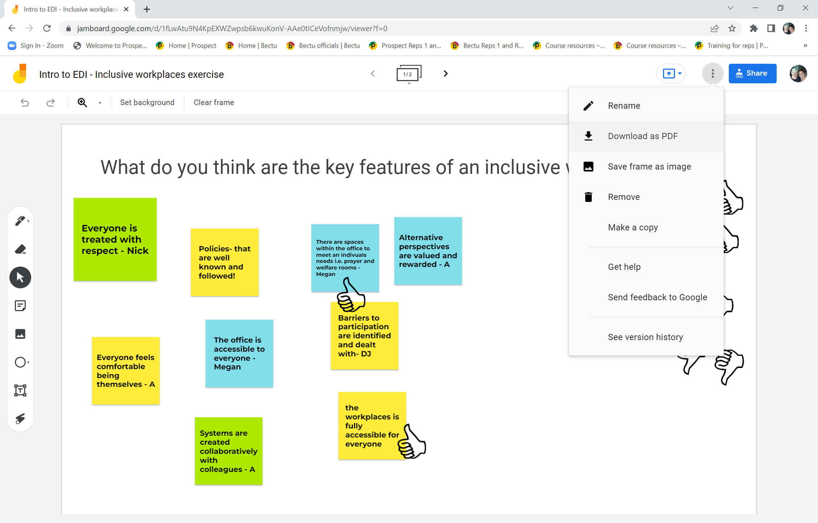
Notes:
If you’re using a team jamboard – you may have access to previous posts so you just copy and paste over for your needs. If not, if you click the three dots at the top right hand corner next to the share button, it gives you the option to copy the jamboard and change the date

Slide 3
Notes:
Once you have made a copy, you can clear the frame or delete the previous posts and then add an example post to help guide the reps in the first activity.
Reps need to add their own post it by clicking on the left hand column – fourth icon down ( like a post it), once they click on this it will present like a sticky note to write on…..
As the tutor you need to ensure the jamboard is editable.

Slide 4
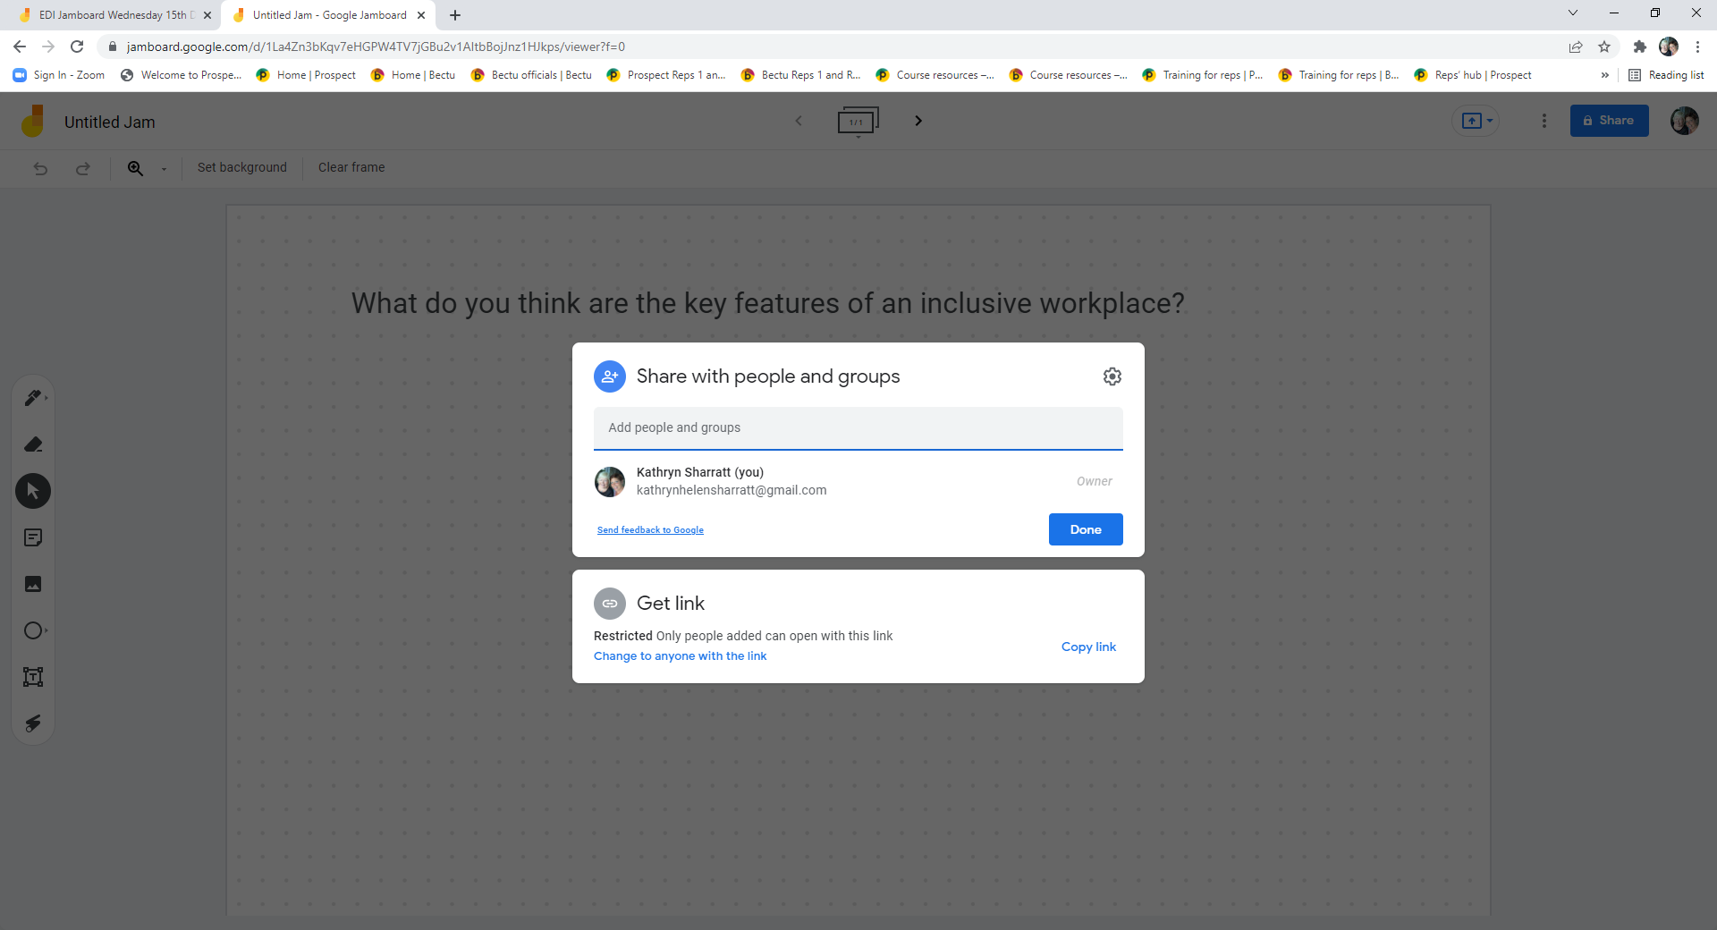
Notes:
Remember to make sure the link is editable…..

Slide 5
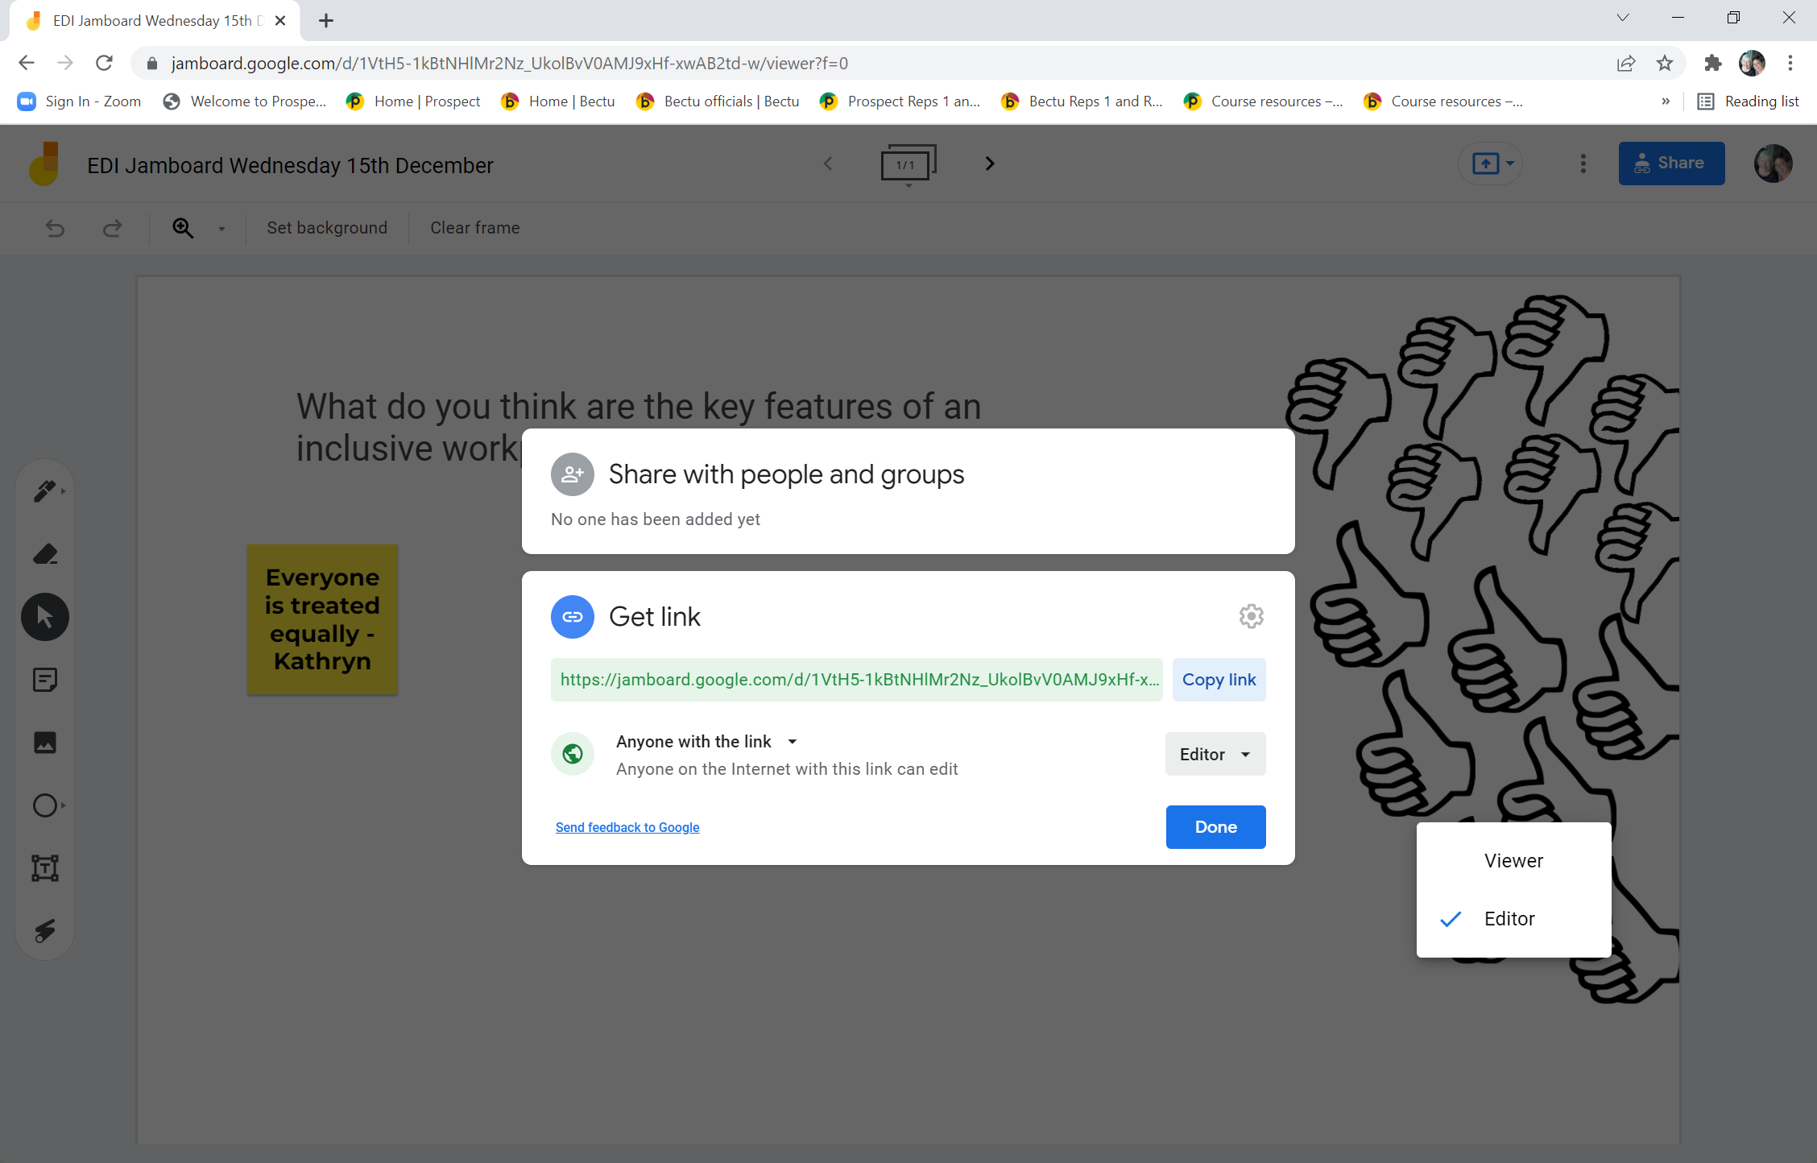
Notes:
You must copy the link into the chat function so the reps can add post its onto the jamboard……
As you will see you have the option as editor and viewer - you’ll need to switch the option to editor before you share the link in chat.

Slide 6
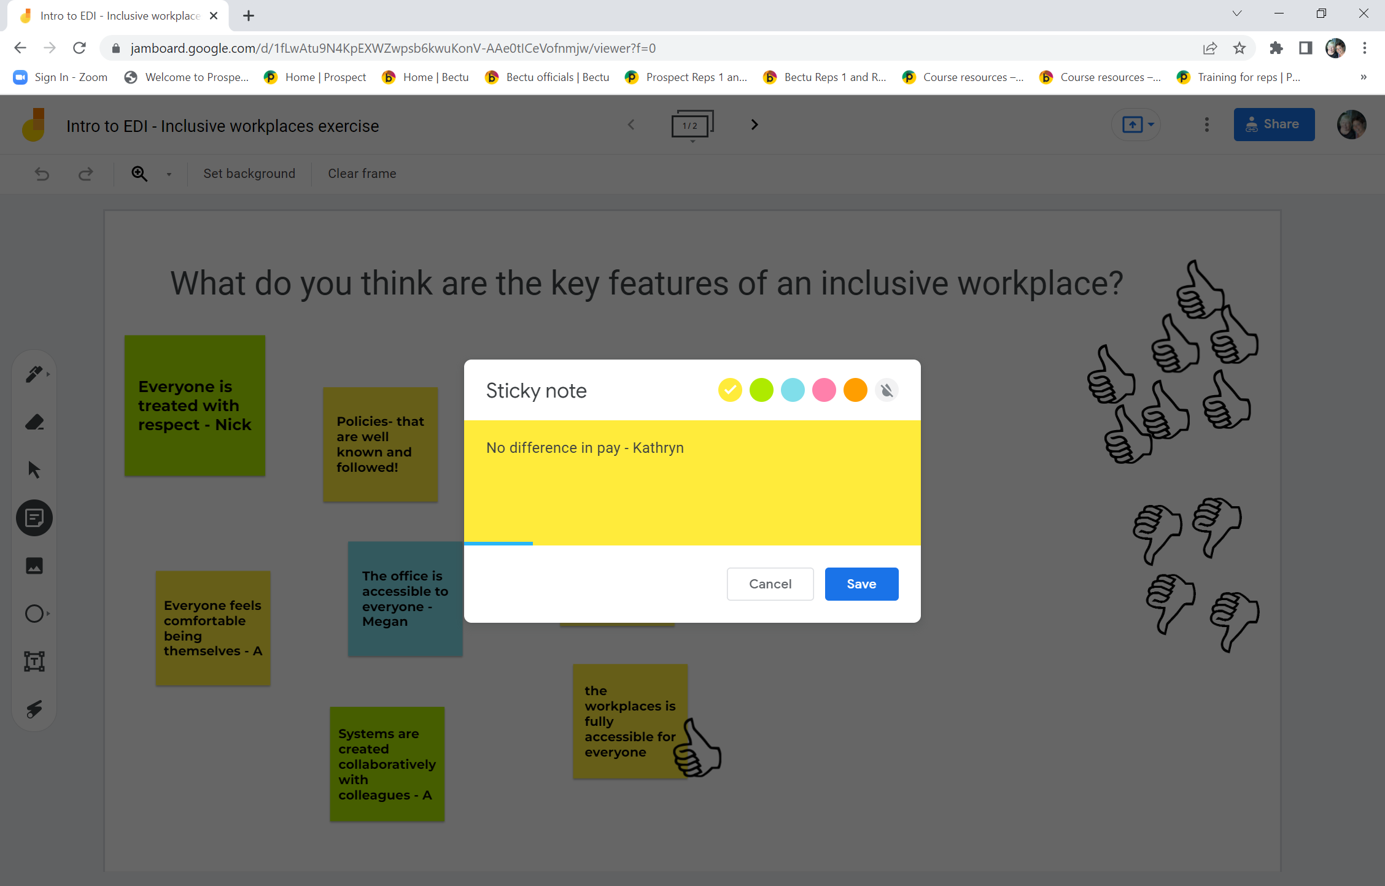
Notes:
Once you’ve shared the link with the rep, they’ll have access to the jamboard. Go over the main functions before they start
Once you’re happy with what you’ve written – ask the reps to add their name and then press save and the sticky note should add to the jamboard…..

Slide 7
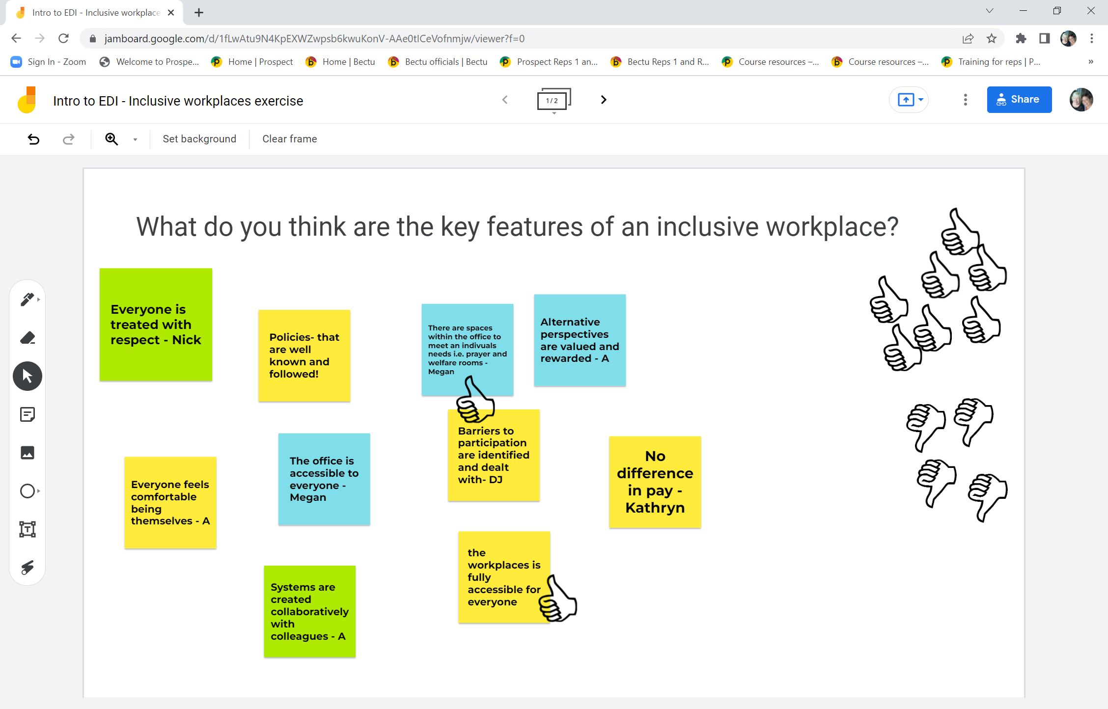
Notes:
With the added post it displayed.
The tutor or anyone with access can move the post its around and if you wish and you agree or disagree with a comment, you can add a thumbs up/thumbs down by dragging one over to the appropriate post it.

