Slide 1
Greenfield Site Training Session 3
Jan.24
Notes:
Outcomes to be achieved:
Ensure they have the Reps 1 workbook
https://prospect.org.uk/get-involved-in-the-union/course-resources-prospect-activists/
This session is designed to:
Teach them what the recognition procedure is
Teach them a reps rights
Encourage them on to the next training courses
Explain that these 3 sessions will also act as the Reps 1 course to enable them to continue their reps journey once we have gained recognition.
Hopefully they know each other but you can do icebreaker if needed. Introduce yourself.

Slide 2
You should now be at, or close to, recognition in the workplace
You should now have the Reps 1 workbook which will help in this session
You will have completed the pre-session work and watched the video about how Prospect is structured

Slide 3
A rep’s rights in a recognised workplace
Notes:
Outcomes to be achieved:
To add confidence to reps when embarking on the role, most new reps want to know what they and can’t do. This next section clarifies the legal rights of a rep and in accordance with the TULR©A ACT; based on the ACAS guidance for time off for representatives – also known as facility time the categories and how they are divided.

Slide 4
Difference between:
Negotiation - discussions aimed at reaching an agreement, even if it is imposed. May end in a ballot as negotiations will need member sign off– for example pay talks
Consultation - exchanging information and opinions in order to reach a better understanding/make a decision. Agreement may not be reached.
Information – being told about what is happening, possibly without the ability to influence or change what is planned
Notes:
Go through the slide

Slide 5
Activity: What can a union negotiate on?
In a big group make a list of what you would like a trade union to negotiate on, over and above the statutory recognition minimum.
Notes:
Use whiteboard
Outcomes to be achieved: improve understanding of what can be negotiated (15 minutes)
Split class into small groups of 3 or 4 (10 mins max)
Sum up with explaining that negotiate is finding a compromise that both sides are happy with. Campaigning is persuading others that something needs to be done.
We are looking for the groups to come up with
Explain only trade issues not political issues such the global climate strike 2019
Can negotiate on:
Pay and conditions
Health & safety
Equality
Redundancy
Time off
If you know examples from anyone branch, add them in.

Slide 6
Your legal rights and responsibilities
Your legal rights come under the Trade Union and Labour Relations (Consolidation) Act 1992.
Under section 199 of the Trade Union and Labour Relations (Consolidation) Act 1992 the Advisory, Conciliation and Arbitration Service (Acas) has a duty to provide practical guidance on the time off to be permitted by an employer
ACAS Code of Practice 3
Notes:
Outcome to be achieved: learn where these laws come from.
it may be that if you H&S reps you need to mention the brown book
The link is in your book to download the code of practice 3
The rights of a rep are split broadly to into two categories; duties and activities.

Slide 7
Duties
Employees who are union representatives of an independent trade union recognised by their employer are to be permitted reasonable paid time off during working hours to carry out certain trade union duties.
Examples are: pay negotiations, consultation on restructuring, or representing an individual member in a grievance. These tasks also include time to prepare for these duties and to do other things "concerned with" them (eg briefing and consulting members before and after meetings with management, or branch committee meetings to discuss such issues).
Notes:
Outcome to be achieved:
The rights of a rep are split broadly to into two categories; duties and activities.
What is a duty? As listed on slide……. Anything that benefits the employer/ reps need to inform/consult or negotiate on
Reasonable paid time off by employer in recognised workplace.

Slide 8
Activities
Union reps are entitled to reasonable time off during working hours to carry out certain trade union activities, which are seen as different from duties.
In essence, the law recognises that unions need the participation of their members to operate effectively.
Activities might include: attending meetings to discuss internal union business, organising union elections.
Notes:
Outcome to be achieved:
Reps are entitled to reasonable time off to carry out certain trade union duties. The law recognises that unions need the participation of their members and so activities are to allow reps time for this. E.G recruitment. This time although entitled is more often unpaid.
It is important that reps understand that the ACAS guidance is the minimum expected but reps need to check their own agreement as the facility time may be better.

Slide 9
Responsibilities
A Union rep has to inform the employer when they wish paid time off to undertake trade union duties or activities.
The procedure would normally found in the facilities agreement or in the recognition agreement.
This should provide clear guidelines on how a rep applies for time off.
Time for training can be declined as there is no cover, but a reasonable request can’t keep being denied.
Notes:
Outcome to be achieved:
A rep should always try to build good relationship with their manager to show they are professional in their role, this includes keeping the employer informed if they need facility time.

Slide 10
Activity: What are your rights?
Working together in a big group, for the following examples, come up with what are the reps rights and what they can check to confirm this?
What other options are there?
Notes:
Outcome to be achieved:
Using the information on the previous slides, look at the word doc with the headings and decide as a group which examples would fit under which headings. Examples on page 28 of workbook.

Slide 11
Activity: What would you do if?
As a big group look at the situations and decide what can be done.
Notes:
Do this activity as big group face to face
Outcome to be achieved:
Much of your role initially will be signposting or finding out information. However, there are instances where you can assist whilst you build up your knowledge and understanding. Here are some scenarios (page 29/30 in workbook) as a group discuss what you might do as a rep……….
Remind reps they are not trained to deal with personal cases but can advise and signpost queries.

Slide 12
Next steps for you
Notes:
Outcomes to be achieved:

Slide 13
What next?
Reps part 2 (Case Handler)runs over 3 mornings Tuesday – Thursday in one week, running 3-4 times monthly.
Negotiation Skills – runs over 3 mornings, Tuesday – Thursday, in one week, running 3-4 times a year online (as demand requires
Health and Safety (running once a month over 4 sessions)
Public Speaking (running 3 session prior to conference)
Further details;
https://prospect.org.uk/training-for-reps/ or contact your Prospect Organiser.
Notes:
Ensure you run the final poll

Slide 14
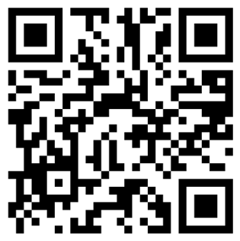
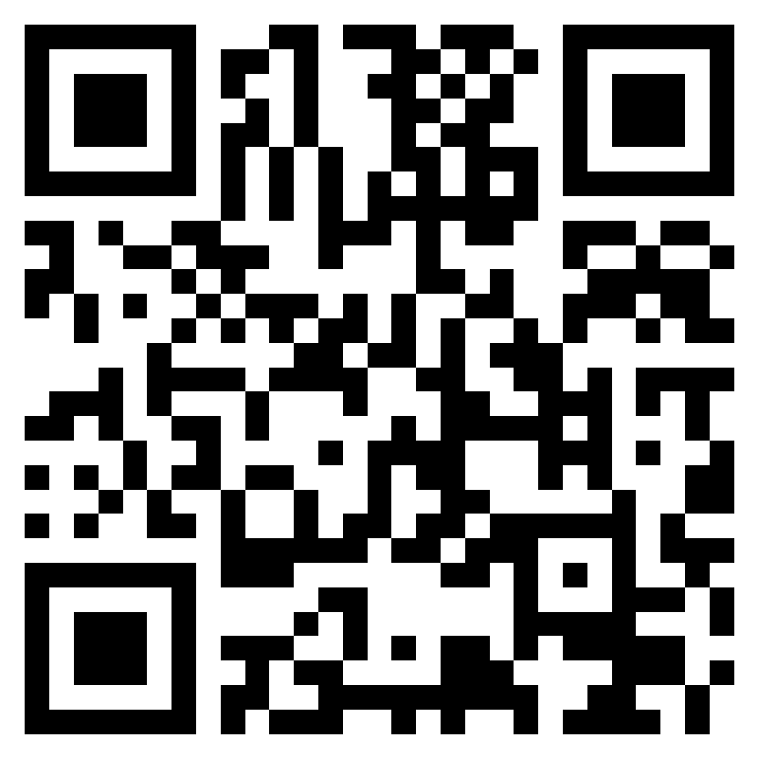
Evaluation & EDI
https://forms.office.com/e/5FCnzqRaMj
https://forms.office.com/e/ZQmRFJYa6i?origin=lprLink
Notes:
On teams where no polls are set up – use these links/QR codes for the evaluations & EDI

Slide 15
Questions?

