Slide 1
Effective Organising for Union Reps
Notes:
Introduction
Housekeeping – (toilets, breaks, fire alarms etc)
Introductions – Who – where – experience of organising - what they want to get out of the course
Online – Raise hand, closed captions etc. Explain you may use break out rooms but that you will control the technicalities and they don’t need to worry.

Slide 2
Learning Objectives
By the end of this training you will
Understand what organising is and what it can achieve
Know how to assess what your branch looks like now.
Know how to produce a strategic organising plan for your branch
Notes:
Outline the purpose of the course and go over the learning objectives. Make sure that they are aware that they will be required at the end to produce an action plan. This may be divided into personal action points and actions for their branch. They should think about adding their strategic plan evaluation as an agenda item at the next BEC.

Slide 3
Session 1
What is Organising
Notes:
Outline that Organising is a term that is much used but often means different things to different people. This session will explore what it means to you, your branch and in the wider world and what effective organising can achieve.

Slide 4
Activity B
What do you understand by the term “Organising”?
What are the benefits of Organising?
Notes:
Note – Activity A will be introductions.
Highlight that there are no real right or wrong answers at this point, this is an exploration of what they know/understand/think.
Collect answers on whiteboard (online) or ideally on post it notes attached to a flip chart or wall but a flip chart is also fine. Post-its allow grouping of ideas for discussion
Group answers together.
Feedback – go through some of the themes and benefits
Point out that we will revisit what their answers later to see if they have changed.

Slide 5
What is organising
Organising is about building your branch structures and power base to effect change. It is more than recruitment, although that is part of what organising entails.
Notes:
Hopefully the themes that come out of Activity B will support this summary but if not link what they have said to this and work in any good points. The point of this slide is to introduce attendees to the idea that organising is about building structures that will enable recruitment and encourage active members rather than just about recruiting. It also introduces the idea that organising is about building power for change. These structures also help with the servicing element of union work (casework) and make negotiations more meaningful.

Slide 6
What is Organising?
Building Structures
Branch Officers
Reps
Communications
Building influence
Density
Issues
Activity
Notes:
Go through the slide, this is one way of outlining what organising entails. The discussion from the activity might add more. Be ready to incorporate these.

Slide 7
Features of an Organised Branch
High Membership density
Engaged & Active members
Visible Profile
Constructive Dialogue
Representative membership
Active Representatives
Active and Representative Committee
!
Notes:
This list will be familiar to anyone who has done Reps 1 but may be new to others. Remind/introduce why these are important in building the strength of their branch. You may want to add a note about density in dispersed branches if that is appropriate.
Explain that density is good but they need to think about getting members active and how they might do this (small asks, communications etc).
Constructive dialogue is essential between members and the branch leadership, get them thinking about their communications strategy and techniques and if this is an action point.
Does the membership represent the workforce as a whole or is there an action point there? Does the committee represent the demographics of the workforce in general?
This is a good point to remind them that they should be noting down action points.

Slide 8
Activity C
Reflect on the features of an organised branch on the previous slide. How does your branch measure against those features?
Notes:
Once attendees are started on this activity go back to previous slide. Ask them to reflect on the list and score where their branch is now 2 points for good, 1 point for getting there, 0 points for not good or don’t know. How does their branch score? What reflections do they have? Feedback to the rest of the group and add actions to action plan.
Attendees could work as a group on the scoring and pool knowledge or work in small groups and then feed back. If this is happening online a breakout room or rooms could be used so they can talk away from the tutor.

Slide 9
Organising and Negotiations
Negotiations deliver results
Recruitment
Growing membership
Members set priorities
Notes:
The value of organising is power! Explain how Organising and negotiations interlink and fuel each other. Plus explain that creating structures leads to increased power and therefore more likely change. Start to introduce why good communications structures are important to this and ask where they would build them into this cycle and how/what they would communicate.

Slide 10
Organising and casework
Notes:
Does the branch have a casework forum or a way of tracking themes in casework. This is useful as it may identify areas that can be addressed by campaigning or negotiation. Organising around issues is always easier and more productive and will demonstrate to non-members the value of joining beyond “in case you get into trouble”.
The pie chart is made up but shows that this imaginary branch could do some campaigning around bullying behaviours and perhaps some issues mapping on sickness.

Slide 11
Session 2
Knowing your Branch
Notes:
In this session we will look at three aspects of assessing what your branch looks like now and how to move organising forward:
Workplace mapping and information gathering
Health checking your branch
Setting goals

Slide 12
Information Gathering
Obtaining accurate and relevant information about the workforce in a systematic way is essential to effective organising activity. If done well it can form the basis of successful union activity, including recruiting, communications, developing activists and campaigning around issues.
Notes:
Reps need to start to think beyond mapping, i.e. that all that is required is an exercise in finding out where members and non-members are (although this is one aspect of data gathering and still important as a start), and start to think about 360 degree information gathering that enables building structures and power. Start them to think about what information is needed to achieve their goals.

Slide 13
Gathering information is useful to:
Know where your members are
Identify weak areas of membership
Begin recruiting members in a strategic way
Know where reps and activists are
Identify weak areas of reps and activists
Begin identifying and developing potential reps and activists
Identify issues
Know best how to contact people
Develop a communications Strategy
Notes:
Introduce the concept of mapping as a basis of information gathering as a whole, talk through these elements. You could ask if they can think of any more or anything else it would be useful to know. For eg – in hybrid workplaces, the best days to talk to people, when all staff days are etc.
Word in bold are to identify that mapping is not just about members/non-members but also about other information gathering – these words are not exhaustive

Slide 14
Why gather this information?
Helps you to understand the branch membership and increase density.
When you’ve mapped your workplace, you’ll have a clear idea of who you’re organising, where, and why.
Because remote working is changing the way branches communicate with members and non-members
Notes:
Reinforcing that information gathering is a multi-layered and ongoing exercise and any outcomes should be living documents which inform your branch organising and recruitment plan, it should be re-visited and updated on a regular basis. Top tip: find someone who loves data and put them in charge of this. A reminder though, this is not a solo activity and should not just fall to one person.
Points to make:
When you’re planning these sort of exercises, focus on the information that you need to get an accurate picture of who, where and why you’re organising.
Only collect the information that will help you to build the union and/or run a campaign.
Working out what information is needed to achieve your goal is a good way to begin your organising.
Things to consider:
Who are your colleagues – members & non-members
How is your workplace structured – physical boundaries
What teams work together – teams may cross physical boundaries
Are there any other unions present?
What are the working patterns – shifts/rotas/PT/FT
What are the social structures – breaktimes etc.
Who/where are your reps and activists

Slide 15
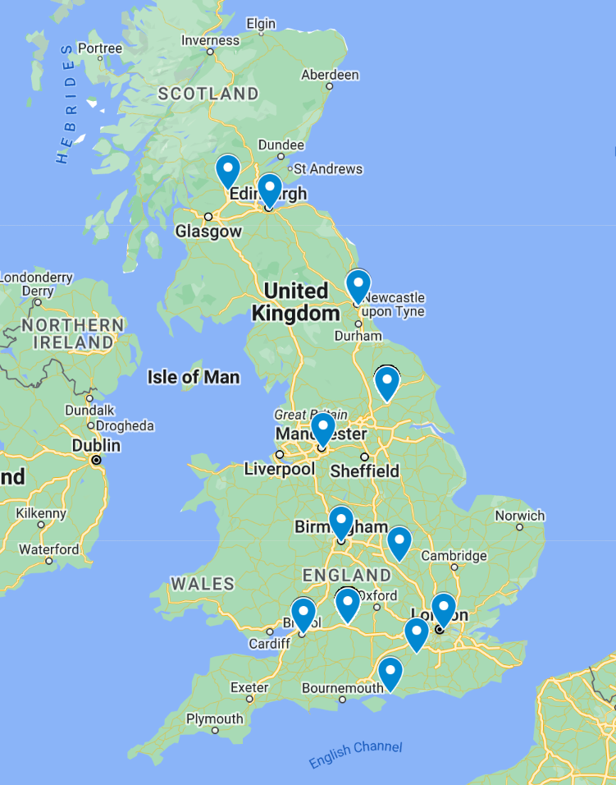
 | Job Title | Staff | Members | Density (%)
 | Archaeologist | 50 | 5 | 10
 | Business Officer | 50 | 24 | 48
 | Inspector | 50 | 29 | 58
 | Listing Advisor/Co-ordinator | 50 | 22 | 44
 | Science Advisor | 50 | 6 | 12
 | Team Leader | 20 | 9 | 45
Notes:
Some ideas for collating the information – can the attendees come up with any more?
The map… some workplaces are physically dispersed and so mapping comes down to knowing exactly where people are based. It will also highlight gaps in membership if a known site is missing.
The table shows some other ways to map your workplace - the example is by department, a common way to map a workplace.
There may be other ways to break down workforce – operation v office based for example. These types of staff may have different issues and so be best organised together.
If you want to create a physical map there are various tools to do this – you can plot data by postcode in Excel or online using google maps

Slide 16
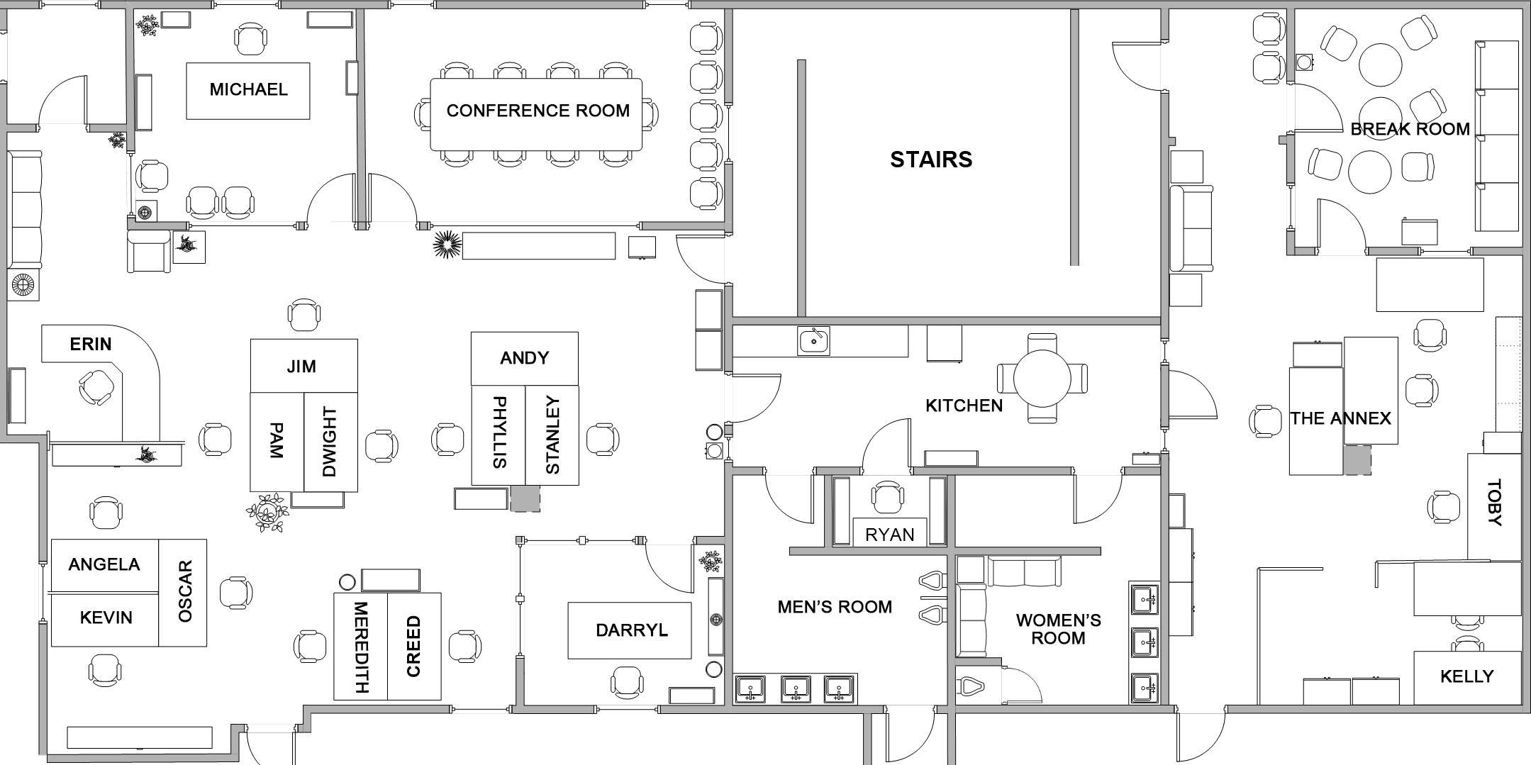
Notes:
This is a good way to introduce them to thinking outside the member/non-member box. Start with what do they notice about this picture, if necessary lead attendees along the route of who can talk to who then talk about:
What other information might they need to get (days people are in, team days,
What opportunities does this plan bring to mind (leaving information in communal areas etc)
Are there any issues apparent (why is Ryan in a cupboard behind the toilets!! – possible H&S issue, is Toby in a difficult workplace environment? etc)

Slide 17
Sounds simple?
Information gathering is more challenging in some workplaces than others.
Don’t let perfection get in the way of progress.
It should be fun! Contacting and meeting members.
This information is always a work in progress and will need updating to keep it relevant.
Notes:
Go through the points as a summary

Slide 18
Activity D
Have you engaged in a branch mapping or information gathering exercise?
If so, what was the experience like?
If not, what are the barriers?
In your groups discuss what data you need and why and add data gathering to your action plan
What would your three next steps be?
Notes:
Group discussion on their experience so far of mapping. It is ok if they have never done it so make that clear. Hopefully they have a better understanding now of the usefulness of data gathering.
The goal setting exercise later in the course may add to their action plan

Slide 19
GDPR and Data
Mapping and information gathering is a legitimate union activity.
The right to organise cannot be taken away by GDPR legislation.
Protect data, keep secure, limit audience, password protect.
Distribute activity and data – like a distributed network, more secure less chance of any GDPR issues.
Notes:
The usual GDPR rules apply with regard to storing personal data.
Hold lists of members and non-members separately.
Paper lists the same as electronic lists
Individuals have a right to know what you have written – they are not likely to know the lists exists so access requests are unlikely to be an issue, but you should consider possibility. If you have rated people be prepared to defend this, so think about what it means when you write it down.
Remind them of Tracey Hunt if they are nervous about GDPR
Employers often hide behind GDPR to prevent organising but there are ways around this. E.g. if they have a members list and a staff directory, with a little work they can work out who the non-members are!

Slide 20
Sources of Information
Official Company Reports and Accounts
https://beta.companieshouse.gov.uk
Company Structure – where is HQ, where are offices in UK – distribution of staff/job roles
Online staff list/Email Lists/Fire Safety Building lists.
Physical Layout of Building – who sits where
Social – what networks you are in
(inside and outside of work)
Notes:
Very quickly go over the slide.
If the employer is not forthcoming with lists of staff etc , there are some places that reps could look to find out more information

Slide 21
Identifying Issues
Talking to colleagues will help identify issues in the workplace that matter to them.
Surveying
Organising is more effective when done around an issue.
Notes:
Make the point that it is always easier to organise around issues that people feel strongly about. Part of the action plan might be to think about how the branch gathers those issues and how they ensure communications with members is not all one way.

Slide 22
Mapping workplace issues
https://library.prospect.org.uk/id/2011/March/15/Body-workplace-mapping-factcard
Mapping techniques enable reps to investigate issues e.g. stress
Involving constituents ensures we develop a collective approach, protecting individuals who may fear being singled out by management.
Mapping uses a fun approach to encourage discussion, analysis and strategy development.
Reps demonstrate there is something they can do. After all, once something’s visible, it’s hard to ignore!
Notes:
Introduce this as an extra aspect of information gathering. It is based on the techniques already discussed but applied to issues rather than members. The idea is that they can use the data gathered to investigate hotspots further, therefore strategically driving campaigning, and to evidence negotiations.

Slide 23
Issues Mapping Techniques
Body mapping helps gather health information such as: ailments, diseases, injuries, aches and pains, stress symptoms, reproductive problems and other common patterns of ill health. It can help reps prioritise further investigation and action.
Workplace mapping helps gather information on issues such as:, bullying and harassment, long hours, failure to consult, etc. Again, this can help reps to prioritise their representations
Notes:
Body mapping is around surveying members on any physical symptoms they are experiencing and seeing if there are any correlations or hotspots. This might be by work area or grade for example. This is a particularly useful if done with technicians but also useful in office settings.
Workplace Mapping is probably the technique they will use the most as it involves gathering issues from members and mapping this in a way that best presents the data for what the branch wants to achieve. Again this is usually by department or workplace but could beby grade/job title depending on what the branch want to look at. It could be both.

Slide 24
Making contact
Consider who is the best person to make the first contact.
People are much more likely to take part in something if they’re asked to do so by a friend or trusted colleague, than if a stranger asks them.
Your job as organisers, is to identify the best person to have that conversation and support them.
Notes:
Go through points, this is about reinforcing the point about active members.

Slide 25
Worked example
Large City Hospital
Mental Health and Stress
Survey
Mapping hotspots
Investigation
Report to management
Notes:
Tutors can use this or substitute their own example. You could substitute a slide with the below process and talk through it. There is a detailed account of the worked example in the tutor resources.
The process for this was:
Survey issued that gathers information on the issue (in this case symptoms of stress). This might involve a system of scoring (in this case based on management standards)
Survey was anonymous but ask participants to state their department/workplace/job title (whatever is the focus)
Have a small “reward” for filling in the survey (e,g, larger or eclusive merch item)
Members are tasked with distribution and collection in their area (ward or department in this case), also a series of stands promoting the survey in the main foyer (highlight that this was done a while ago – how might they use more electronic methods?)
Surveys scored and mapped against department etc.
Outcomes in real life example:
While most respondents stated they could cope with their stress levels analysis of the symptoms people identified showed a growing work-related stress problem that we were able to get management to take seriously, through the JNCC, and take preventative action.
Stress “hotspots” were identified in several departments and we were able to investigate these further. Some were to be expected (although still acted upon) such as ICU, A&E and Operating Theatres but some were unexpected such as CSSD which when investigated highlighted a bullying culture that could then be organised around as a separate issue.
On a side note the distribution of the campaign identified several “natural leaders”

Slide 26
Building your Team
Asking union members to join your team seems like an obvious place to start.
If they agree to get involved, the following tips will help ensure their experience is a good one.
Make what you ask them to do relevant to them – something that they care about.
Be realistic about what you ask them to do – make sure that it’s achievable.
Give them small tasks to start off with and, as you identify their strengths and their confidence grows, give them bigger and more complex tasks.
Emphasise how members strengthen the union and can make it more effective.
Make it clear that you and everyone in the union value all offers of help.
Notes:
Once you have identified, using the health check, what reps and/or activists the branch needs they then need to think about who to approach and how. If traditional branch roles and structures don’t work for them then they need to think about what does. Splitting roles is not a bad thing!

Slide 27
Importance of Succession Planning
Keeping knowledge in the branch
Developing new reps and branch officers
Spreading the workload
Notes:
All strategic planning should have an eye to succession. Someone retiring should not come as a surprise and the branch should continue to function as if no-one has left. Ideally, the outgoing officer should mentor and support the incoming one before they go. Branches should always have an eye to moving members forward.

Slide 28
Finding the informal leaders in your workplace?
If you don’t engage with the informal leaders in your workplace, you may find that you can’t organise effectively.
Informal leaders often become reps
Think about the informal networks in your workplace:
Who speaks to who at breaks?
Are there groups of friends who spend time with each other outside of work?
Who are the influential people, the informal leaders, in these groups ?
Notes:
This is about knowing who people in your workplace listen to. This is especially important when campaigning or building towards industrial action as these people will be the ones who get your message out and get others active in the campaign. They will foster confidence in others.
For further examples tutors can look at the GMB activity in Amazon or for more theoretical knowledge to Jane McAleavy

Slide 29
Good informal leaders in the workplace:
are the same age, gender, ethnicity as their co-workers
are listened to by other workers
are asked for advice and support by other workers
are respected, trusted, and liked by other workers
show a commitment to others
have special skills that help them communicate with particular groups.
Notes:
Outline if attendees/branch officers already have a relationship with those identified as informal leaders they can:
arrange to meet with them to see if they might be willing to get involved
ask them what their concerns and issues are
find out what they know about their colleagues’ concerns.
If you don’t already have a relationship with them:
find out who their friends are and meet with them first
ask their friends about the best way to approach the informal leader
you may need to meet with a chain of people until you’re ready to meet with the informal leader.

Slide 30
Identifying Informal Leaders
Activity E
Discuss who the informal leaders are in your branch/workplaces
Identify the gaps. These might be geographical or in your knowledge
Notes:
In their small groups ask attendees to see if they can identify anyone who fits the profile of an informal leader within their membership. Who do they know who might get a campaign message out or who might talk to particular groups of people. If they can’t identify anyone, ask them how might they find out and to plan how they are going to go about this?

Slide 31
Session 3
Developing Your Branch Plan

Slide 32
Branch Development
Reflect on and assess where your branch is now (A)
Discuss and decide on where your branch needs to be and what it wants to achieve(B)
Plan how you will get from A B
Notes:
Introduce that this is a collaborative process that branch committees should enter into on a yearly basis and evaluate at regular intervals.
Talk them briefly about how the health check and plan forms work. The take away from this is that they should work as a group to fill it in for their branch at a planning day. The purpose of the training is to make them aware of the document and process and how it can be used. However, they should go on to discuss and complete as part of a branch development programme

Slide 33
Notes:
Example of part of a real life branch health check. Membership density for this branch was (at this point) 23%. The branch had just had a long standing Branch Sec step down due to health and personal reasons and an extensive restructure involving the redundancy of several reps. This is a branch in need of rebuilding!
Ask the group what their immediate thoughts are for the goal of this branch and some ideas for tactics to achieve that goal.

Slide 34
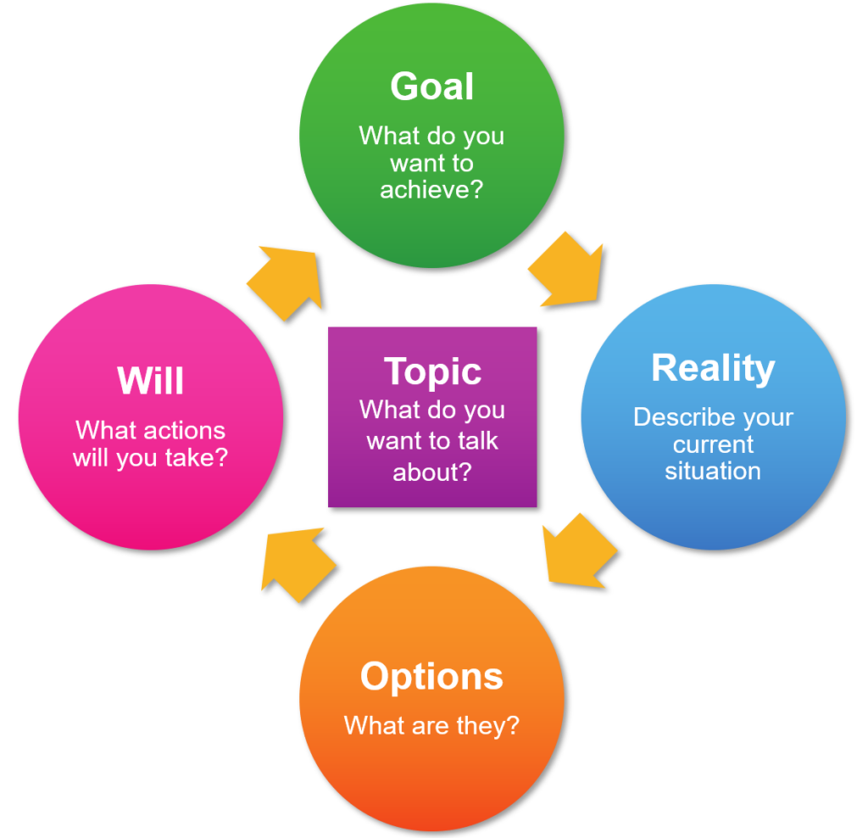
Grow Model
Notes:
Strategic Planning
This is an introduction to strategic thinking and planning. This is just one model (there is another example in the handout which is in the tutor resources.
The GROW model is one method of strategic planning but it works well as it is simple to follow. Introduce them to the stages of thinking by going through them one at a time. They will get to practice this in the next activity.
Goal – What do you want to achieve?
Reality – What is happening now. What do we need to know/find out? What resources do we have/need
Options – What ideas can we come up with to achieve the goal
Will – What can we commit to, who will do it and by when. This is the Who, Where, What, When, How of the plan

Slide 35
Activity F
One member of the group should identify an organising issue
Rest of group to draw out the reality of the goal using open questions
Identify some options
Plan a strategy using the GROW model.
Notes:
This activity will introduce the attendees to solving a problem using an action learning set before planning a solution using the GROW model that they were introduced to in the last slide.
Identify the person who will propose an organising (if there is a Branch Secretary they would be a good choice) and then the rest of the group tease out some of the issues and things they need to know. Encourage them to ask open questions but it doesn’t matter if a few of them are closed (yes/no answers), the important thing is that they don’t offer options or solutions at this stage.
From this they should be able to identify some goals and realities to fit into the GROW model and come up with a basic plan.

Slide 36
Developing a strategic plan
Strategic planning involves three phases: discussion, development, and review. The process typically consists of five steps
Identifying your current position and future goals
Identifying opportunities and threats
Developing a plan that will enable you to reach your goals
Implementing the plan
Monitoring progress and make changes as needed
Notes:
Another perspective on strategic planning. Go through the points on the slide briefly.

Slide 37
Bringing it all together
Notes:
This final session is the tying up of the training and bringing together all they have learnt as well as looking at their net steps – which should include a planning meeting to put into practice what they have learnt.

Slide 38
Action Plan
Suggestions:
Mapping
Data Gathering
Branch Health Check
Organising Sub Committee
Branch Specific Actions
Notes:
The things listed are just suggestions, the branch should by this point have come up with their own action plan which they can now share. Organisers might want to collate some of the net steps on a flip chart and photograph or collect the data digitally for future reference.

Slide 39
Revisiting Organising
Activity:
Go back to what you said at the start of the course on your definition of organising.
Has your definition changed?
Has your understanding changed?
What will you do differently?
Notes:
Revisit the Activity B

Slide 40
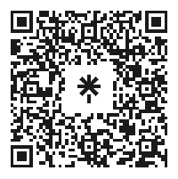
Notes:
Introduce this checklist as a further way of assessing where they are (reality) and where they want to be (goals) - it will resonate with some of the things they have talked about in the training e.g. issues mapping.

Slide 41
Further Reading
Promoting Your Union - Jason Mann
Workers Can Win – Ian Allinson
Lessons in Organising – Gawain Little
No Shortcuts: Organising for Power – Jane McAlevey
TUC Pocket Guide to Organising
Notes:
If anyone wants any further reading then these are some of my suggestions – please feel free to add your own. The TUC guide is really good and branches can get up to 50 for free if they email the TUC.

Slide 42
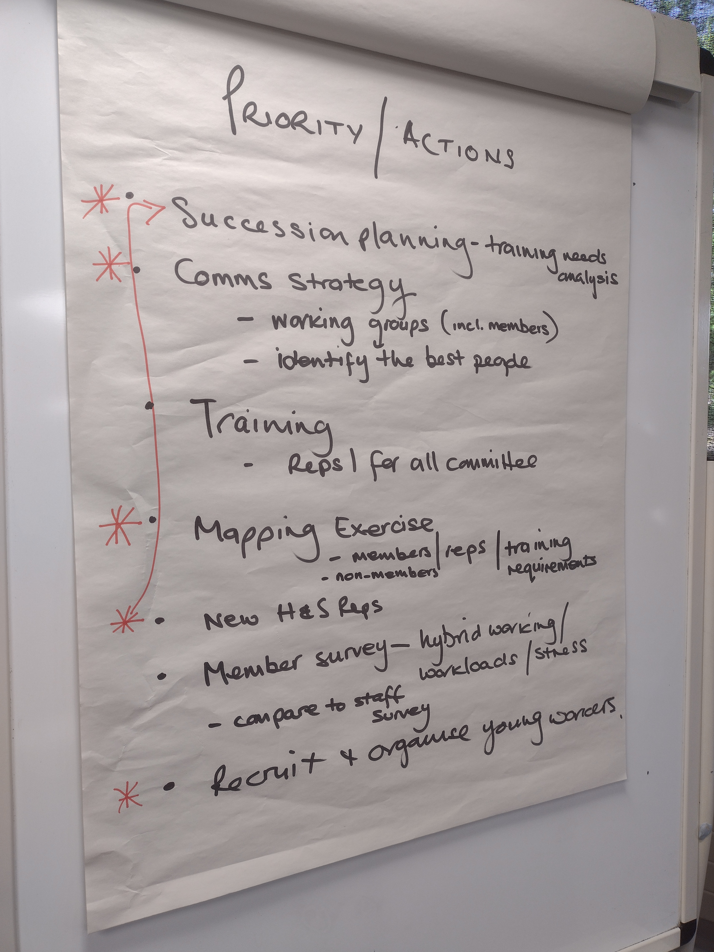
Suggested Agenda for development day
09:30 Branch Health Check
10:30 Tea/coffee break
10:45 Action Plan
12:30 Lunch
13:30 Goals, timeline and next steps
15:30 Finish
Notes:
This is of course fluid but this is what we have piloted. The first two sessions were done in smaller groups with a branch leader in each group then fed back for the final session where each action/goal was put in priority order and a timeline of actions created. Organisers will want to keep checking back with the branch on this and it may be worth marking progress and evaluation as an agenda item at BECs

Slide 43
Questions?

